Slide 1
Psychology Research Methods (PSYC 3130: Experimental Psychology & Lab)
Welcome

Slide 2
Welcome to PSYC 3130: Experimental Psychology w/Mike Hoerger
Grab a syllabus
Complete and hold on to the student survey (last page)
Have any enrollment issues? Talk to me BEFORE class begins!

Slide 3
Overview
3 goals for today: Get to know each other, understand why you’re here, get oriented to the course
My info
Introductions
Rationale for the course
Syllabus review, Q & A
Course website

Slide 4
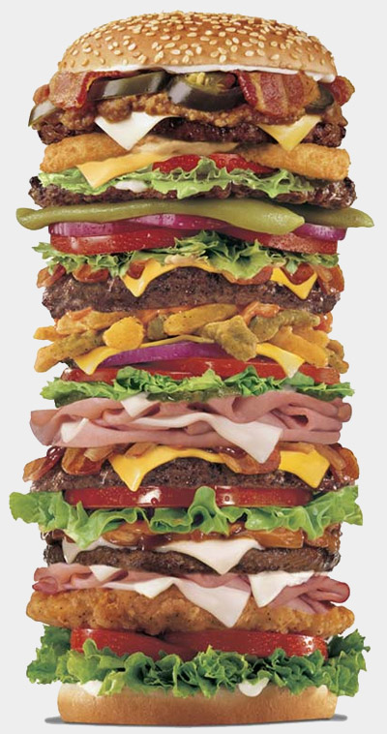
My Info
Hoerger rhymes with burger
I prefer to be called Mike, but feel free to say Dr. Hoerger, Dr. H., Mike H., or professor
Note, there is another Mike in the department
Assistant Professor of Psychology, Psychiatry, and Oncology

Slide 5
My Info
Clinical Health Psychologist
From Michigan: BS at MSU, PhD in Clinical Psychology at CMU
Internship/fellowship at U of Rochester
Joined Tulane in 2013
LA CaTS Roadmap Scholar, in May ‘16 finished a post-doctoral MS in Clinical Research (combination of biomedical and epidemiologic research methods)

Slide 6
Introductions
Keep it to 10 seconds
Name, year, major(s)

Slide 7
Why Is this Course Required?
Required for nearly all psychology degree programs, ranked the most important course by departments
Understanding research methods can help you to conduct better research
Even if you have no intention of conducting research, there is a good chance you will someday; your skills will be valued
Understanding research methods can help you to be a more critical consumer of psychology research
Useful in your personal life
Useful in most careers where competence is valued

Slide 8
Why Is this Course Required?
Why are you majoring/minoring in psychology or an allied discipline?
#1 Reason: “I want to help people.”
OK, better than harming people, though harming professions pay more than helping professions (they have to) and we can debate the implications of crippling student debt for your ultimate career path
Better question: How much do you want to help people?
Let’s compare four people’s career paths

Slide 9
Misanthrope A
This is not you (hopefully). This person does not care about helping people. They are interested in money and power without regard to the societal effect.
What careers do you think of?
How many people will they harm in their career and how badly?
Now let’s compare with 3 do-gooders

Slide 10
Therapist B
Full-time psychotherapist who hates research
Assume a standard case load, outcomes, and career
30 clients/week; see each client for an average of 6 months, so 60 clients/year
Typical therapy outcomes = improvement of 0.80 SD units (essentially like going from 79th to 50th percentile on symptoms). In lay terms “helps a great deal”
Work from ages 30 to 65 = 35-year career
Help 2,100 clients a great deal (60 x 35)

Slide 11
Therapist C
Full-time research-savvy psychotherapist
Assume as a savvy research consumer helps their clients 20% faster
Comparable to treating 2,520 clients as well as Therapist B
420 more people helped a great deal
Probably can also get state/county/federal contracts, make fat stacks, hire more people, help more people indirectly

Slide 12
Researcher D
Full-time researcher
Good, not great. Devotes entire career to making PTSD treatments 3% more efficient
VA disseminates new treatment package; they seem to have about 200 major treatment centers
Assume each center has 10 therapists who each treat 60 clients/year (probably a major underestimate)
That’s 120,000 clients/year
If they achieved the same outcomes with 3% increased efficiency, that would allow them to help 3,600 more people in the first year alone, more than Therapist B/C’s career-long accomplishment
Help 36,000 more people over the decade, 360,000 over the subsequent century

Slide 13
Summary
Misanthrope A ☹ ☹ ☹ ☹ ☹ ☹ ☹ ☹ ☹ ☹ ☹ ☹ ☹ ☹ ☹ ☹ ☹ ☹ ☹ ☹ ☹ ☹ ☹ ☹ ☹ ☹ ☹ ☹ ☹ ☹ ☹ ☹ ☹ ☹ ☹ ☹ ☹ ☹ ☹ ☹ ☹ ☹ ☹ ☹ ☹ ☹ ☹ ☹ ☹ ☹ ☹ ☹ ☹ ☹ ☹ ☹ ☹ ☹ ☹ ☹ ☹ ☹ ☹ ☹ ☹ ☹ ☹ ☹ ☹ ☹ ☹ ☹ ☹ ☹ ☹ ☹ ☹ ☹ ☹ ☹ ☹ ☹ ☹ ☹ ☹ ☹ ☹ ☹ ☹
Therapist B ☺ ☺ ☺ ☺ ☺ ☺ ☺ ☺ ☺ ☺ ☺ ☺ ☺ ☺ ☺ ☺ ☺ ☺ ☺ ☺ ☺
Therapist C ☺ ☺ ☺ ☺ ☺ ☺ ☺ ☺ ☺ ☺ ☺ ☺ ☺ ☺ ☺ ☺ ☺ ☺ ☺ ☺ ☺ ☺ ☺ ☺ ☺
Researcher D ☺ ☺ ☺ ☺ ☺ ☺ ☺ ☺ ☺ ☺ ☺ ☺ ☺ ☺ ☺ ☺ ☺ ☺ ☺ ☺ ☺ ☺ ☺ ☺ ☺ ☺ ☺ ☺ ☺ ☺ ☺ ☺ ☺ ☺ ☺ ☺ ☺ ☺ ☺ ☺ ☺ ☺ ☺ ☺ ☺ ☺ ☺ ☺ ☺ ☺ ☺ ☺ ☺ ☺ ☺ ☺ ☺ ☺ ☺ ☺ ☺ ☺ ☺ ☺ ☺ ☺ ☺ ☺ ☺ ☺ ☺ ☺ ☺ ☺ ☺ ☺ ☺ ☺ ☺ ☺ ☺ ☺ ☺ ☺ ☺ ☺ ☺ ☺ ☺ ☺ ☺ ☺ ☺ ☺ ☺ ☺ ☺ ☺ ☺ ☺ ☺ ☺ ☺ ☺ ☺ ☺ ☺ ☺ ☺ ☺ ☺ ☺ ☺ ☺ ☺ ☺ ☺ ☺ ☺ ☺ ☺ ☺ ☺ ☺ ☺ ☺ ☺ ☺ ☺ ☺ ☺ ☺ ☺ ☺ ☺ ☺ ☺ ☺ ☺ ☺ ☺ ☺ ☺ ☺ ☺ ☺ ☺ ☺ ☺ ☺ ☺ ☺ ☺ ☺ ☺ ☺ ☺ ☺ ☺ ☺ ☺ ☺ ☺ ☺ ☺ ☺ ☺ ☺ ☺ ☺ ☺ ☺ ☺ ☺ ☺ ☺ ☺ ☺ ☺ ☺ ☺ ☺ ☺ ☺ ☺ ☺ ☺ ☺ ☺ ☺ ☺ ☺ ☺ ☺ ☺ ☺ ☺ ☺ ☺ ☺ ☺ ☺ ☺ ☺ ☺ ☺ ☺ ☺ ☺ ☺ ☺ ☺ ☺ ☺ ☺ ☺ ☺ ☺ ☺ ☺ ☺ ☺ ☺ ☺ ☺ ☺ ☺ ☺ ☺ ☺ ☺ ☺ ☺ ☺ ☺ ☺ ☺ ☺ ☺ ☺ ☺ ☺ ☺ ☺ ☺ ☺ ☺ ☺ ☺ ☺ ☺ ☺ ☺ ☺ ☺ ☺ ☺ ☺ ☺ ☺ ☺ ☺ ☺ ☺ ☺ ☺ ☺ ☺ ☺ ☺ ☺ ☺ ☺ ☺ ☺ ☺ ☺ ☺ ☺ ☺ ☺ ☺ ☺ ☺ ☺ ☺ ☺ ☺ ☺ ☺ ☺ ☺ ☺ ☺ ☺ ☺ ☺ ☺ ☺ ☺ ☺ ☺ ☺ ☺ ☺ ☺ ☺ ☺ ☺ ☺ ☺ ☺ ☺ ☺ ☺ ☺ ☺ ☺ ☺ ☺ ☺ ☺ ☺ ☺ ☺ ☺ ☺ ☺ ☺ ☺ ☺ ☺ ☺ ☺ ☺ ☺ ☺ ☺ ☺ ☺ ☺ ☺ ☺ ☺ ☺ ☺ ☺ ☺ ☺ ☺

Slide 14
Summary
All of these calculations are very rough
Meant to demonstrate that the lasting impact of research has the potential to “help people” with orders of magnitude more than we might realize
Not meant to disparage non-research careers
Not meant to imply that psychologists need only focus on “mental health,” as our skills are vital to “health” broadly construed
Your goal is to grapple with how you can best “help people,” given your unique talents, skills, interests

Slide 15
This Course
“Psychology Research Methods” in 5 overlapping areas
Foundations: Landscape, ethics, ideas, career development
Correlational studies
Measurement
Experiments
Clinical research
Review Syllabus
Review website, readings, assignments

