Slide 1
The Research Landscape: Contextualizing psychology research
Internationally, Nationally, Regionally, Locally

Slide 2
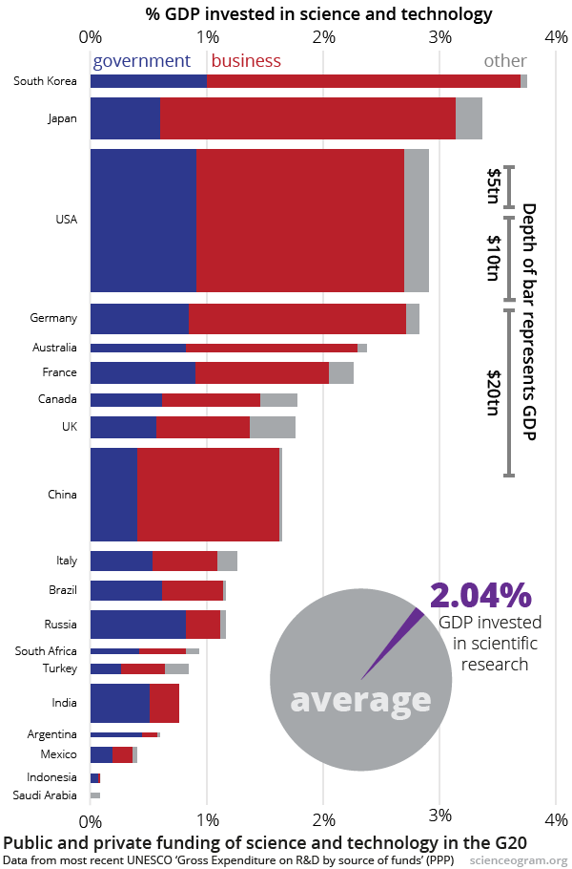
International Context
About 1/3 of psychologists are in the U.S., 1/3 in Europe, 1/3 elsewhere
U.S. funds about 1/3 of the world’s research budget

Slide 3
National Context
Graduates/year at U.S. institutions
Psychology doctoral programs: 6,000
Medical school: 18,000
Nursing masters/doctoral programs: 26,000
Law school: 45,000

Slide 4
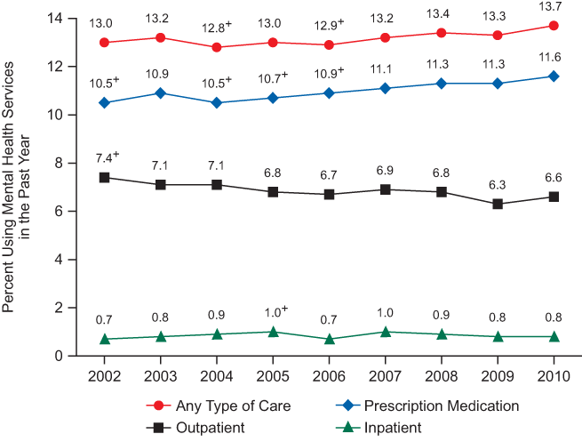
National Context
Public health problems – mental health

Slide 5
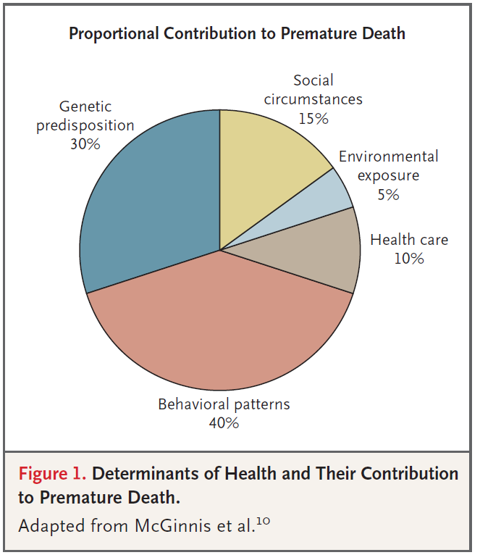
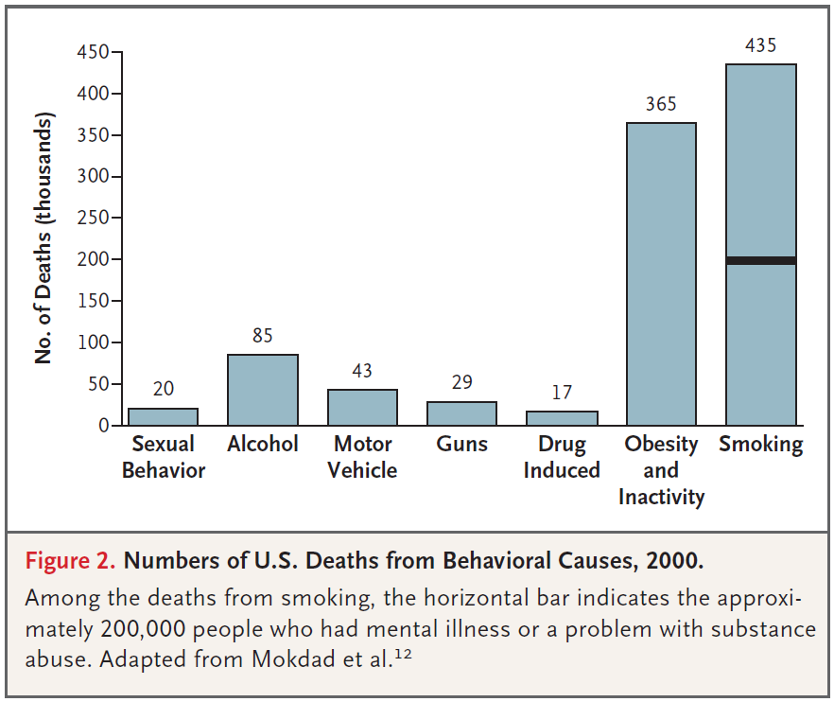
National Context
Public health problems – physical health
Schroeder, S. A. (2007). We can do better—improving the health of the American people. New England Journal of Medicine, 357, 1221‐1228.

Slide 6
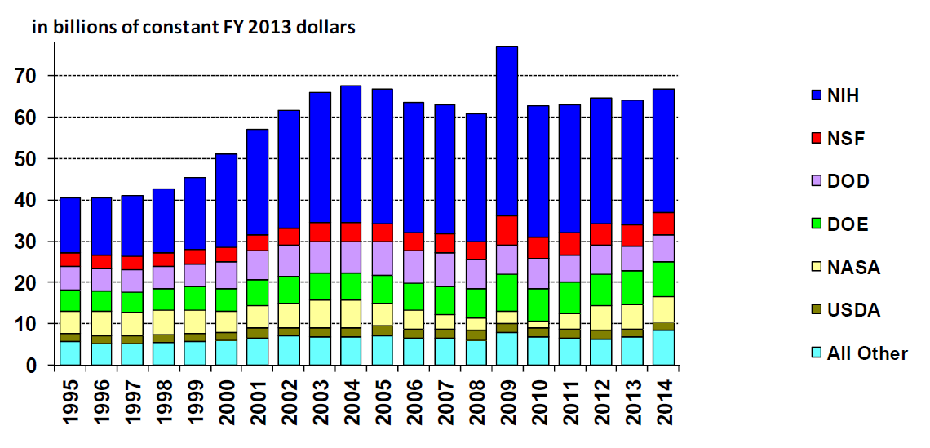
National Context
U.S Research Funding Trends

Slide 7
National Context
National Institutes of Health
Includes 27 institutes and centers
National Cancer Institute, National Eye Institute, National Institute of Mental Health, National Institute of Child Health and Human Development
Many different types of research grants
R01, R03/R21, K, T, F
NIH Loan Repayment Program
Pays off half of remaining student loan debt per year (up to $35,000/year) for those with doctorates devoting at least 50% of their time to research

Slide 8
National Context
Critique of NIH
Disease-centric
Too focused on treatment instead of prevention
Too focused on biomedical markers (blood pressure, progression-free survival) rather than biopsychosocial outcomes people care about (longevity and well-being)

Slide 9
National Context
Affordable Care Act established the Patient-Centered Outcomes Research Institute (PCORI)
Based on trusted priority statements, massive stakeholder input
Includes scientists and stakeholders as reviewers
Overarching focus on decision making
5 priorities: “Person-centered” outcomes research, disparities, healthcare systems, communication/dissemination, and methodology
About 20% of studies have a mental health focus, with many more examining health conditions with an important behavioral component (cancer, diabetes)
Most assess some component of well-being (psych stuff)

Slide 10
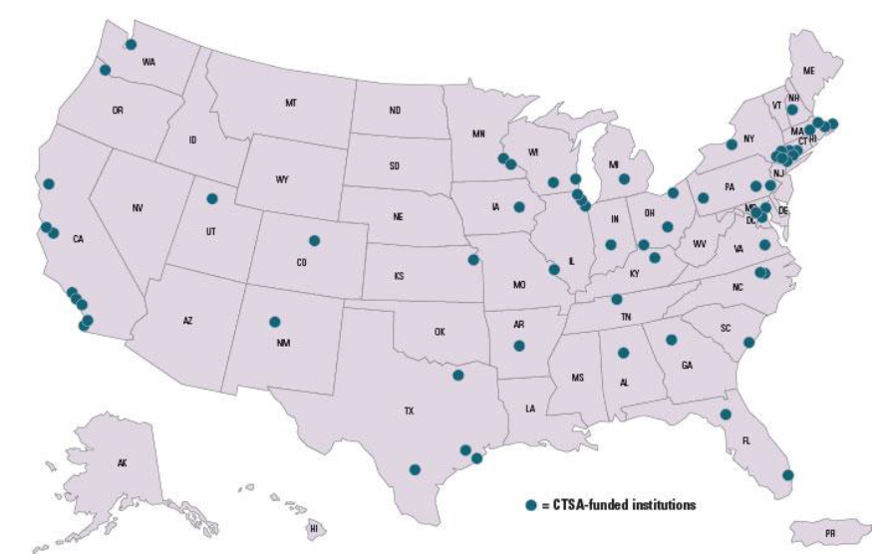
Regional Context
Focus on health research varies considerably across the country
Clinical and Translational Science Centers

Slide 11
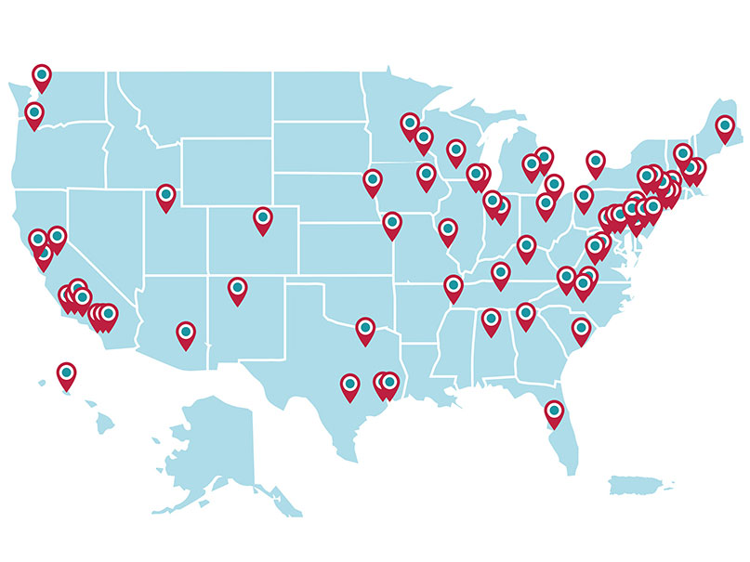
National Cancer Institute Comprehensive Cancer Centers

Slide 12
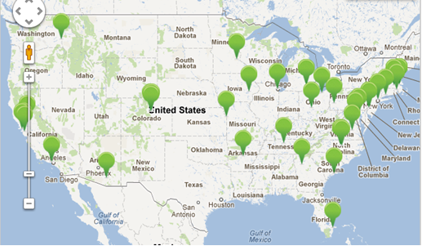
1st Round of PCORI funding

Slide 13
Regional Context
Louisiana Clinical and Translational Science (LA CaTS) Center
Primary Institutions: Pennington Biomedical, Tulane, LSU HSC
Affiliations with other LSU branches, Xavier, Children’s Hospital, Medical University of South Carolina
Building infrastructure (mentorship, advising, consulting, pilot grants, training, regulatory support) needed to catalyze clinical and translational research in Louisiana
Much of the research focused on cancer and obesity

Slide 14
Local Context
Tulane Psychology Dept’s Research (Oversimplified)
Kid stuff (School and Developmental)
Baker, Cunningham, Gray, Lockman, Nastasi, Overstreet
Brain/behavior (Neuroscience)
Colombo, Daniel, Dohanich, Fadok, Markant
Stereotypes and prejudice (Social)
Molix, Murray, O’Brien, Ruscher
Psycho-Oncology (Health Psychology)
Hoerger

Slide 15
Local Context
Other Opportunities
Department of Psychiatry and Behavioral Sciences: Drury, Scheeringa
Global Community Health and Behavioral Sciences: Seal, Taylor, Theall

