Slide 1
Measurement: Part 2

Slide 2
Overview
How does validity differ from reliability?
What are the main types of measurement validity, and how are they similar and different?
What are the other major types of validity?

Slide 3
Discussion Questions for Review
What does it mean for a measure to be reliable?
Consistent
What does it mean for a measure to be valid?
Accurate, measures what it’s supposed to
Why would anyone care about any of this?
Developing a measure
Selecting a measure for a research study
Selecting a measure for a practice, business, etc.
Critically consuming scientific articles

Slide 4
Types of Validity
Measurement Validity
Face Validity
Content Validity
Construct Validity
Criterion Validity
Other Validities

Slide 5
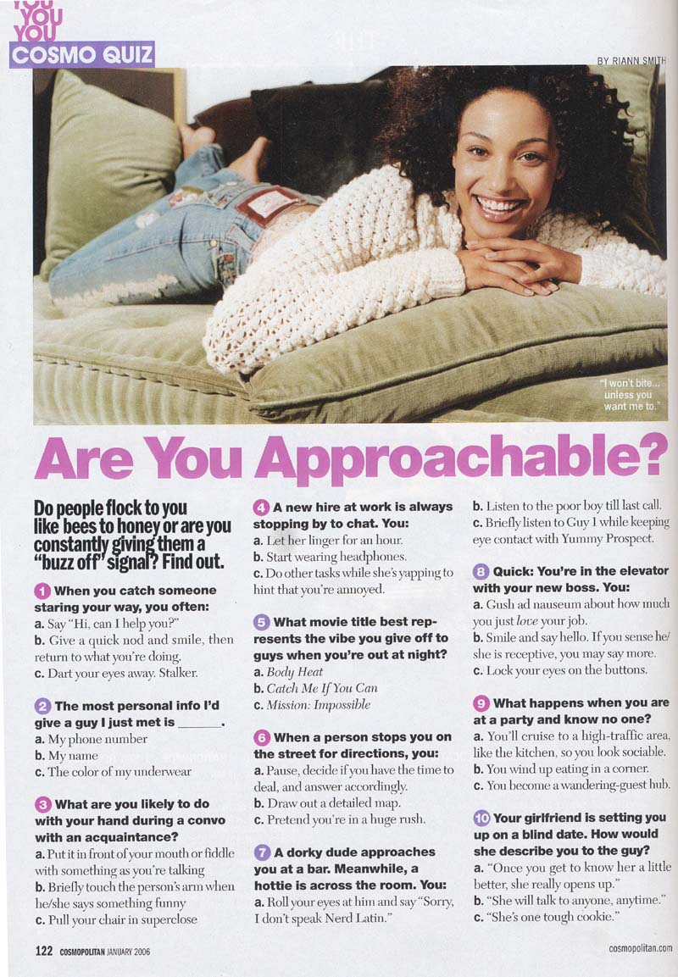
Face Validity
Does the measure appear to assess the construct?
Very subjective, nothing statistics
PHQ-9 Depression Screener
Over the past two weeks, did you have thoughts you would be better off dead or of hurting yourself in some way?
MMPI – Somatization
Do you often feel like you have a tight band around your head?

Slide 6
Content Validity
Does a measure cover the breadth of the content domain?
Content domain = all important elements of a construct
9 symptoms of depression
5 domains of personality (neuroticism, extraversion, openness, agreeableness, conscientiousness)
5 areas of delay of gratification (see next slide)
How many areas of quality of life?
Poor content validity means the study is assessing a somewhat different construct than intended
Impacts interpretation of findings, explains inconsistencies across measures

Slide 7
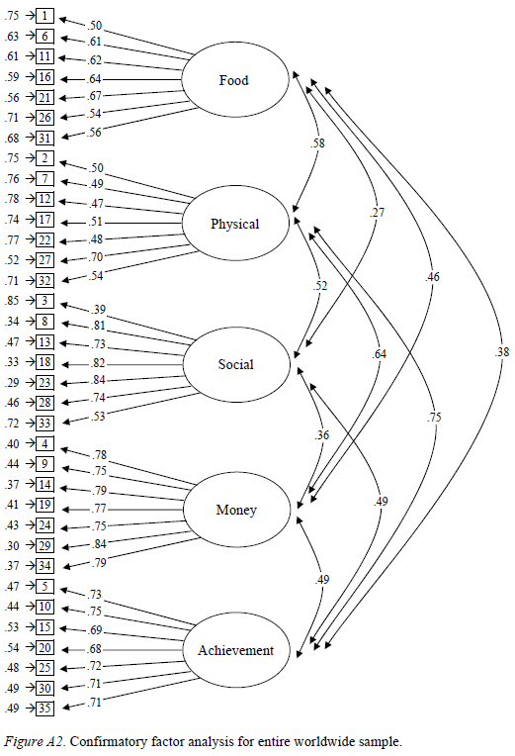
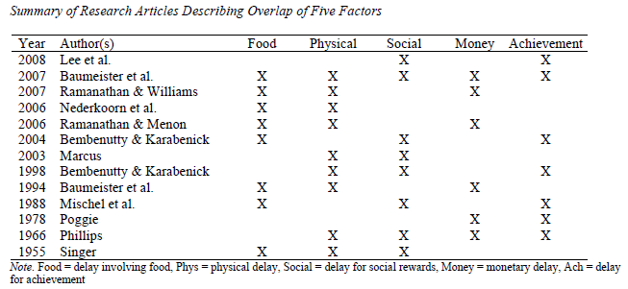

Slide 8
Construct Validity
Is there evidence the measure has theoretically-meaningful associations with other measures?
Does it have convergent and discriminant validity?
Convergent validity: Scores on the measure correlate with scores on similar measures
Discriminant validity: Scores on the measure lack correlations with dissimilar measures

Slide 9
Good Construct Validity
Measure | EI-Tulane
EI-SREIS | r = .82
EI-TEUQue | r = .73
EI-SEI | r = .78
Neuroticism | r = -.18
Extraversion | r = .13
Openness | r = .08
Agreeableness | r = .03
Conscientiousness | r = .14
IQ | r = .37
Social Desirability | r = .11
SES | r = .23

Slide 10
Bad Construct Validity – Why?
Measure | EI-Tulane
EI-SREIS | r = .32
EI-TEUQue | r = .23
EI-SEI | r = .28
Neuroticism | r = -.18
Extraversion | r = .13
Openness | r = .08
Agreeableness | r = .03
Conscientiousness | r = .14
IQ | r = .27
Social Desirability | r = .11
SES | r = .13

Slide 11
Bad Construct Validity – Why?
Measure | EI-Tulane
EI-SREIS | r = .82
EI-TEUQue | r = .73
EI-SEI | r = .78
Neuroticism | r = -.68
Extraversion | r = .63
Openness | r = .08
Agreeableness | r = .03
Conscientiousness | r = .64
IQ | r = .77
Social Desirability | r = .51
SES | r = .63

Slide 12
Criterion Validity
Is there evidence the measure is associated with important outcomes?
Criterion = outcome, so essentially outcome validity
Concurrent validity = evidence from cross-sectional studies
Predictive validity = evidence from longitudinal studies
Thinking back to prior lectures, which is better and why?

Slide 13
Good Criterion Validity
Measure | EI-Tulane
Undergrad GPA | r = .27
Job Performance | r = .25
Relationship Satisfaction | r = .44
Physical Health | r = .20
Mental Health | r = .38

Slide 14
Other Validities
Measurement Validity = how well a measure measures what it’s supposed to (how well a measure operationalizes a construct)
Other Validities
Internal Validity = Strength of causal inferences
External Validity = Generalizability across people, places, and time
Statistical Conclusion Validity = Accuracy in interpreting statistical results (p-values, effect sizes, etc.)

