Slide 1
Developing and Evaluating Research Ideas

Slide 2
Overview
How can we use “theory” to develop research ideas?
What are other practical strategies we can use to develop research ideas?
How do we evaluate research ideas?

Slide 3
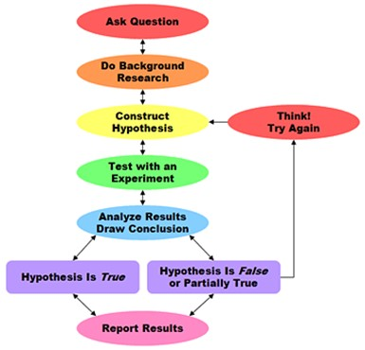
Scientific Method
Intro Psych and every other science textbook ever
Theory: Logical (i.e., testable, falsifiable, parsimonious), well-organized framework for understanding the cumulative body of evidence on a topic
Hypotheses: Specific predictions
Design + Run the Study
Analyze and Report Results
Revise and Expand Theory

Slide 4
Examples of Theory
Psychotherapy: Psychodynamic, cognitive, behavioral, integrative
Personality: Five-factor model of personality
Social/Developmental: Social learning theory, Terror management theory, Affective forecasting theory, Self-regulation theory
Intelligence: General intelligence factor (g)

Slide 5
Sources of Ideas
Theory: Need to have an excellent command of the relevant literature. Shortcuts…
Search for “theory,” “review” or “meta-analysis”
Find a good-but-old article, and check who is citing it
Check “future directions” section of relevant articles
Check these sources:
APA journals and special issues

Slide 6
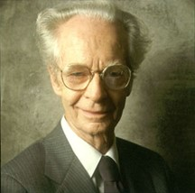
“But it is time to insist that science does not progress through carefully designed steps called ‘experiments,’ each of which has a well-defined beginning and end.” - Skinner

Slide 7
Other Sources of Ideas
National Priority Statements
PCORI: Priorities + methods
National Academy of Medicine (formerly Institute of Medicine/IOM): Search thousands of reports
Other Researchers
Project team (lab) meetings
Grants websites: NIH, NSF, PCORI
Clinical observation
Existing data
Exploration

Slide 8
Evaluating Research Ideas
When developing studies, evaluating term papers and manuscripts, evaluating publications, evaluating grants
Significance = importance for societal health and well-being
Number of people affected
Severity of the problem
Ability to solve the problem
Innovation = novelty
“First study”
New context, method, population
Potential for a scientific breakthrough, rapid uptake

