Slide 1
Correlations #2/3

Slide 2
Overview
Interpreting Correlations: p-values
Challenges in Observational Research
  Correlations reduced by poor psychometrics (reliability and validity)
    Combining measures
  Individual predictors often weak
    Multiple regression
  Correlation ≠ causation
    Directionality and 3rd-variable problems
    Causal inference
    Advanced topics: Standardized betas (β) , mediation, moderation
    Beyond causation: Prediction and description

Slide 3
Interpreting Correlations
Correlation coefficient
  Magnitude
    Clinical significance, real-world significance, public health significance
  p-value
    Probability of observing an association of a particular magnitude when no real-world relationship exists
    More simply: Probability the result is due to sampling error
    Even more simply: Probability the result is due to chance
    p < .05 means statistically significant, trustworthy, reliable, not due to chance

Slide 4
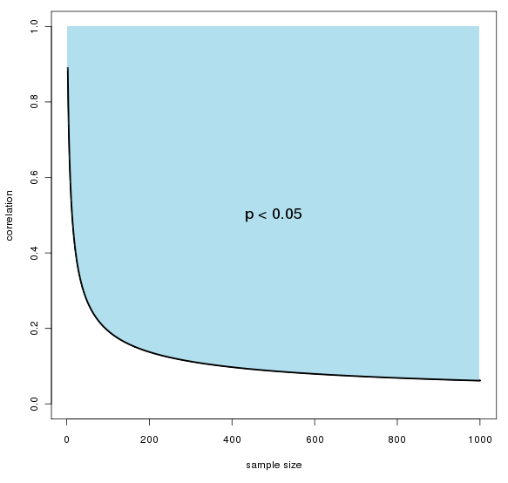
Statistical Significance
Depends on the
observed effect
(magnitude of the
correlation)
Depends on the
sample size

Slide 5
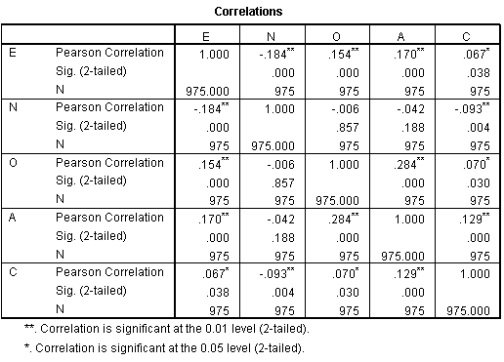

Slide 6
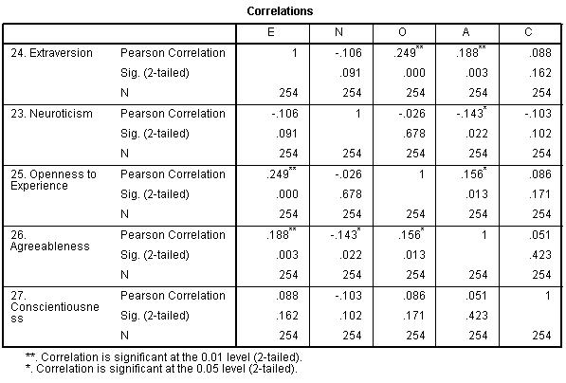

Slide 7
Challenges Encountered in Observational Research
Correlations reduced by poor psychometrics (reliability and validity)
Individual predictors often weak
Correlation ≠ causation

Slide 8
Challenges Encountered in Observational Research
Correlations reduced by poor psychometrics (reliability and validity)
  Use/make better measures (next unit)
  Combine measures
Individual predictors often weak
  Multiple regression
Correlation ≠ causation
  Methods for improving causal inferences
  Prediction is fun too

Slide 9
Combining Measures
Any given item (or measure or indicator) has error
Can reduce overall error by combining items, measures, indicators
Many different ways
  Complex: Many varieties of factor analysis
  Elegant: Summated scale scores (add them)

Slide 10
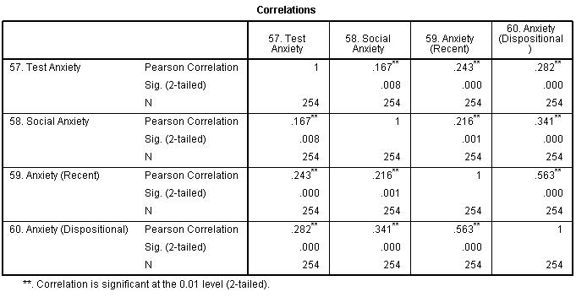

Slide 11
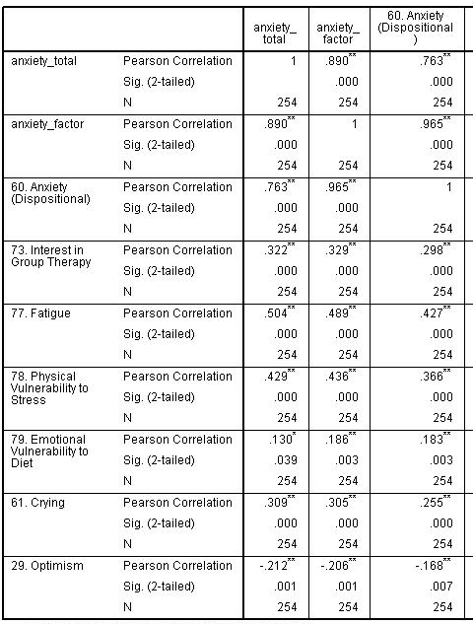

Slide 12
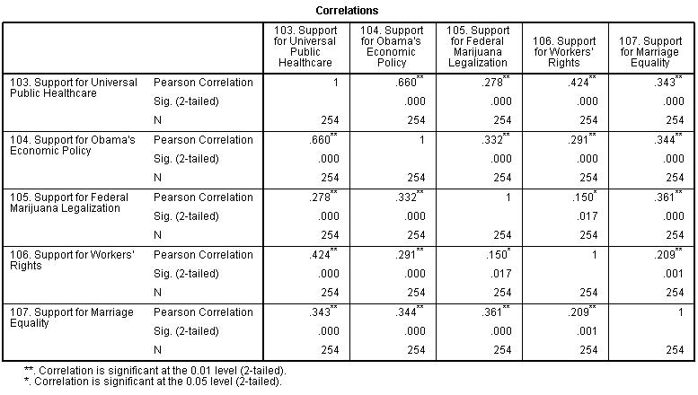

Slide 13
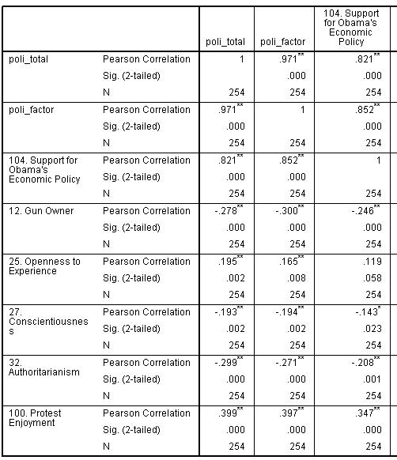

Slide 14
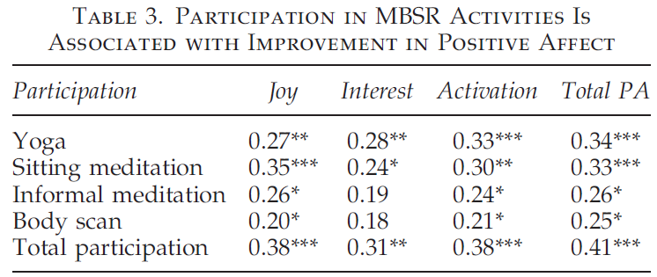

Slide 16


Multiple Regression
Single predictors often weak
Human behavior is often multidetermined
Can be used to examine how well several different independent variables combine to predict a single
dependent variable of interest
  When to use this versus
  summated scale scores?
R
r

Slide 17
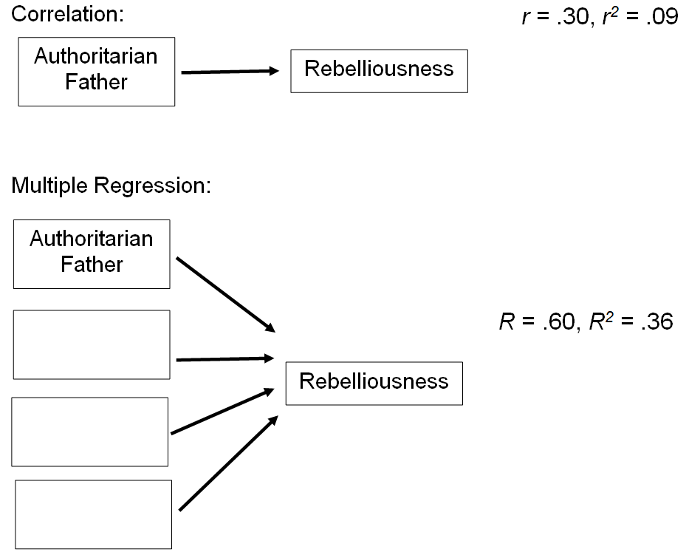

Slide 18
One predictor… not bad

Slide 19
Try finding some more predictors…

Slide 20
Now put them in a multiple regression…

Slide 22
Correlation ≠ Causation
Mantra of Psyc 1000
Directionality problem
3rd-variable problem
  AKA Confounding
Education
Level
r = -.20
Depression
Symptom
Severity

Slide 23
Correlation ≠ Causation
Education
Level
r = -.20
Depression
Symptom
Severity

Slide 24
Correlation ≠ Causation
Education
Level
r = -.20
Depression
Symptom
Severity

Slide 25
Correlation ≠ Causation
Education
Level
r = -.20
Depression
Symptom
Severity

Slide 26
Correlation ≠ Causation
Education
Level
Parental
SES
r = -.20
Depression
Symptom
Severity

Slide 27
Correlation ≠ Causation
Pot
Smoking
r = .20
Ice Cream
Eating

Slide 28
Causal Inference
Ability to infer (assert) causation exists on a continuum
Requirements for Causation
  Internal validity: Rule out 3rd variables (alternative explanations)
  Temporal precedence
Also helpful
  Stronger associations
  Theoretically plausible
  Corroborating experimental evidence

Slide 29
3rd–Variable Problem
Methodologic Control
  If worried about a 3rd variable, control for it in your sample (e.g., if worried about SES, only study doctors)
Measure 3rd Variables
  Measure potential confounders to show they are not correlated with the variables you wish to study
Statistically Control for 3rd Variables
  Easy peasy. Many statistical techniques for doing this (e.g., partial correlations, ANCOVA), but we’ll just use regression
  Only works well if the potential confounder was measured well (breast milk example)

Slide 30
Statistical Control in Regression

Slide 31
Statistical Control in Regression
Imagine that cigarette smoking across the lifespan is correlated with physical health at age 60 (r = -.40)
If you were a cigarette company, what third variables might you blame?
Alcohol use, extraversion, income, education level, poor coping skills
Do a multiple regression and find that smoking is still associated with physical health even after controlling for those variables (β = -.37, p < .001)

Slide 32
Temporal Precedence
Cross-sectional vs. longitudinal study
  Prospective vs. retrospective study
Social
Support
T1
Social
Support
T2
Depression
Symptom
Severity T1
Depression
Symptom
Severity T2

Slide 33
Temporal Precedence
Social
Support
T1
Social
Support
T2
Depression
Symptom
Severity T1
Depression
Symptom
Severity T2

Slide 34
Temporal Precedence
Social Support at T1 predicts Depression at T2, while controlling for Depression at T1.
More or less, Social Support levels at T1 predicts changes in depression.
Social
Support
T1
Social
Support
T2
β = .03
β = .21
Depression
Symptom
Severity T1
Depression
Symptom
Severity T2

Slide 35
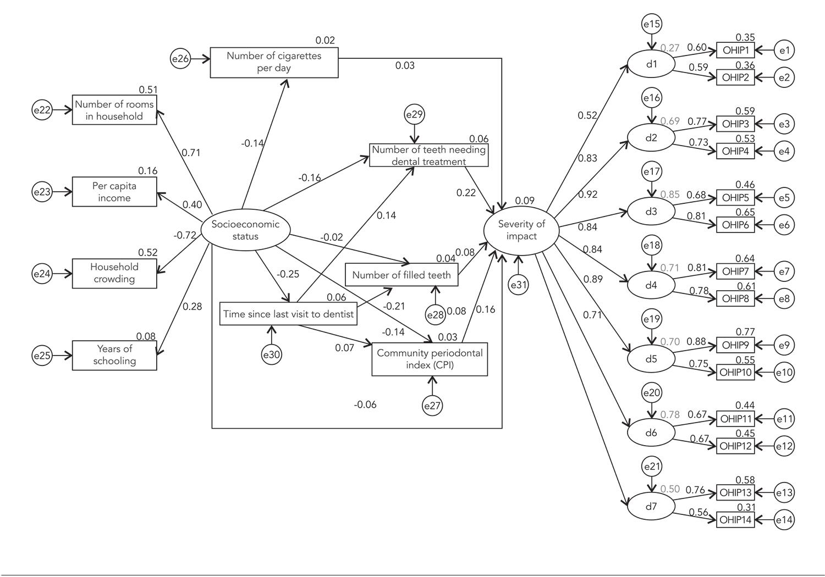

Slide 36


Slide 37
Mediation
Rather than examining how A causes B, focuses on a causal chain: A causing B causing C…
Social
Support
T1
Child Depression
Symptom Severity
T3
Depression
Symptom
Severity T2

Slide 38
Moderation
Different from mediation
Also called “interaction” and “effect modification”
Means that an association varies by group
Relationship between A and B depends on C
Social
Support
T1
Social
Support
T1
β = .21
β = .11
Depression
Symptom
Severity T2
Depression
Symptom
Severity T2
Males Females

Slide 39
Prediction and Description
Observational research (and correlations) are important in their own right, regardless of whether or not associations are causal
Examples
  Decision-making research
  Personalized medicine, MMPI, Pandora, dating
  Others

Slide 41
