Slide 1
Clinical Research: Part 1 Small-N Designs

Slide 2
Overview
How do Small-N designs fit within the broader context of clinical research?
What are the strengths and limitations of Case Studies?
What are the varying types of Single-Subject Designs, and why are they used?

Slide 3
Introduction to Clinical Research
Randomized Controlled Trials (soon)
Quasi-experimental Designs (next time)
Small-N designs (today)
Involves attempting to help a single or small number of individuals
Therapy, parenting, animal training, school-based intervention, medicine, sports psychology, self-help

Slide 4
Rationale for Small-N Designs
Critique of large-N designs
Any difference is statistically significant if big enough N
Clinical (practical, real-world) significance can be demonstrated with a single individual
Group-level findings may not apply to a particular individual
Health service psychology (e.g., clinical, counseling, school psychology) is often focused on intervening with individuals
Periodic fluctuations in historical focus on groups vs. individuals

Slide 5
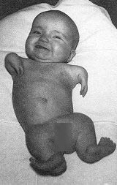
Case Studies
Detailed account of a single case
Examples
Charcot and Freud, Thalidomide, FAS, SSRI-induced suicidality, Lung cancer
Advantages
Excellent detail, Useful when a single incident proves a claim, Focuses attention, facilitating more comprehensive research
Disadvantages
Prone to bias, Can facilitate pseudoscience, Difficult to show internal validity, Poor external validity

Slide 6
Single-Subject Designs
Study an individual or small sample in detail
Like a case study, but much more focus on data and control, involves tracking outcomes closely and implementing interventions systematically
Terminology
A = baseline
B = some treatment, manipulation, or intervention
C, D, E, etc = other treatments
CD = combination of two treatments
B₁, B₂, B₃ = variation of same treatment
DV (outcome) measured repeatedly throughout varying phases

Slide 7
Example Designs
Simple examples
A-B
A-B-A
A-B-A-B
Other examples
A-B₁-B₂-B₃
A-B-C-BC
A-B₁-B₂-B₃-C-D-B₂D-A-B₂D

Slide 8
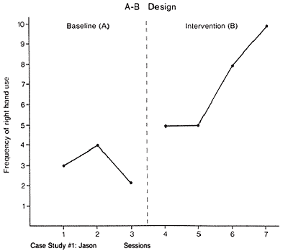
Frequency of Emotion Words

Slide 9
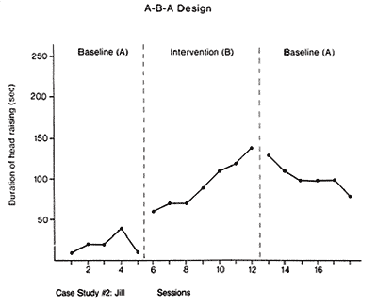
Minutes Spent Reading Each Day

Slide 11
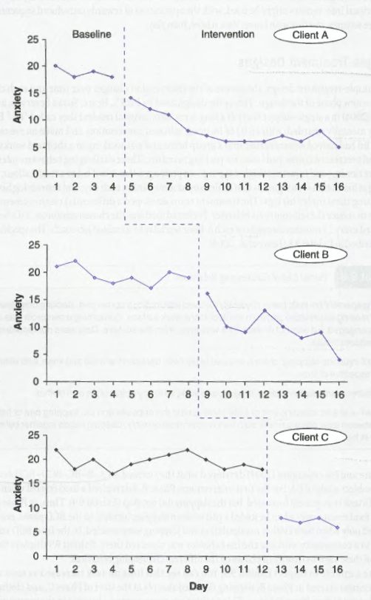
Multiple-Baseline Designs
Multiple people, settings, or outcomes - why?
Phase changes typically staggered - why?

Slide 12
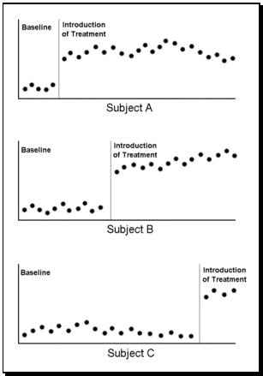

Slide 13
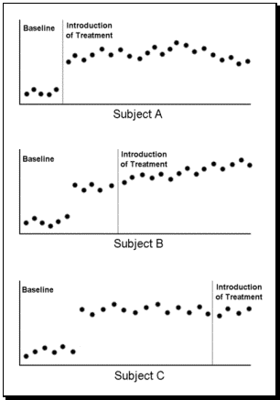

Slide 14
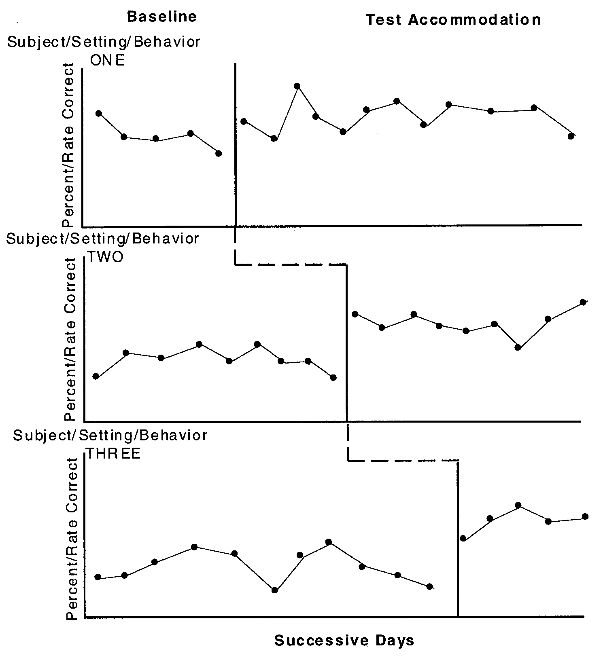

Slide 15
Changing-Criterion Designs (Shaping)
Begin by identifying a goal (outcome, criterion, target behavior) that is too complex to readily achieve
Identify subgoals along the pathway to the goal
Offer a reward when the first subgoal is met
In each subsequent phase, only offer the reward when the next subgoal is met, until finally reaching the goal
Examples: Encouraging reading, training a dog to fetch beer, exercise, behavioral activation, getting a partner/parent/sibling to do something

Slide 16
