Slide 1
Experiments: Part 5 Interactions

Slide 2
Overview
“Most smart people don’t understand interactions”
What are main effects?
What are interactions, and how do they differ from main effects?
How can we work from examples to identify factors, levels, conditions, main effects, and interactions?

Slide 3
Main Effects vs. Interaction Effects
“Main effect” means a factor (independent variable) has an effect on the outcome (dependent variable)
But… under all situations?
But… for all people?
If “yes, generally” → Main effect
If “it depends” on the situation or person → Interaction
Examples to Discuss:
Effect of studying on long-term knowledge retention
Effect of exercise on weight loss

Slide 4
Main Effects vs. Interactions
Main effects are more about general rules
But science is often about defining boundary conditions, when rules apply and when they don’t
Interactions are more about exceptions-to-the-rules
When is an effect bigger?
When is an effect smaller or absent?
When is an effect in the opposite direction?

Slide 5
Interaction Effects
Also called “interactions,” “moderators” and “effect modifiers”
Means that the effect of one variable depends on someone’s status on another variable
Means that the effect of one factor on the outcome differs depending on where someone falls on another factor
One factor could increase the effect of another factor
One factor could decrease the effect of another factor
One factor could change the direction of the effect of another factor

Slide 6
Factorial Matrix
Does anxiety increase support for cigarette taxes?
What are the effects of anxiety and mortality salience on support for cigarette taxes?
 |  | Anxiety
 |  | Low | High
Mortality Salience | Absent | 5.0 | 7.0 | 6.0
 | Present | 8.0 | 6.0 | 7.0
 |  | 6.5 | 6.5

Slide 7
Factorial Matrix
In absence of mortality salience, anxiety increases support for taxes
What are the effects of anxiety and mortality salience on support for cigarette taxes?
 |  | Anxiety
 |  | Low | High
Mortality Salience | Absent | 5.0 | 7.0 | 6.0
 | Present | 8.0 | 6.0 | 7.0
 |  | 6.5 | 6.5
+2

Slide 8
Factorial Matrix
In the presence of mortality salience, anxiety decreases support for taxes
What are the effects of anxiety and mortality salience on support for cigarette taxes?
 |  | Anxiety
 |  | Low | High
Mortality Salience | Absent | 5.0 | 7.0 | 6.0
 | Present | 8.0 | 6.0 | 7.0
 |  | 6.5 | 6.5
-2

Slide 9
Notation Examples
Factors? Levels? Conditions?

Slide 11
Main Effects and Interactions
Factor Matrices
Line Graphs
Bar Graphs

Slide 12
Is CBT or psychodynamic therapy better for depression? (Assume a 2-pt difference on the BDI is statistically significant)
 |  | Personality Type
 |  | Open-minded | Avoidant
Therapy | CBT | 25 | 24 | 24.5
 | Dynamic | 24 | 26 | 25.0
 |  | 24.5 | 25.0

Slide 13
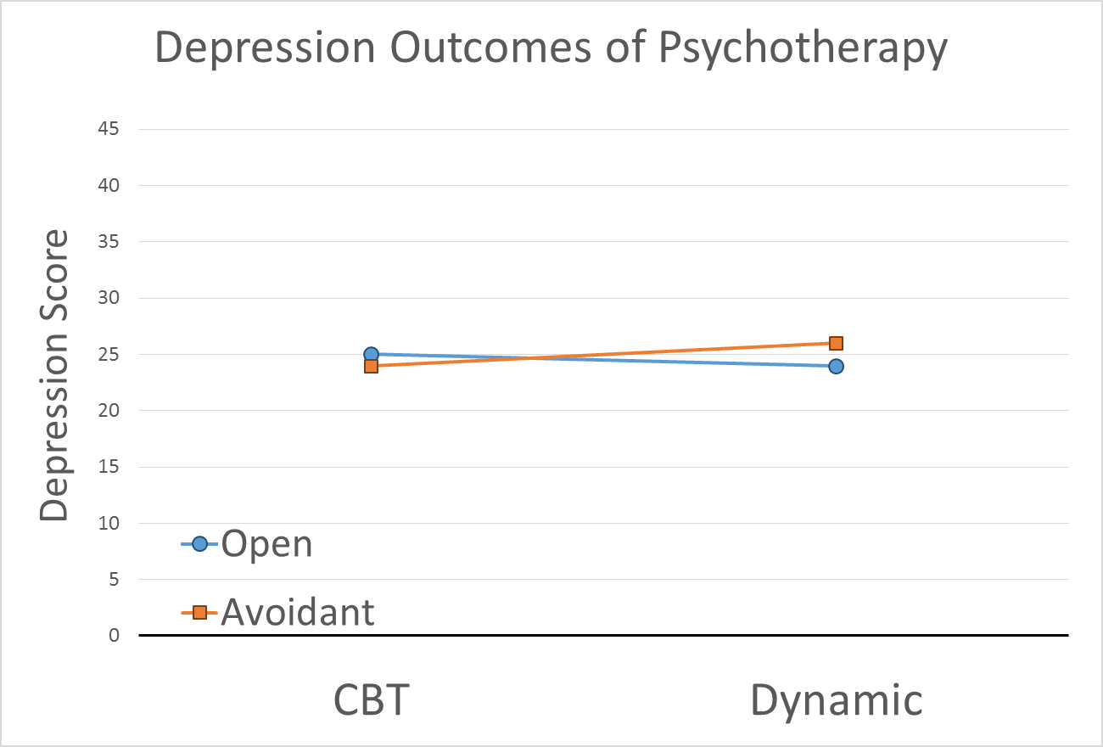

Slide 14
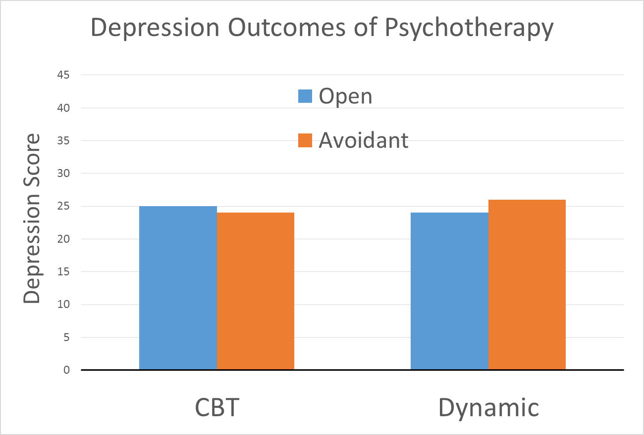

Slide 15
Is CBT or psychodynamic therapy better for depression? (Assume a 2-pt difference on the BDI is statistically significant)
 |  | Personality Type
 |  | Open-minded | Avoidant
Therapy | CBT | 12 | 13 | 12.5
 | Dynamic | 24 | 26 | 25.0
 |  | 18.0 | 19.5

Slide 16
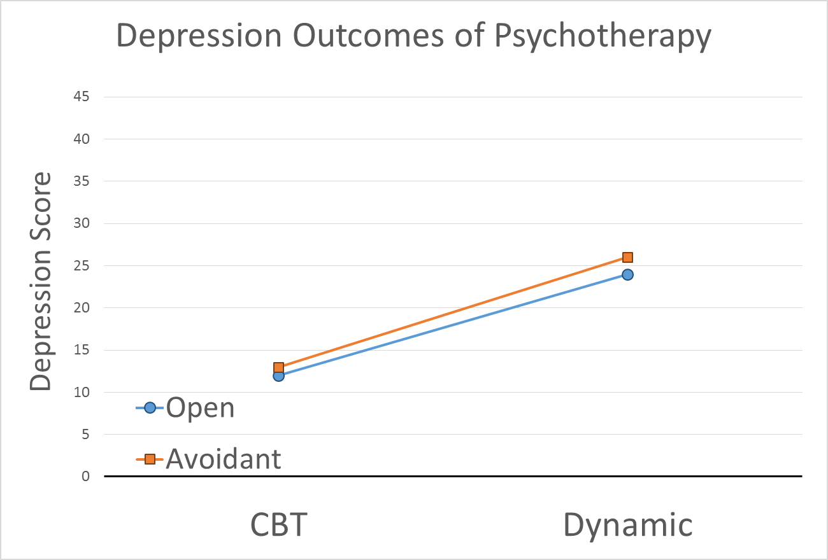

Slide 17
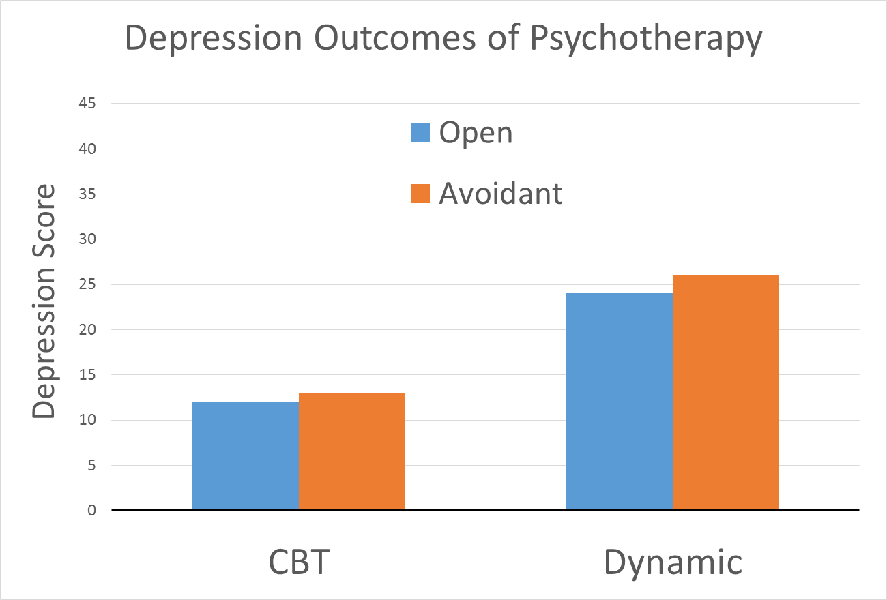

Slide 18
Is CBT or psychodynamic therapy better for depression? (Assume a 2-pt difference on the BDI is statistically significant)
 |  | Personality Type
 |  | Open-minded | Avoidant
Therapy | CBT | 12 | 38 | 25.0
 | Dynamic | 12 | 37 | 24.5
 |  | 12.0 | 37.5

Slide 19
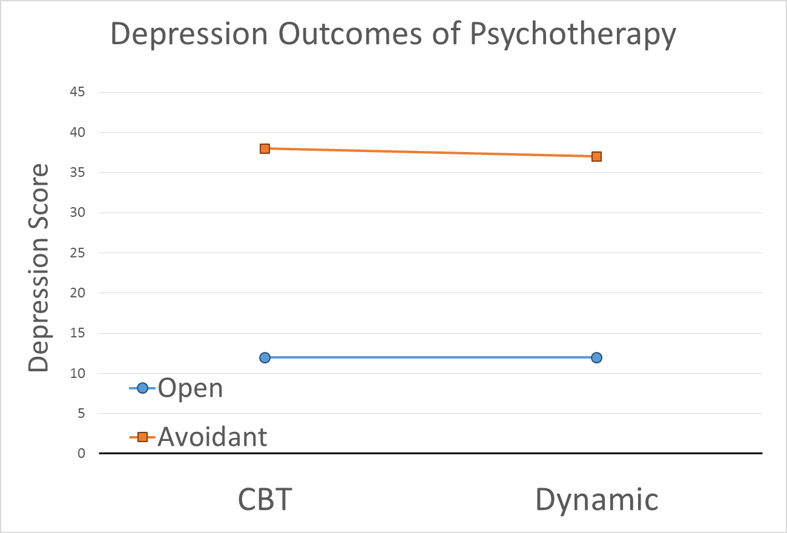

Slide 20
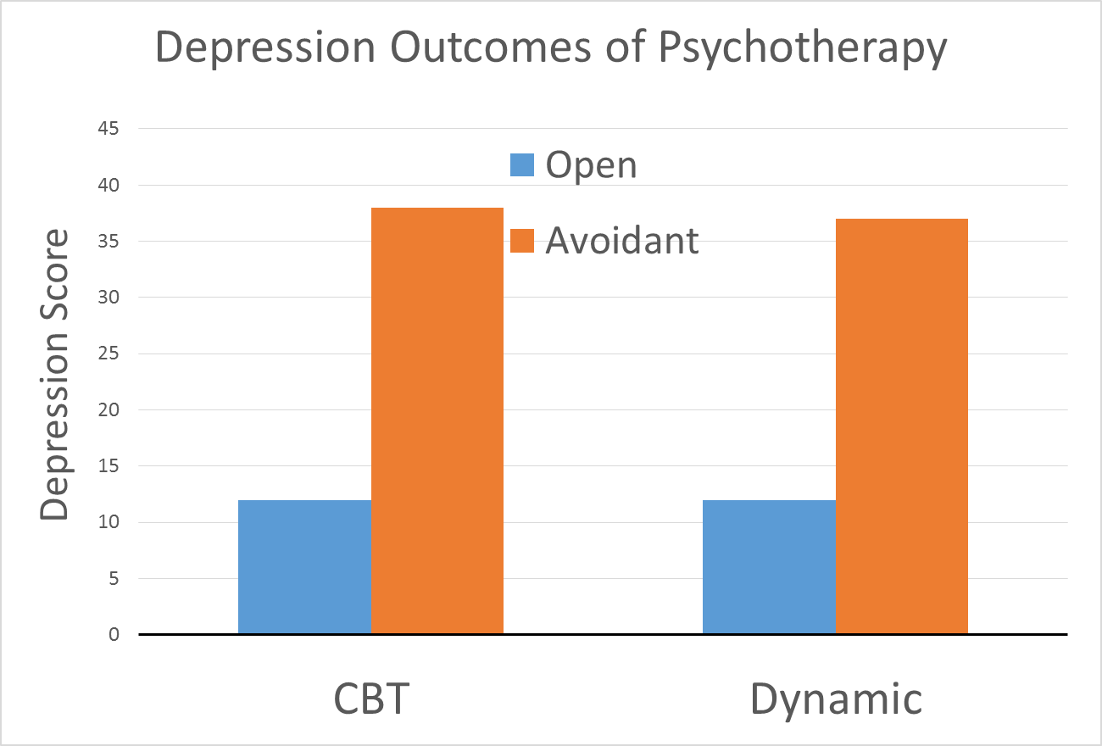

Slide 21
Is CBT or psychodynamic therapy better for depression? (Assume a 2-pt difference on the BDI is statistically significant)
 |  | Personality Type
 |  | Open-minded | Avoidant
Therapy | CBT | 40 | 17 | 28.5
 | Dynamic | 15 | 41 | 28.0
 |  | 27.5 | 29.0

Slide 22
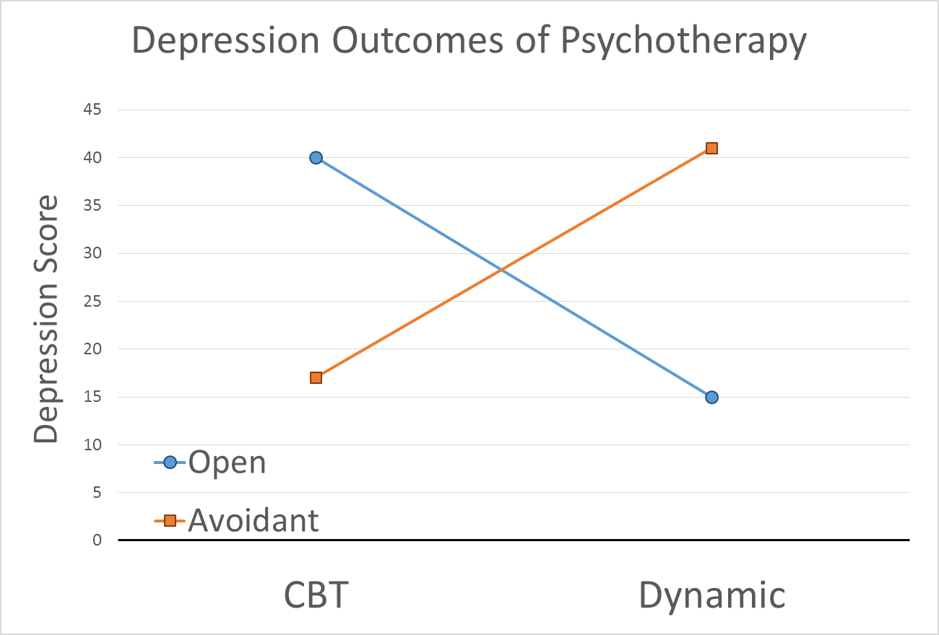

Slide 23
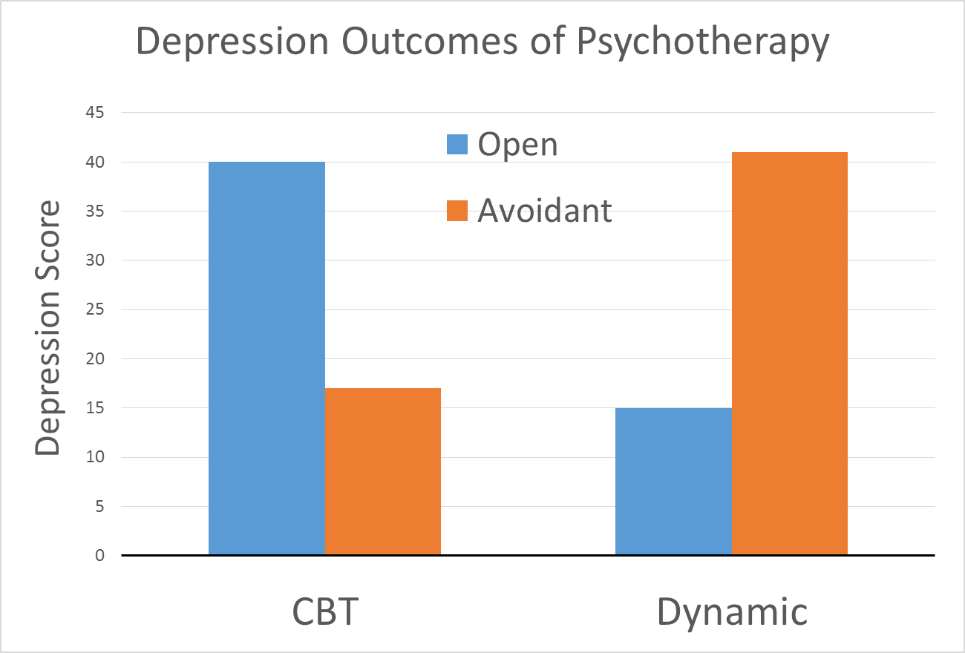

Slide 24
Is CBT or psychodynamic therapy better for depression? (Assume a 2-pt difference on the BDI is statistically significant)
 |  | Personality Type
 |  | Open-minded | Avoidant
Therapy | CBT | 29 | 34 | 31.5
 | Dynamic | 6 | 43 | 24.5
 |  | 17.5 | 38.5

Slide 25
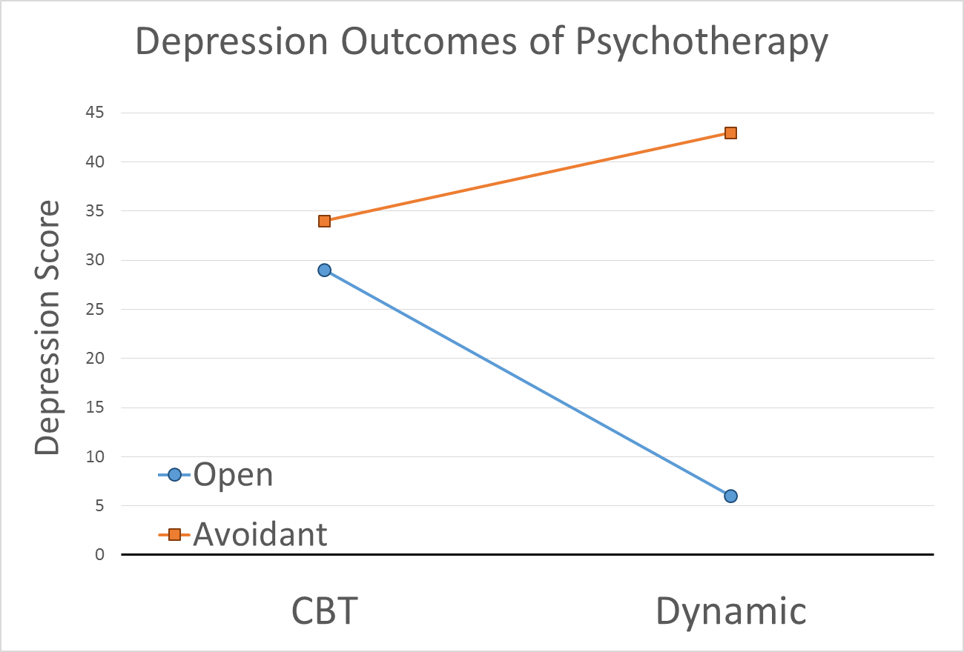

Slide 26
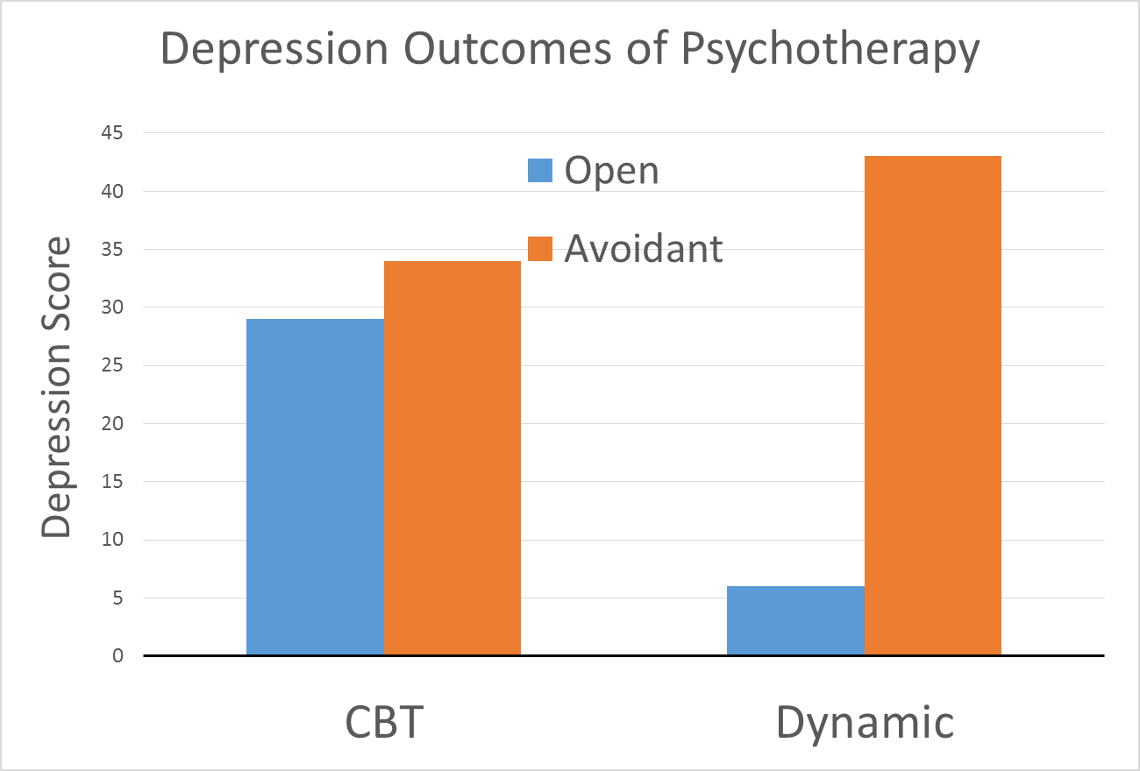

Slide 27
Are loud obnoxious commercials more effective than typical commercials in affecting consumer behavior?

