Slide 1
Technology and Psychology Research

Slide 2
Overview
Background
Types of Internet Research
Recruitment
Implementation
Data Quality

Slide 3
Background
Two areas where younger researchers destroy older researchers
Today’s talk is mostly focused on the Internet, but other applications are evident
Guidance based on 20 years of web design experience, a dozen or so online studies, recruitment of nearly 20,000 participants, writing of APA ethics guidelines

Slide 4
Types of Internet Research (Overlapping)
1. Phenomenological
  Focused on the internet (or whatever form of technology) itself
  Examples: What are the benefits of online support groups? Why are people’s motives for using Tinder? How does Facebook influence mood?
  Class Activity
    60-second brainstorm
    Small group discussion
    Class discussion

Slide 5
Types of Internet Research
2. Observational
  Review and collect data from public documents
  Even if data is “public” still respect local norms
    Don’t just start analyzing data from an LGBT discussion forum without permission
    Don’t creep on Facebook profiles
    Get stakeholder feedback where needed

Slide 6
Types of Internet Research
3. Internet-mediated
  Study is implemented online instead of in person (e.g., online survey)
  Requires careful ethical consideration about confidentiality, consent, and debriefing
  Reduced risk of coercion
  Environmental benefits
  Social/economic justice?
  Efficient… too efficient?

Slide 7
Recruitment
SONA
Psychology Research Websites
  Psychological Research on the Net
    Lists most recent studies at the top
    http://psych.hanover.edu/research/exponnet.html
  Online Social Psychology Studies
    http://www.socialpsychology.org/expts.htm
Mechanical Turk ($)
  https://www.mturk.com/mturk/welcome

Slide 8
Recruitment
ResearchMatch
  Available to over 100 institutions -- now Tulane!
  80,000+ volunteers
  Can specify demographics (e.g., age, race, location, BMI), health history (e.g., 350 with HIV, >10,000 with depression, 170 with prostate cancer, 31,000 “healthy”)
  https://www.researchmatch.org
Other sources of targeted recruitment
  Discussion forums, listservs, health education or interest websites
  Seek stakeholder perspective and permission
  Beware of Wikipedia and Facebook

Slide 9
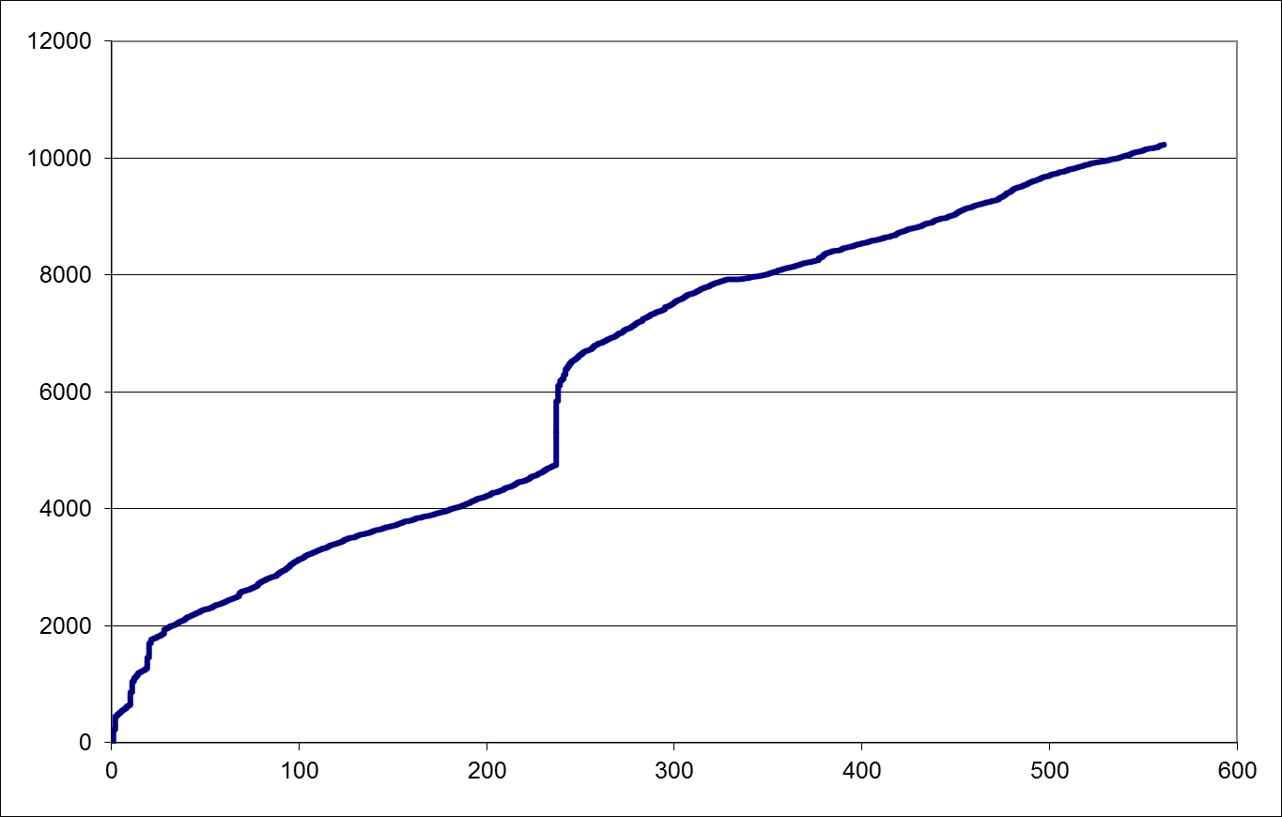
n
Time (days)

Slide 10
Implementation
Low-tech: Email
Surveymonkey ($)
  Free for 10 questions and < 100 responses
  More sophisticated plans at $25+/month
Qualtrics ($$) – free to Tulane
REDCap ($$$) – free to LA CaTS
Custom website ($$$$) – can provide feedback
Need not involve a standard computer: phone call, email on phone, text message, Fitbit, whatever
  Ecological Momentary Assessment (EMA)

Slide 11
Data Quality – Addressable but Must Address
Dropout (see graph)
  In absence of major incentives (money, SONA credits, feedback), most won’t devote more than 15 mins (about 100-120 items) unless very committed or engaged (e.g., patient learning something useful)
Response Validity
  Check for repeat IP addresses, duration (too short/long)
  Use “infrequency” or “catch” items
  Ask (1) if they responded carefully, and (2) if they completed the survey before

