Slide 1
Translational Team Science

Slide 2
Overview
Basic vs. Applied Research
  Limitations
Translational Research
Translational Team Science

Slide 3
Basic vs. Applied Research
Basic Research
  Discover basic facts, with no immediate focus on solving real-world problems
  Knowledge for knowledge’s sake
  Speculative, often takes decades of cumulative knowledge to benefit society, but breakthroughs can lead to paradigm shifts
  Learning, sensation/perception, neuroscience, and most social, personality, and developmental

Slide 4
Basic vs. Applied Research
Applied Research
  Can impact real-world problems relatively quickly, but focuses on incremental science rather than breakthroughs
  Makes relevant and immediate contributions to real-world problems
  Most healthcare research, much research in clinical, counseling, school, and I/O psychology

Slide 5
Critique of Basic/Applied Distinction
Many studies fall in between
Much basic research is not designed to solve a real-world problem but could be used for that purpose
Throwing money at applied research has only produced mixed results
“Research gap”

Slide 6
Translational Research
Aims to translate basic research discoveries into applied solutions that can benefit societal health and well-being
Acknowledges that science is about the speed of solving real-world problems
  Bridging the “Research Gap” (see Figure)
  T1: Speed up application of basic science to interventions
  T2: Speed up dissemination and implementation of useful interventions

Slide 7
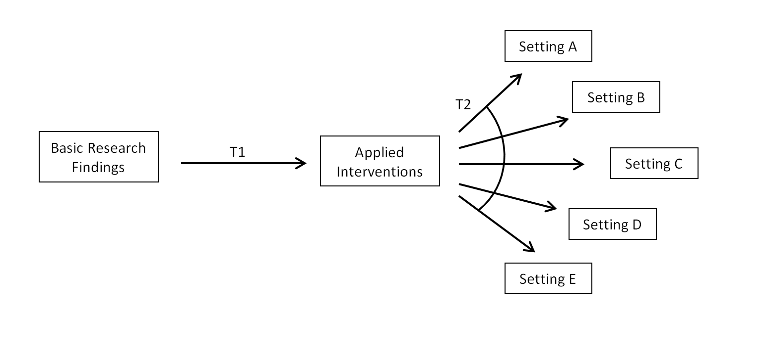

Slide 8
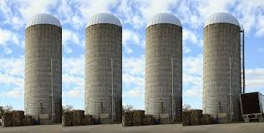
Research Silos
Food
Deserts
Apple
Scab
Grit
Rhinoviruses
Microconstruct Y
Anhedonia
Math
Anxiety
Gallbladder
Cancer
Detection
Microconstruct X
Microconstruct Z
Schizophrenia
Biomarkers

Slide 9
Translational Team Science
Shift away from research led by a single investigator in a single scientific discipline
Shift toward interdisciplinary (or “transdisciplinary”) team science, drawing upon multiple domains of basic and applied research expertise, clinical expertise, and community perspectives
Challenges and Opportunities
  Jack of all trades, master of none (Fox vs. Hedgehog)
  Psychology’s slow response
  Biomedicine’s baffled reaction
  Challenging interpersonally (expertise, communication, norms), and intellectually
  Good for people who are high on openness to experience, tolerant of ambiguity, bored easily, coalition builders, and ambitious

Slide 10
Family Physician
Administrative Assistant
Psychologist
Nurse
Standardized Patient Instructor (Actor) w/Cancer Hx
Oncologist
Medical
Sociologist
Medical Social Worker
Biostatistician
Family Physician/ Epidemiologist
Biostatistician
Psychologist

