Slide 1
Contextualizing psychology research
Internationally, Nationally, Regionally, Locally

Slide 2
Why Research?
Why are you majoring/minoring in psychology or an allied discipline?
#1 Reason: “I want to help people.”
  OK, better than harming people, though harming professions pay more than helping professions (they have to) and we can debate the implications of crippling student debt for your ultimate career path
  Do you want to benefit society modestly or substantially?
    Let’s compare several career paths

Slide 3
Therapist A
Full-time psychotherapist who hates research
Assume a standard case load, outcomes, and career
  30 clients/week; see each client for an average of 6 months, so 60 clients/year
  Typical therapy outcomes = improvement of 0.80 SD units (essentially like going from 79th to 50th percentile on symptoms). In lay terms “helps a great deal”
  Work from ages 30 to 65 = 35-year career
  Help 2,100 clients a great deal (60 x 35)
    1,680 SD units if you want to get statistical

Slide 4
Therapist B
Full-time research-savvy psychotherapist
  Assume as a savvy research consumer improves outcomes by 20%
    Sees 2,100 clients, but therefor helps them by 1.0 SD units (like going from 84th to 50th percentile)
  OR Assume can treat clients 20% more efficiently
    Comparable to treating 2,520 clients as well as Therapist A
    420 more people helped a great deal
  Probably can also get state/county/federal contracts, make fat stacks, hire more people, help more people indirectly

Slide 5
Researcher C
Full-time researcher
  Good, not great. Devotes entire career to making PTSD treatments 3% more efficient
  VA disseminates new treatment package; they seem to have about 200 major treatment centers
    Assume each center has 10 therapists who each treat 60 clients/year (probably a major underestimate)
    That’s 120,000 clients/year
  If they achieved the same outcomes with 3% increased efficiency, that would allow them to help 3,600 more people in the first year alone, more than Therapist A/B’s career-long accomplishment
  Help 36,000 more people over the decade, 360,000 over the subsequent century

Slide 6
Summary
Therapist A ☺ ☺ ☺ ☺ ☺ ☺ ☺ ☺ ☺ ☺ ☺ ☺ ☺ ☺ ☺ ☺ ☺ ☺ ☺ ☺ ☺
Therapist B ☺ ☺ ☺ ☺ ☺ ☺ ☺ ☺ ☺ ☺ ☺ ☺ ☺ ☺ ☺ ☺ ☺ ☺ ☺ ☺ ☺ ☺ ☺ ☺ ☺
Researcher C ☺ ☺ ☺ ☺ ☺ ☺ ☺ ☺ ☺ ☺ ☺ ☺ ☺ ☺ ☺ ☺ ☺ ☺ ☺ ☺ ☺ ☺ ☺ ☺ ☺ ☺ ☺ ☺ ☺ ☺ ☺ ☺ ☺ ☺ ☺ ☺ ☺ ☺ ☺ ☺ ☺ ☺ ☺ ☺ ☺ ☺ ☺ ☺ ☺ ☺ ☺ ☺ ☺ ☺ ☺ ☺ ☺ ☺ ☺ ☺ ☺ ☺ ☺ ☺ ☺ ☺ ☺ ☺ ☺ ☺ ☺ ☺ ☺ ☺ ☺ ☺ ☺ ☺ ☺ ☺ ☺ ☺ ☺ ☺ ☺ ☺ ☺ ☺ ☺ ☺ ☺ ☺ ☺ ☺ ☺ ☺ ☺ ☺ ☺ ☺ ☺ ☺ ☺ ☺ ☺ ☺ ☺ ☺ ☺ ☺ ☺ ☺ ☺ ☺ ☺ ☺ ☺ ☺ ☺ ☺ ☺ ☺ ☺ ☺ ☺ ☺ ☺ ☺ ☺ ☺ ☺ ☺ ☺ ☺ ☺ ☺ ☺ ☺ ☺ ☺ ☺ ☺ ☺ ☺ ☺ ☺ ☺ ☺ ☺ ☺ ☺ ☺ ☺ ☺ ☺ ☺ ☺ ☺ ☺ ☺ ☺ ☺ ☺ ☺ ☺ ☺ ☺ ☺ ☺ ☺ ☺ ☺ ☺ ☺ ☺ ☺ ☺ ☺ ☺ ☺ ☺ ☺ ☺ ☺ ☺ ☺ ☺ ☺ ☺ ☺ ☺ ☺ ☺ ☺ ☺ ☺ ☺ ☺ ☺ ☺ ☺ ☺ ☺ ☺ ☺ ☺ ☺ ☺ ☺ ☺ ☺ ☺ ☺ ☺ ☺ ☺ ☺ ☺ ☺ ☺ ☺ ☺ ☺ ☺ ☺ ☺ ☺ ☺ ☺ ☺ ☺ ☺ ☺ ☺ ☺ ☺ ☺ ☺ ☺ ☺ ☺ ☺ ☺ ☺ ☺ ☺ ☺ ☺ ☺ ☺ ☺ ☺ ☺ ☺ ☺ ☺ ☺ ☺ ☺ ☺ ☺ ☺ ☺ ☺ ☺ ☺ ☺ ☺ ☺ ☺ ☺ ☺ ☺ ☺ ☺ ☺ ☺ ☺ ☺ ☺ ☺ ☺ ☺ ☺ ☺ ☺ ☺ ☺ ☺ ☺ ☺ ☺ ☺ ☺ ☺ ☺ ☺ ☺ ☺ ☺ ☺ ☺ ☺ ☺ ☺ ☺ ☺ ☺ ☺ ☺ ☺ ☺ ☺ ☺ ☺ ☺ ☺ ☺ ☺ ☺ ☺ ☺ ☺ ☺ ☺ ☺ ☺ ☺ ☺ ☺ ☺ ☺ ☺ ☺ ☺ ☺ ☺ ☺ ☺ ☺ ☺ ☺ ☺ ☺ ☺ ☺ ☺ ☺ ☺ ☺
Misanthrope D ☹ ☹ ☹ ☹ ☹ ☹ ☹ ☹ ☹ ☹ ☹ ☹ ☹ ☹ ☹ ☹ ☹ ☹ ☹ ☹ ☹ ☹ ☹ ☹ ☹ ☹ ☹ ☹ ☹ ☹ ☹ ☹ ☹ ☹ ☹ ☹ ☹ ☹ ☹ ☹ ☹ ☹ ☹ ☹ ☹ ☹ ☹ ☹ ☹ ☹ ☹ ☹ ☹ ☹ ☹ ☹ ☹ ☹ ☹ ☹ ☹ ☹ ☹ ☹ ☹ ☹ ☹ ☹ ☹ ☹ ☹ ☹ ☹ ☹ ☹ ☹ ☹ ☹ ☹ ☹ ☹ ☹ ☹ ☹ ☹ ☹ ☹ ☹ ☹

Slide 7
Summary
All of these calculations are very rough
Meant to demonstrate that the lasting impact of research has the potential to “help people” with orders of magnitude more than we might realize
Not meant to disparage non-research careers
Not meant to imply that psychologists need only focus on “mental health,” as our skills are vital to “health” broadly construed
Your goal is to grapple with how you can best “help people,” given your unique talents, skills, interests

Slide 8
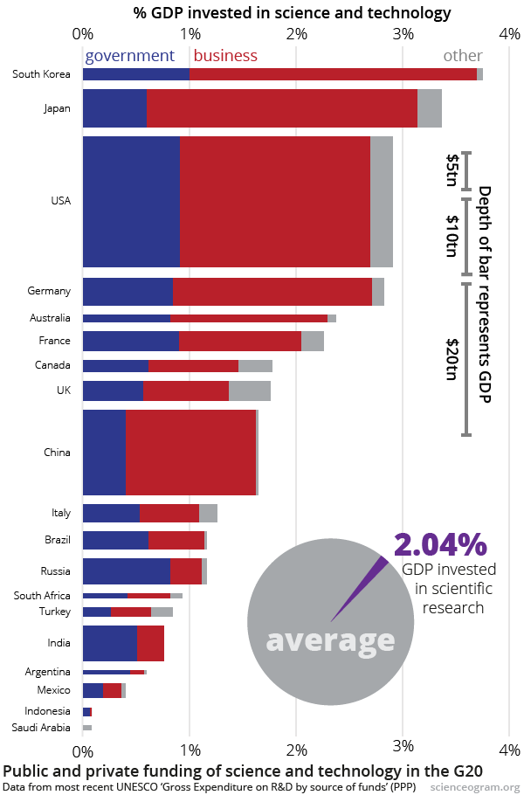
International Context
About 1/3 of psychologists are in the U.S., 1/3 in Europe, 1/3 elsewhere
U.S. funds about 1/3 of the world’s research budget

Slide 9
National Context
Graduates/year at U.S. institutions
  Psychology doctoral programs: 6,000
  Medical school: 18,000
  Nursing masters/doctoral programs: 26,000
  Law school: 45,000

Slide 10
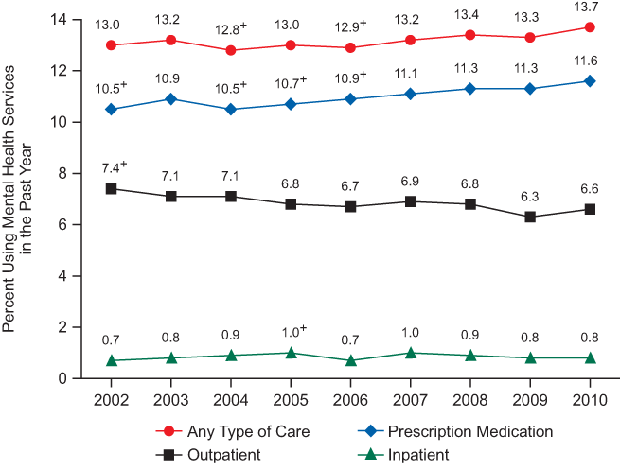
National Context
Public health problems – mental health

Slide 11
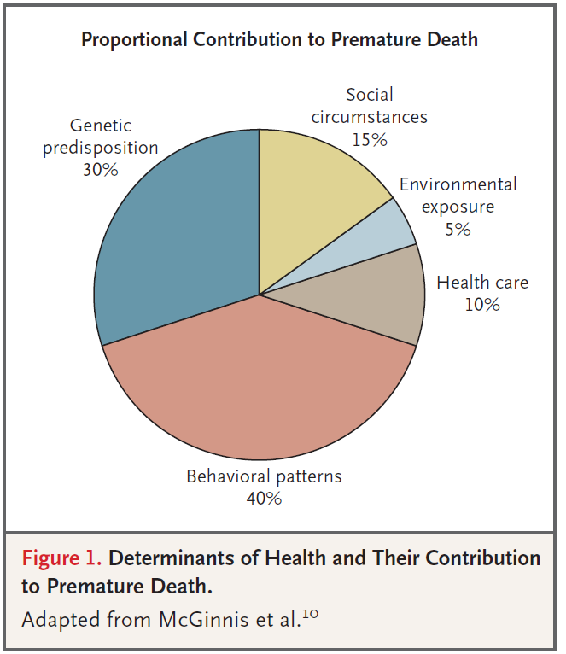
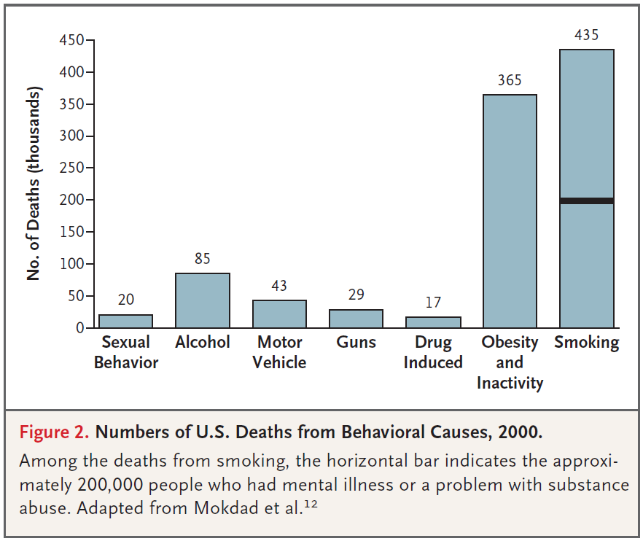
National Context
Public health problems – physical health
Schroeder, S. A. (2007). We can do better—improving the health of the American people. New England Journal of Medicine, 357, 1221‐1228.

Slide 12
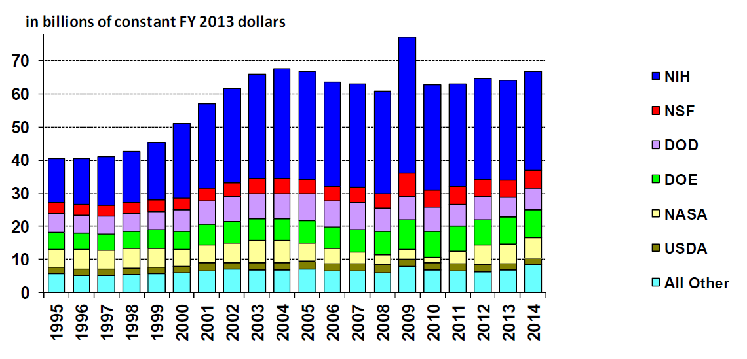
National Context
U.S Research Funding Trends

Slide 13
National Context
National Institutes of Health
Includes 27 institutes and centers
  National Cancer Institute, National Eye Institute, National Institute of Mental Health, National Institute of Child Health and Human Development
Many different types of research grants
  R01, R03/R21, K, T, F
  NIH Loan Repayment Program
    Pays off half of remaining student loan debt per year (up to $35,000/year) for those with doctorates devoting at least 50% of their time to research

Slide 14
National Context
Critique of NIH
  Disease-centric
  Too focused on treatment instead of prevention
  Too focused on biomedical markers (blood pressure, progression-free survival) rather than biopsychosocial outcomes people care about (longevity and well-being)

Slide 15
National Context
Affordable Care Act establishes the Patient-Centered Outcomes Research Institute (PCORI)
  Based on trusted priority statements, massive stakeholder input
  Includes scientists and stakeholders as reviewers
  Overarching focus on decision making
  5 priorities: “Person-centered” outcomes research, disparities, healthcare systems, communication/dissemination, and methodology
  About 20% of studies have a mental health focus, with many more examining health conditions with an important behavioral component (cancer, diabetes)
  Most assess some component of well-being (psych stuff)

Slide 16
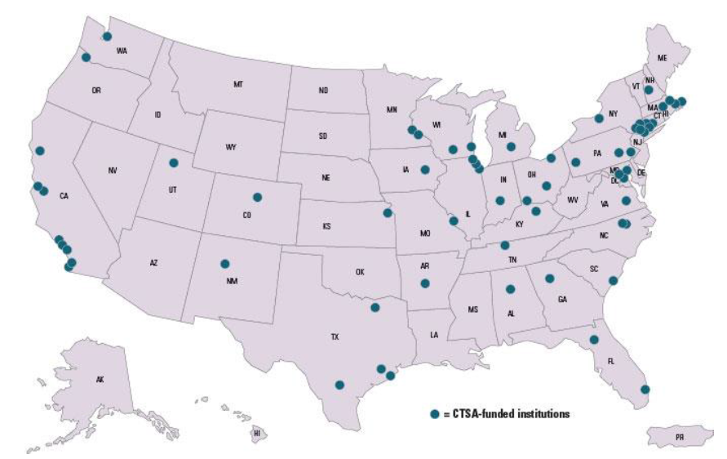
Regional Context
Focus on health research varies considerably across the country
Clinical and
Translational
Science Centers

Slide 17
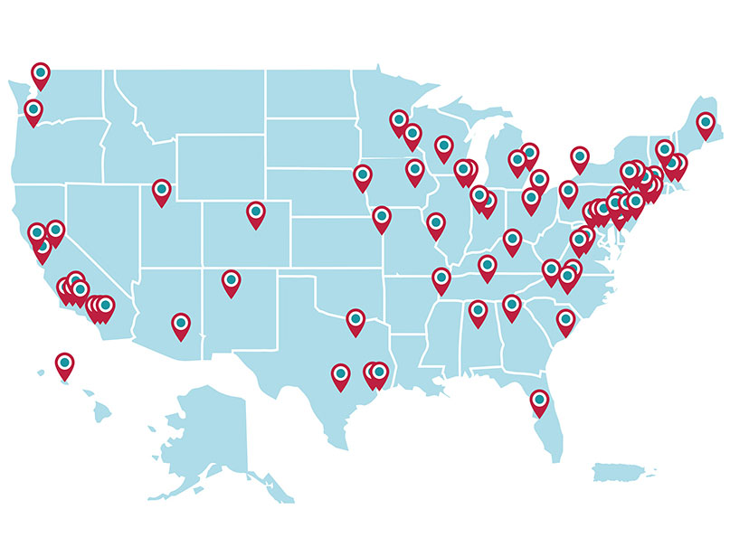
National Cancer Institute Comprehensive Cancer Centers

Slide 18
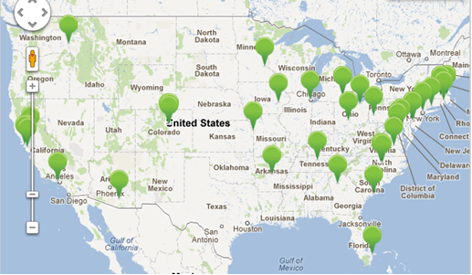
1st Round of PCORI funding

Slide 19
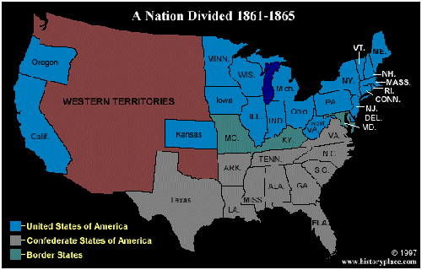

Slide 20
Regional Context
Louisiana Clinical and Translational Science (LA CaTS) Center
  Primary Institutions: Pennington Biomedical, Tulane,
  LSU HSC
  Affiliations with other LSU branches, Xavier, Children’s Hospital, Medical University of South Carolina
  Building infrastructure (mentorship, advising, consulting, pilot grants, training, regulatory support) needed to catalyze clinical and translational research in Louisiana
  Much of the research focused on cancer and obesity

Slide 21
Local Context
Tulane Psychology Department: Research (Oversimplified)
Kid stuff (School and Developmental)
  Baker, Cunningham, Gray, Lockman, Nastasi, Overstreet
Brain/behavior (Neuroscience)
  Colombo, Daniel, Dohanich, Golob, Markant*
Stereotypes and prejudice (Social)
  Molix, Murray,* O’Brien, Ruscher
Adult mental health
  Hoerger

Slide 22
Local Context
Other Opportunities
Department of Psychiatry and Behavioral Sciences: Drury, Scheeringa
Global Community Health and Behavioral Sciences: Seal, Taylor, Theall

