Slide 1
Science vs. Pseudoscience

Slide 2
Overview
Epistemology
Review pseudoscience video
Characteristics of science
Characteristics of pseudoscience

Slide 3
Epistemology (Ways of Knowing)
Authority
Logic
Life experience
Science
  Descriptive studies
  Observational studies (correlational studies)
  Experimental studies
    Walter Mischel’s impact

Slide 4
Science vs. Pseudoscience
What is the difference?
What are some examples of pseudoscience in the video clip?
Were there any you disagreed with?
How could disagreements be resolved?

Slide 5
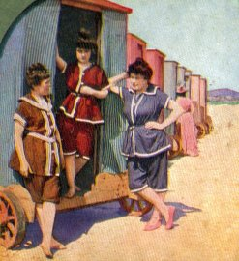
Characteristics of Science
Deterministic
Objective
Data-driven
Revisable

Slide 6
Pseudoscience
Literally “fake science”
Arguments appear scientific but lack convincing evidence
Grain of truth but exaggerated claims
Vague, often untestable
Uses reification

Slide 7
Science vs. Pseudoscience
Critique of these terms
Diagnoses to Consider
  Drapetomania, chlorosis, halitosis
  Multiple personality disorder → Dissociative identity d/o
  Manic-depression → Bipolar
  Hyperactive Child Syndrome → Minimal Brain Dysfunction → Hyperkinetic Reaction of Childhood → Attention Deficit Disorder (ADD) → Attention-Deficit/Hyperactivity Disorder (ADHD)
Treatments: Rebirthing therapy, Critical Incident Stress Debriefing (CISD), Eye Movement Desensitization and Reprocessing (EMDR)

Slide 8
What have these been used to treat?
Starving, blistering, bleeding, ice baths, spinning, tranquilizing chair, drowning, morphine, opium, straightjackets, sterilization, castration, eugenics, beatings, clitoridectomies, teeth pulling, removal of various body parts, coma therapy, seizure-induction, spinal fractures, electroshock, lobotomy

