Slide 1
POWER

Slide 2
Background
Power
  Ability to detect a statistically significant effect (p < .05)
Power Analysis (or Sample Size Analysis)
  Process of finding the sample size needed to determine that an effect is statistically significant
  Can be conducted a priori (prospectively) to choose a good sample size
  Can be conducted a posteriori (retrospectively, after the fact) to see whether an obtained sample size was sufficient

Slide 3
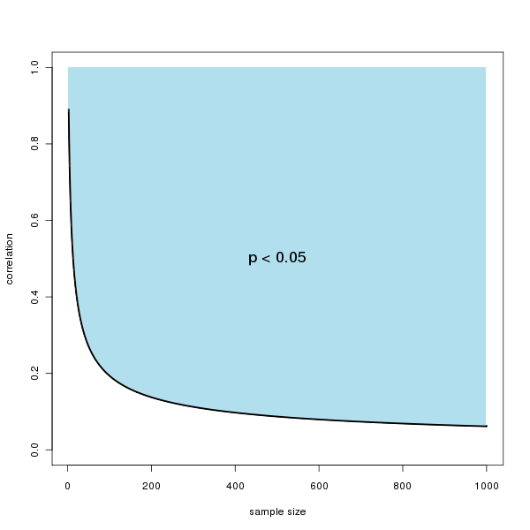

Slide 5
Why Power Matters
Most studies in psychology and medicine have been underpowered (too small of samples to detect effects as statistically significant)
Waste of…
  Tax dollars, charitable contributions, and tuition
  Time of researchers, research assistants, staff
  Time of research volunteers
Power analyses are relatively simple and produce better science

Slide 6
Factors Influencing Power
1. Rules for significance testing
  Alpha level of p < .05, two-tailed test
  Pretty uniform rules (no flexibility)
2. Observed effect size (e.g., d or r )
  Bigger → More likely to get a statistically significant result
  Depends on the real-world effect size (no flexibility)
  Depends on quality of measures & methods (of course, try to do these well)
3. Sample size
  Bigger → More likely to get a statistically significant result
  Unlike other factors, highly controllable!

Slide 7
Conducting Power Analysis
1. Set rules for significance testing (no flexibility)
2. Set the minimum effect size (e.g., d or r ) you personally define as important
  Would an r of .30 be important in your study? What about an r of .20? An r of .10?
3. Use a power calculator to see what sample size would be needed in order for that effect size to reach statistical significance

Slide 8
Online Calculators
Correlations
  http://vassarstats.net/tabs_r.html
  Put in the N and r values, see what it takes to reach statistical significance
Cohen’s d
  http://www.graphpad.com/quickcalcs/ttest1/?Format=SD
  Put in “1” for each SD and “0” for the Group Two Mean
  Put in the desired Cohen’s d for Group 1 Mean, see what it takes to reach statistical significance

Slide 9
Summary Information
r | Sample size needed for statistical significance
.10 | 385
.20 | 97
.30 | 44
.40 | 25
.50 | 16

Slide 10

Summary Information
r | Sample size needed for statistical significance
.10 | 385
.20 | 97
.30 | 44
.40 | 25
.50 | 16
With a bigger sample size, better able to detect
smaller effect sizes as statistically significant

Slide 11
Summary Information
r | Sample size needed for statistical significance
.10 | 385
.20 | 97
.30 | 44
.40 | 25
.50 | 16
Small effect
Medium effect

Slide 12
Summary Information
d | Sample size needed for statistical significance
.20 | 387
.30 | 174
.40 | 99
.50 | 64
.60 | 46
.70 | 34
.80 | 27

Slide 13
Summary Information
d | Sample size needed for statistical significance
.20 | 387
.30 | 174
.40 | 99
.50 | 64
.60 | 46
.70 | 34
.80 | 27
With a bigger sample size, better able to detect
smaller effect sizes as statistically significant

Slide 14
Summary Information
d | Sample size needed for statistical significance
.20 | 387
.30 | 174
.40 | 99
.50 | 64
.60 | 46
.70 | 34
.80 | 27
Small effect
Medium effect

Slide 15
“Rules of thumb”
What do you think of the following guidelines?
N = 200 for complex correlational models (factor analysis, structural equation modeling, anything that looks like an animal trap)
N = 20 per group in experimental psychology studies

