Slide 1
Professional Development (PD) #1:
Mentor/Job Searches

Slide 2
Overview
Searching
Selecting
Communication
  Email tips
  Applied persuasion
  Arranging introductions
Future PDs
  Getting into graduate school and alternatives
  CVs/resumes
  Interviewing

Slide 3
Finding Mentors/Jobs in Research
Tulane departmental websites (see also, first lecture)
  Psychology
NIH Reporter
Google Scholar and CVs
As a senior, setting your future should be a second (third?), full-time job
If these tips seem trivial, you do not understand
This information should supplement advising, graduate program books, career advice books

Slide 4

Qualities to Look for in a Mentor or an Institution
Public Health
Significance
Overlapping circles
Mentor/Institution’s RECENT
funding and publication record
Your
Interests
Mentor/Institution’s
Interests and Strengths

Slide 5
How to Write an Effective Email
RE: Clinical Psychology Ph.D. Program at Northwestern
-----------------------------------------------------------------------------
Dear Dr. Smith,
I am a senior psychology major at Tulane University
and hope to begin graduate study in clinical psychology
in the fall 2015 semester.
Are you currently accepting students with interests and
experience in personality research?
Thanks for your help,
Jane Doe
Tulane University

Slide 6
How to Write an Effective Email
RE: Research Assistant at WPIC?
-----------------------------------------------------------------------------
Dear Dr. Smith,
As a senior psychology major at Tulane University with experience conducting research on neuroimaging in depression, I am seeking a two-year post-Baccalaureate research assistantship beginning after April.
Would you be willing to meet by phone to discuss potential research opportunities at WPIC?
My CV is attached, and I would be happy to supply any other information that would be helpful. Thank you,
Jane Doe
Tulane University
-----------------------------------------------------------------------------
Attached: Doe_CV090414.pdf

Slide 7
Key Elements of an Effective Email
Do your homework. Make sure the answer to your question is not supplied on their web site
Succinct. Professors may get 10-500 emails per day. If your message is long, it may be ignored, or “saved for later” and forgotten
Formal
  Dear Dr. (not Hi Joe or Hey Ms. – unless your goal is to be offensive, or you have received permission to be less formal)
  Avoid exclamation points, smiley faces, ellipses, and sending a message with “high importance” (typically code for low importance)

Slide 8
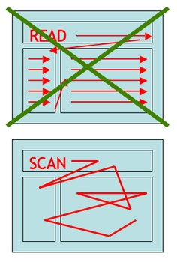
Key Elements of an Effective Email
RE:
  Stands for “Regarding:”
  Supplied by default upon reply,
  which may lead someone to think
  they’re interested in reading the
  email
File Name Formats
  Last name, topic, date
Visual Scanning

Slide 9
Foot-in-the-Door
Implemented when someone’s default response to what you want is likely to be “No,” but they might reconsider
Make a small request that is likely to get a “Yes”
Build up to a larger request over time
Can appear openly manipulative, and trigger reactivity, if the gap between the initial small request and the later large request is too great
Very useful for cold contacts
Example:
  You want a job or want to join someone’s lab. Begin by emailing simply for a meeting

Slide 10
Door-in-the-Face
Implemented when someone’s default response to what you want is likely to be “Yes,” and you’re hoping to get just a little more
Make a large initial request, just beyond what you believe they will agree to
Be ready to list off smaller and smaller requests (or list them immediately after, if you will be unable to give a split-second response)
Can appear foolish, immature, or entitled if the initial request is deemed too sizeable, or if used too frequently
Examples
  Very useful for contract negotiations, or other situations where someone likes you and is invested in you

Slide 11
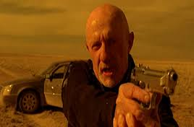
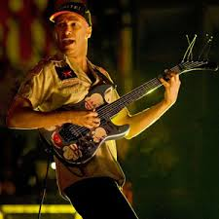
Communication Hierarchy
Cold contact, cold contact with name drop, direct referral, direct introduction, joint meeting
Take it easy
but take it
No more half
measures, Walter

