Slide 1
Measurement: Part 3

Slide 2
Overview
Background
PRIDE Skills
  Preparation: Looking into existing measures
  Response Options
  Item Stems
  Data Collection
  Evaluation
Developing a new scale
(scale = survey = test = measure)

Slide 3
Background
Scale development/selection = major strength of psychology
Major national priority (NIH, PCORI) for efficient use of research funds
Fecundity and not so difficult
  “It cost me two hours and a bottle of wine to write an aggression and a depression scale that turned out to be of equal or superior validity compared with much more sophisticated instruments”
  – Burisch (1984) American Psychologist

Slide 4
Preparation
Choose the construct, and establish content domain
Evaluate existing measures based on
  Measurement reliability
  Measurement validity
  External validity (generalizability to your sample)
  Item wording
Where to find measures
  Google scholar
  IPIP: http://ipip.ori.org/newIndexofScaleLabels.htm
  PROMIS: http://www.assessmentcenter.net/documents/InstrumentLibrary.pdf
  GEM: https://www.gem-beta.org/public/MeasureList.aspx?cat=2

Slide 5
Response Options and Item Stems
What if there are no credible existing measures? Develop your own, for one-time use or as a part of a scale development project
Response Option = pool of potential answers that participants may choose
Item Stems = items, statements, or questions
Usually need to consider these steps simultaneously

Slide 6
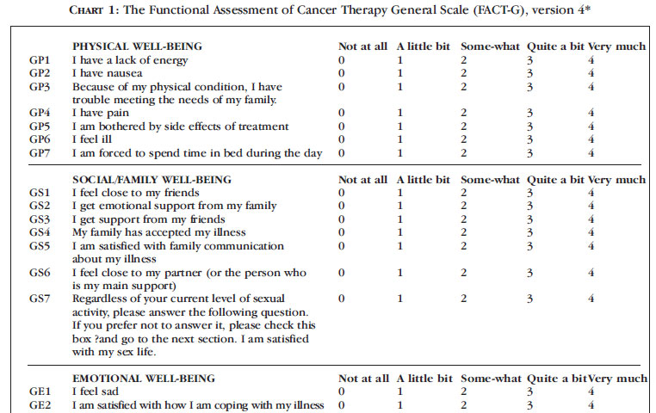
Response Options and Item Stems
Response Options
Item Stem

Slide 7
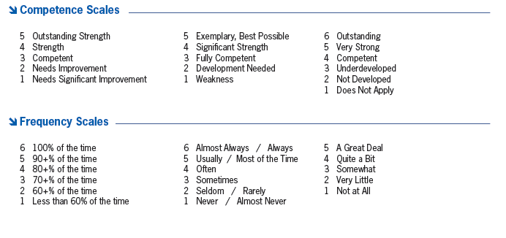
Response Options

Slide 8
Response Options

Slide 9
Response Options

Slide 10
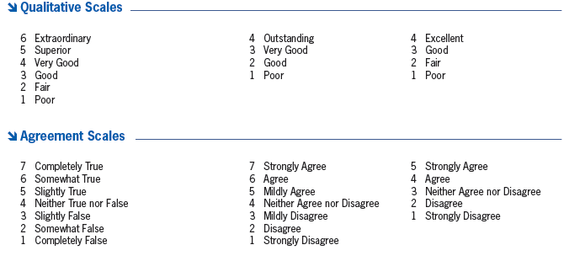
Response Options

Slide 11
Response Options

Slide 12
Response Options
(Not at all) 0 1 2 3 4 5 6 7 8 9 10 (Completely)
(Never) 0 1 2 3 4 5 6 7 8 9 10 (Always)

Slide 13
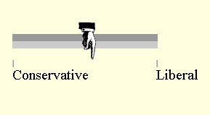
Response Options

Slide 14
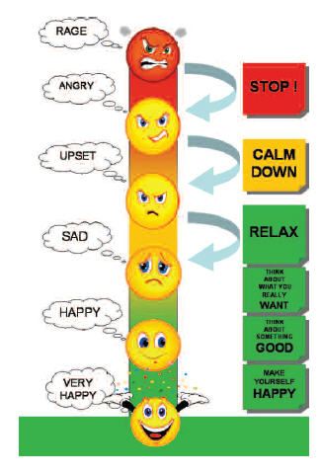
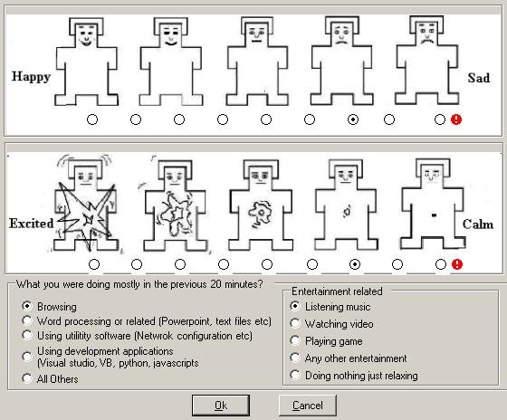
Response Options

Slide 15
Response Options
Goal
  Capture variability across participants. Thinking back, why?
Considerations
  Open-ended vs. closed-ended
    Closed-ended questions are today’s main focus
  Number of response options
    Too few = limited variability = less power = smaller effect size = less likely to find a statistically significant result
    Too many = potentially confusing, burdensome
    Odd vs. even number

Slide 16
Response Options
Rules
  Options should be mutually exclusive
  Anticipate all important possibilities
  Avoid presenting options that lack meaning
    “Other,” “Don’t Know,” “Unsure,” “Refused”
    Usually get discarded in analyses, reducing sample size and one’s power to reach statistically significant conclusions
  Avoid dichotomous questions where possible

Slide 17
Response Options
Tips
  Reduce respondent burden by using the same response options for as much of the survey battery as possible
  If interviewer administered, bring a card displaying the response options
    Can be more efficient, and very useful for sensitive questions where a verbal response might increase embarrassment or anxiety (e.g., prognosis, sexual functioning)

Slide 18
Item Stems
Cover each element of the content domain approximately equally
How many items?
  Usually need 5-7 “good” items per scale (or subscale) to yield adequate statistical properties
  More items is always better statistically, but carries significant tradeoffs (participant burden, dropout, disruption of the flow of care)

Slide 19
Item Stems
Rules
  Avoid terms that can be easily misunderstood, such as idiomatic expressions, technical terms, advanced vocabulary
    Microsoft Word provides the Flesch-Kincaid Grade Level, useful for literacy concerns

Slide 20
I have a lack of energy (2.4)
I have pain (0.0)
I have nausea (1.3)
I worry that my condition will get worse (3.7)
I am sleeping well (0.7)
I am able to enjoy life (2.4)
I am content with the quality of my life right now (3.7)
Considering all parts of my life – physical, emotional, social, spiritual, and financial – over the past two (2) days the quality of my life has been… (13.5)
Over the past two (2) days, when I thought about my life, I felt that my life to this point has been… (5.8)
Over the past two (2) days, when I thought about my whole life, I felt that in achieving life goals I have…. (6.9)

Slide 21
Item Stems
Rules
  Avoid complex or double-barreled questions
    How often would you say your doctor takes the time to listen to your concerns?
    If a problem developed at night or on the weekend, was there a member of the health care team who was available and who was familiar with (patient)?
    Do you have an unmet need to discuss… fear of pain?
    How would you rate the courtesy and efficiency of our receptionist?
    How would you rate your pain and stiffness?
    Go to a favorite concert, play, or sporting event and study less for this course even though it may mean getting a lower grade on an exam you will take tomorrow OR stay home and study to increase your chances of getting a higher grade?

Slide 22
Item Stems
Tips
  Pilot testing to ensure that items are clear and appropriately sensitive to literacy, health conditions, and emotional concerns
  If doing a scale development project
    Ideally include 2-3 times as many items as needed so that the items that are the worst statistically can be dropped in the final version

Slide 23
Response Options and Item Stems
Positivity Bias
  Tendency to provide inflated, favorable evaluations
  Common in medical and educational settings
  “Ceiling effects” = all/mostly very high scores
    Limited variability, so scores will not relate to anything else
    Scores cannot improve in response to intervention
  Importance of carefully considering item stem and response wording, pilot work, validation work
  Fundamental problem in contemporary clinical research

Slide 24
Data Collection
Formats: Paper, internet (prior lectures), interview, phone
Standardization across interviewers and research assistants
  Pleasant + neutral
If conducting a scale development project
  Important to include measures of related constructs and other important criteria
  Larger samples are better (n = 200)
  Seek samples with variability in the construct

Slide 25
Evaluation
Reliability and Validity (see prior lectures)
Item Properties (especially for scale development projects)
  Means
    Should vary across items: Most in middle, some high, some low
    Avoid ceiling and floor effects, where the majority of responses are “too high” or “too low”
  Standard Deviations (variability)
    More variability is better: Can’t have covariation without variation
  Item-Total Correlations
    Each item should probably correlate r = .20 or higher with total scale scores; best items usually correlate r = .50

