Slide 1
Measurement: Part 2

Slide 2
Overview
Measurement Validity
  Face Validity (non-statistical)
  Content Validity (mostly non-statistical)
  Construct Validity (convergent validity, discriminant validity, incremental validity)
  Criterion Validity (concurrent validity, predictive validity, incremental validity)
Other Validities
  Internal Validity
  External Validity
  Statistical Conclusion Validity

Slide 3
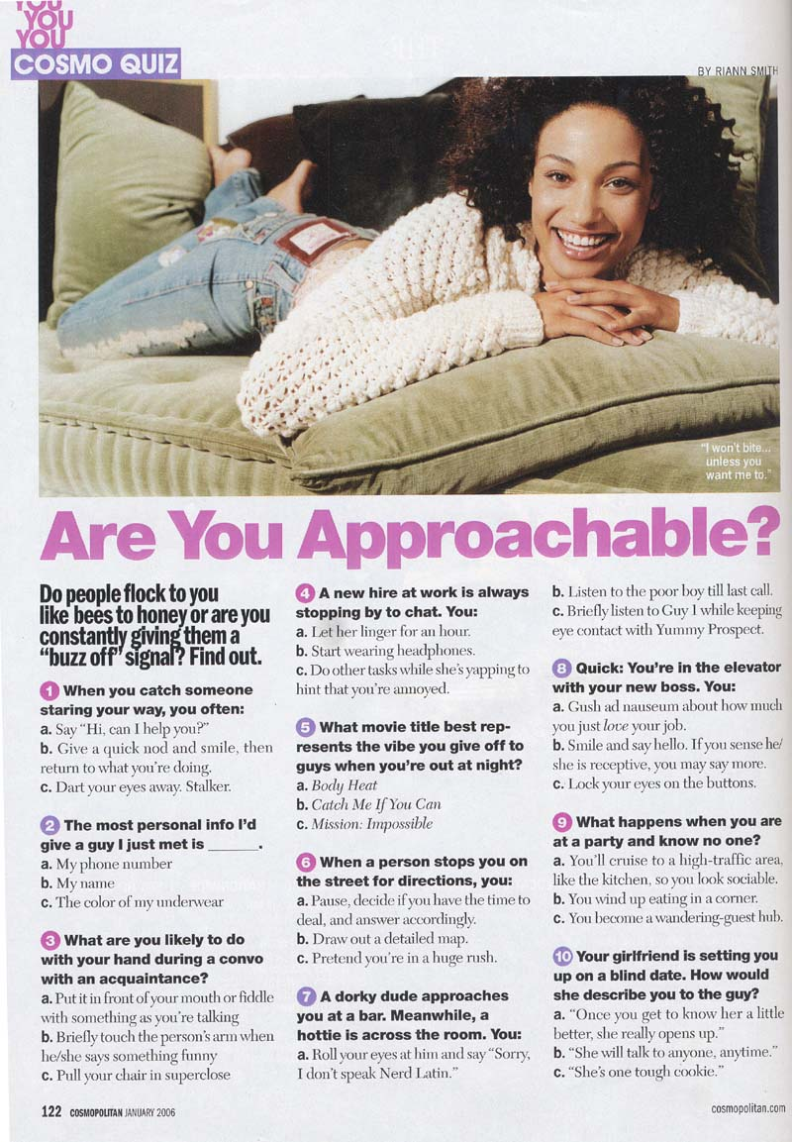

Face Validity
Does the measure appear to assess
the construct?
Very subjective, nothing statistics
PHQ-9 Depression Screener
  Over the past two weeks, did you
  have thoughts you would be better
  off dead or of hurting yourself in
  some way?
MMPI – Somatization
  Do you often feel like you have a tight
  band around your head?

Slide 4
Content Validity
Does a measure cover the breadth of the content domain?
  Content domain = all important elements of a construct
    9 symptoms of depression
    5 domains of personality (neuroticism, extraversion, openness, agreeableness, conscientiousness)
    5 areas of delay of gratification (see next slide)
    How many areas of quality of life?
Poor content validity means the study is assessing a somewhat different construct than intended
Impacts interpretation of findings, explains inconsistencies across measures

Slide 5
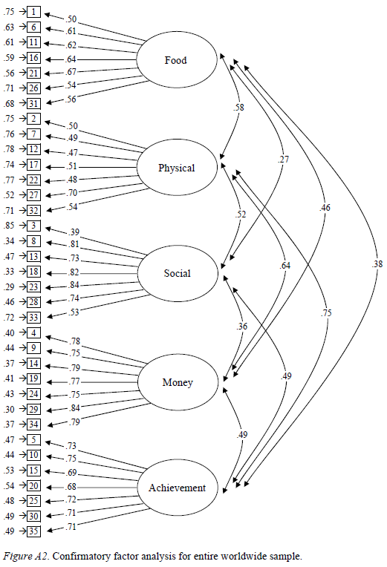
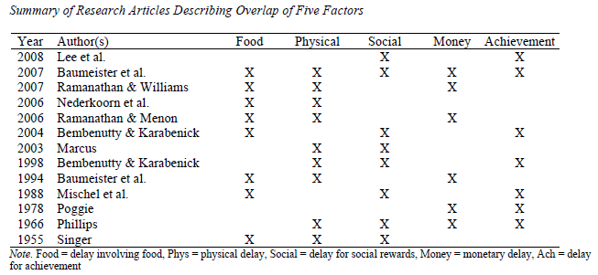

Slide 6
Construct Validity
Is there evidence the measure has theoretically-meaningful associations with other measures?
Does it have convergent and discriminant validity?
  Convergent validity: Scores on the measure correlate with scores on similar measures
  Discriminant validity: Scores on the measure lack correlations with dissimilar measures

Slide 7
Good Construct Validity
Measure | EI-Tulane
EI-SREIS | r = .82
EI-TEUQue | r = .73
EI-SEI | r = .78
Neuroticism | r = -.18
Extraversion | r = .13
Openness | r = .08
Agreeableness | r = .03
Conscientiousness | r = .14
IQ | r = .37
Social Desirability | r = .11
SES | r = .23

Slide 8
Bad Construct Validity – Why?
Measure | EI-Tulane
EI-SREIS | r = .32
EI-TEUQue | r = .23
EI-SEI | r = .28
Neuroticism | r = -.18
Extraversion | r = .13
Openness | r = .08
Agreeableness | r = .03
Conscientiousness | r = .14
IQ | r = .27
Social Desirability | r = .11
SES | r = .13

Slide 9
Bad Construct Validity – Why?
Measure | EI-Tulane
EI-SREIS | r = .82
EI-TEUQue | r = .73
EI-SEI | r = .78
Neuroticism | r = -.68
Extraversion | r = .63
Openness | r = .08
Agreeableness | r = .03
Conscientiousness | r = .64
IQ | r = .77
Social Desirability | r = .51
SES | r = .63

Slide 10
Criterion Validity
Is there evidence the measure is associated with important outcomes?
  Criteria = outcomes, so essentially outcome validity
Concurrent validity = evidence from cross-sectional studies
Predictive validity = evidence from longitudinal studies
Thinking back to prior lectures, which is better and why?

Slide 11
Good Criterion Validity
Measure | EI-Tulane
Undergrad GPA | r = .27
Job Performance | r = .25
Relationship Satisfaction | r = .44
Physical Health | r = .20
Mental Health | r = .38

Slide 12
Incremental Validity
Refers to whether one measure yields stronger associations than another similar measure
Could support construct validity (especially convergent validity) or criterion validity

Slide 13
Good Incremental Validity
Measure | EI-Tulane | EI-SREIS
EI-TEIQue | r = .73 | r = .63
EI-SEI | r = .78 | r = .68
Neuroticism | r = -.18 | r = -.18
Extraversion | r = .13 | r = .13
Openness | r = .08 | r = .08
Agreeableness | r = .03 | r = .03
Conscientiousness | r = .14 | r = .14
IQ | r = .37 | r = .37
Social Desirability | r = .11 | r = .11
SES | r = .23 | r = .23
Measure | EI-Tulane | EI-SREIS
Undergrad GPA | r = .27 | r = .17
Job Performance | r = .25 | r = .15
Relationship Satisfaction | r = .44 | r = .34
Physical Health | r = .20 | r = .10
Mental Health | r = .38 | r = .28
Supporting Construct Validity Supporting Criterion Validity

Slide 14
Other Validities
Measurement Validity = how well a measure measures what it’s supposed to (how well a measure operationalizes a construct)
Other Validities
  Internal Validity = Strength of causal inferences
  External Validity = Generalizability across people, places, and time
  Statistical Conclusion Validity = Accuracy in interpreting statistical results (p-values, effect sizes, etc.)

