Slide 1
Measurement: Part 1

Slide 2
Overview
Background
Scales of Measurement
Reliability
Validity (next time)

Slide 3
Background
Measurement: Process of quantifying human characteristics (sometimes called psychometrics)
Long-standing strength of psychology (IQ, personality), recent emphasis in health (e.g., PCORI)
Necessary for evaluating measures and research
Variables can be understood at two levels
  Construct: theoretical concept, not directly observable (e.g., psychopathy, marital satisfaction, intelligence)
  Operational Definition: Concrete method of assessing a construct
Major methods: Tests and surveys, behavioral observation, and physiologic measures

Slide 4
The Basics: Scales of Measurement
Scale | Categorical/Nominal/Discrete |  | Continuous/Quantitative
 | Multicategorical / Polytomous | Binomial*/ Dichotomous | Ordinal | Interval | Ratio
Examples | Geographic region, Race, Major, Favorite music genre | Gender?, Yes/no status on anything | Any rankings (college, popularity) | Intelligence, Openness, Resilience, Shame | Age, Time, # of health conditions
(1) Rank Order: Numbers have meaning |  |  | X | X | X
(2) Equal Intervals: Differences in scores reflect comparable differences in the construct across the range of scores |  |  |  | X | X
(3) True Zero: Score of zero indicates that absence of the construct |  |  |  |  | X
* Usually, rank is considered arbitrary for dichotomous variables,
though sometimes these variables are treated as continuous in statistical analyses

Slide 5
Scales of Measurement
Implications for Analyses (Tough for beginners)
  Two continuous variables: correlation
  Dichotomous and continuous variable: t-test
  Polytomous and continuous variable: ANOVA
  Type of data always dictates the type of analysis, can be easy (above) or complex (many other statistics)
Implications for Scale Development/Interpretation
  Continuous vs. artificially dichotomized/polytomized variables
  Choice of response options for categorical variables
  Choice of response options for continuous variables

Slide 6
Psychometrics
Measurement Reliability = consistency across measurements
  Opposite of measurement error
  Several types: Split half, internal consistency, parallel forms, test-retest, inter-rater
Measurement Validity = how well a measure measures what it’s supposed to (how well a measure operationalizes a construct)
  Several forms: Face, content, construct (convergent, discriminant, incremental), criterion (concurrent, predictive)
Other Validities: Internal, external, statistical conclusion

Slide 7
Split-half Reliability
How well scores on one half of the test correlate with scores on the other
First half correlated with second half; odds with evens, etc.
Problem: Many ways to split a test in two, and different splits yield different correlations

Slide 8
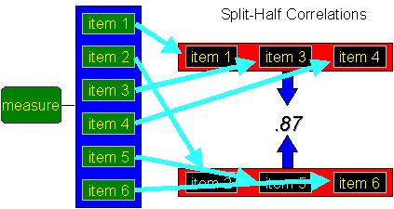

Slide 9

Internal-Consistency Reliability
Cronbach’s alpha (α)
  Average correlation of all possible split-halves (corrected for loss of scale length due to halving)
  Increases as inter-item correlations increase (items correlate well with each other), and increases as the length of the measure increases (errors cancel out)
  Common descriptors:
  Unacceptable < .50 Acceptable .70-.79
  Poor .50-.59 Good .80-.89
  Fair .60-.69 Excellent .90+

Slide 10
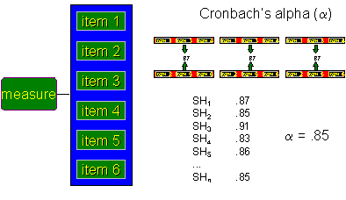

Slide 11


Slide 12
Other Reliabilities
Parallel forms
  Correlation between multiple forms of the same measure (e.g., SAT, GRE, MCAT, neuropsych test)
Test-retest
  Longitudinal correlation between same measure
  Mood vs. personality vs. cognitive skills
Inter-rater
  Correlate scores from two or more different raters
  Measure of agreement or consensus
  Behavioral observations, informant data, health records, clinician ratings/diagnoses

