Slide 1
Developing and Evaluating Research Ideas

Slide 2
Overview
Generating research ideas
  Scientific method and critique
  Ideas from theory
  Ideas from other sources
Evaluating research ideas
  Significance vs. Innovation
  PCORI examples

Slide 3
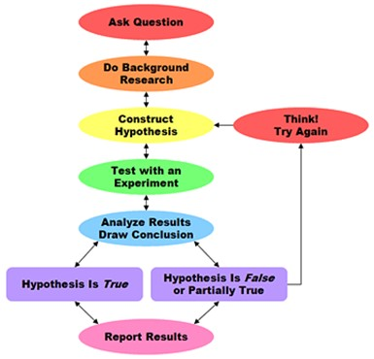
Scientific Method
Intro Psych and every other science
textbook that ever existed
Theory: Framework based on
logic and prior research
Hypotheses: Specific predictions
Design + Run the Study
Analyze and Report Results
Revise and Expand Theory

Slide 4

“But it is time to insist that science does not progress through carefully designed steps called ‘experiments,’ each of which has a well-defined beginning and end.” - Skinner

Slide 5
Sources of Ideas
Theory: Need to have an excellent command of the relevant literature. Shortcuts…
  Search for “review”
  Find a good-but-old article, and check who is citing it
  Check these sources:
    APA journals and special issues
    American Psychologist – Flagship journal of the APA
    Psychological Review – Theoretical articles
    Psychological Bulletin – Review articles, often meta-analyses
  Check “future directions” section of relevant articles

Slide 6
Other Sources of Ideas
National Priority Statements
  PCORI: Priorities + methods
  Institute of Medicine (IoM): List of 975 + downloads
  NIH Science of Behavior Change report
Other Researchers
  Project team (lab) meetings
  Grants websites: NIH, NSF, PCORI
Existing data
Clinical observation
Exploration

Slide 7
Evaluating Research Ideas
When developing studies, evaluating term papers and manuscripts, evaluating publications, evaluating grants
Significance = importance for societal health and well-being
  Number of people affected
  Severity of the problem
  Ability to solve the problem
Innovation = novelty
  “First study”
  New context, method, population
  Potential for a scientific breakthrough, rapid uptake
Practice examples

