Slide 1
Experiments: Part 5

Slide 2
Notation Examples
Factors? Levels? Conditions?

Slide 4
Main Effects and Interactions
Factor Matrices
Line Graphs
Bar Graphs

Slide 5
Is CBT or psychodynamic therapy better for depression?
(Assume a 2-pt difference on the BDI is statistically significant)
 |  | Personality Type
 |  | Open-minded | Avoidant
Therapy | CBT | 25 | 24 | 24.5
 | Dynamic | 24 | 26 | 25.0
 |  | 24.5 | 25.0

Slide 6
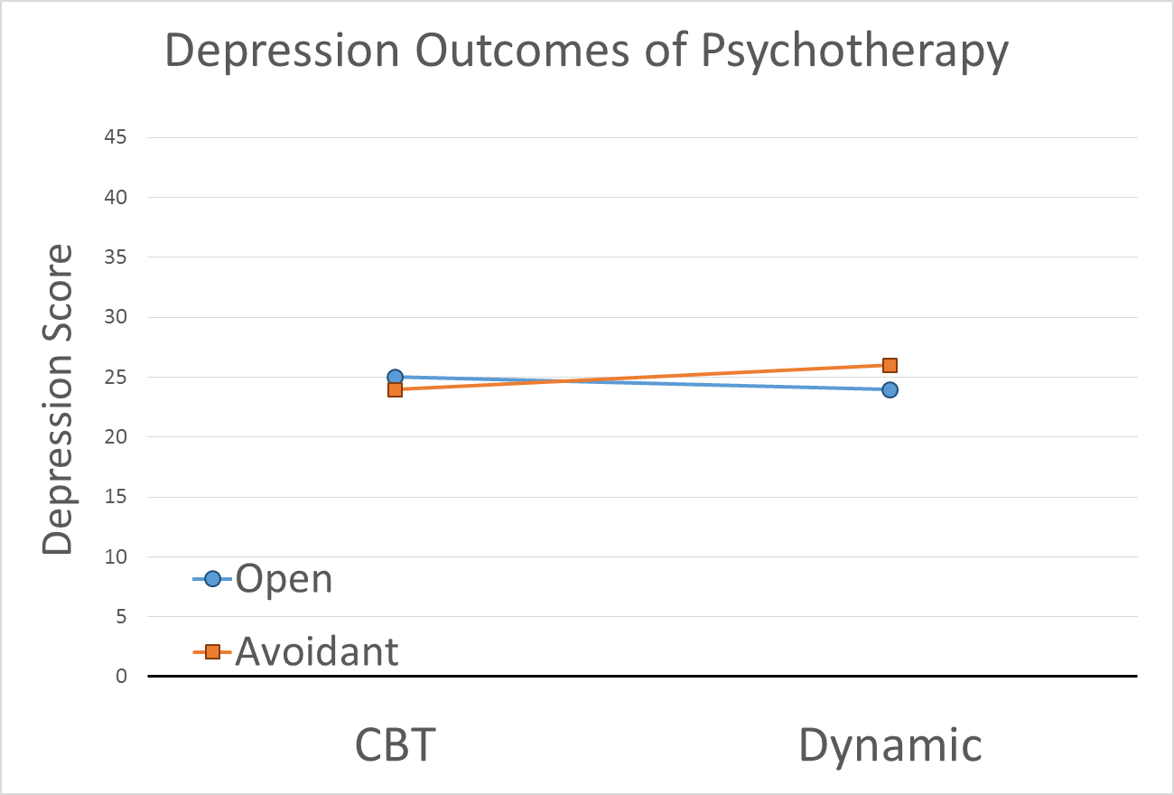

Slide 7
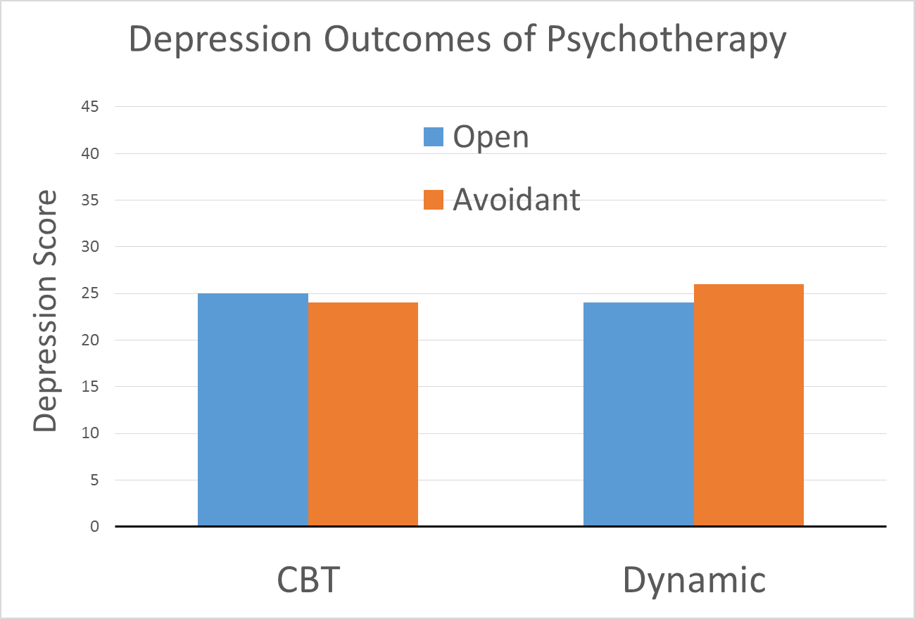

Slide 8
Is CBT or psychodynamic therapy better for depression?
(Assume a 2-pt difference on the BDI is statistically significant)
 |  | Personality Type
 |  | Open-minded | Avoidant
Therapy | CBT | 12 | 13 | 12.5
 | Dynamic | 24 | 26 | 25.0
 |  | 18.0 | 19.5

Slide 9
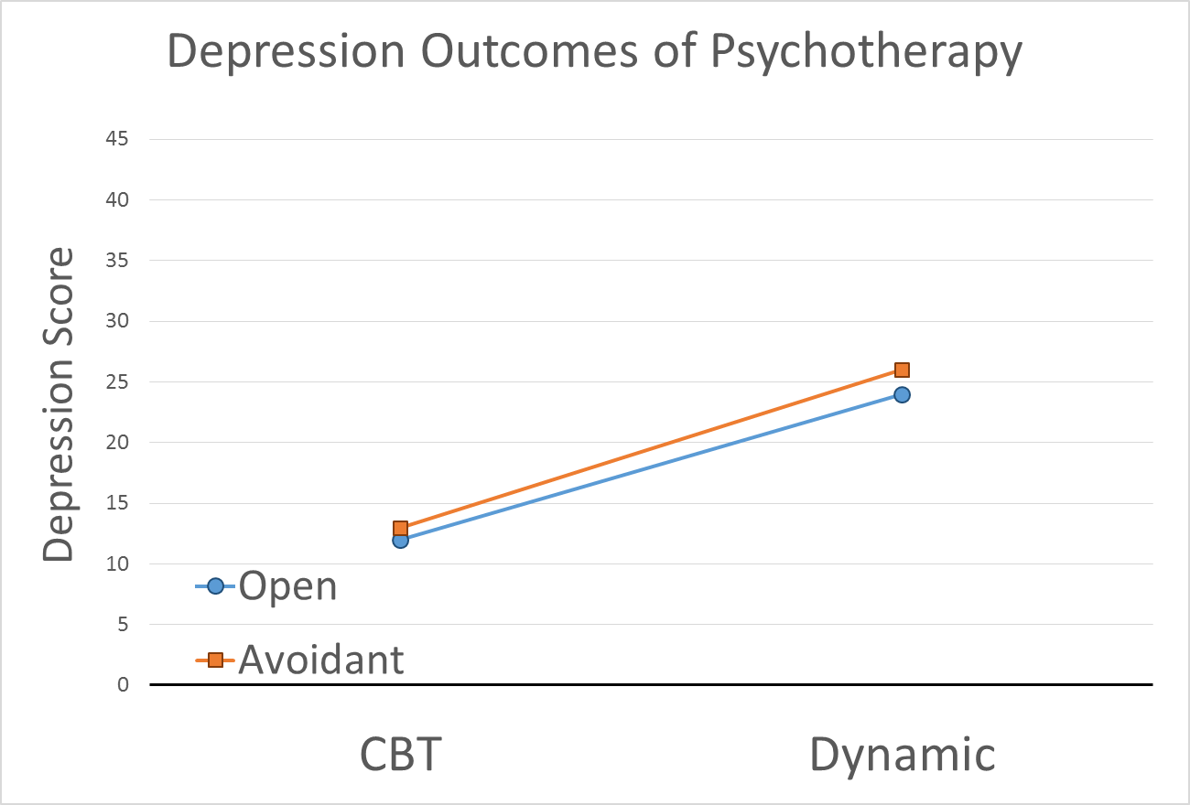

Slide 10
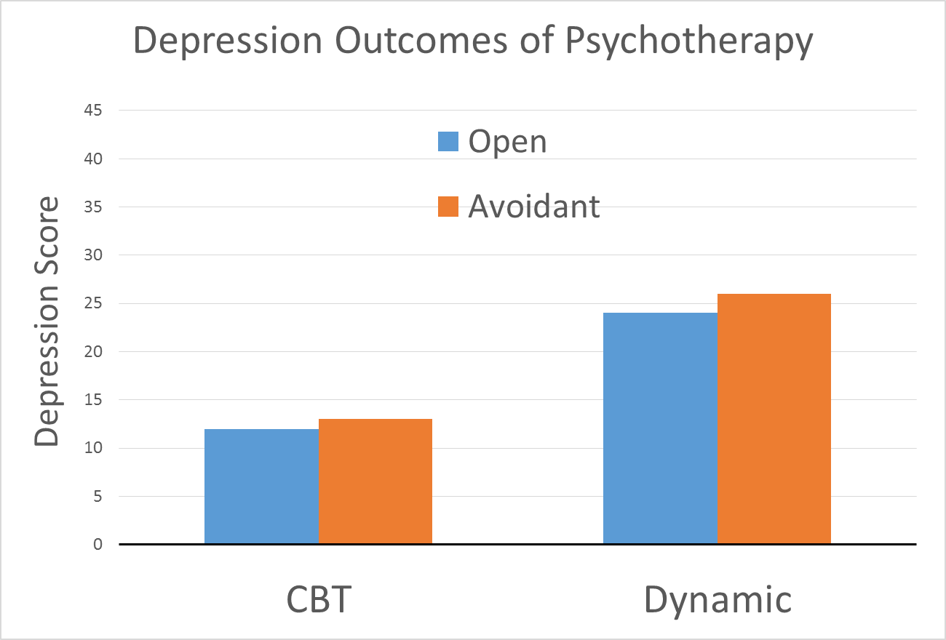

Slide 11
Is CBT or psychodynamic therapy better for depression?
(Assume a 2-pt difference on the BDI is statistically significant)
 |  | Personality Type
 |  | Open-minded | Avoidant
Therapy | CBT | 12 | 38 | 25.0
 | Dynamic | 12 | 37 | 24.5
 |  | 12.0 | 37.5

Slide 12
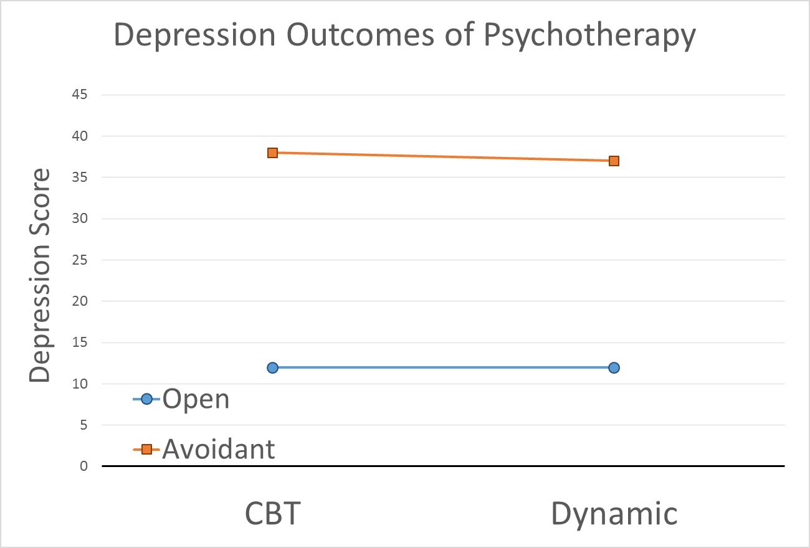

Slide 13
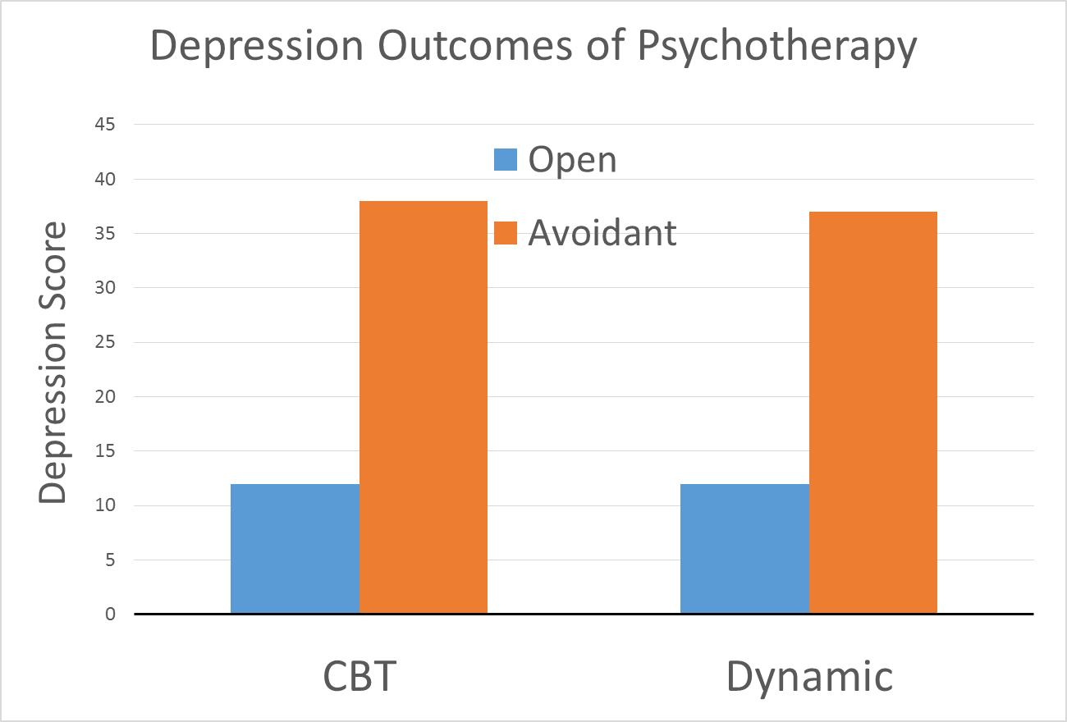

Slide 14
Is CBT or psychodynamic therapy better for depression?
(Assume a 2-pt difference on the BDI is statistically significant)
 |  | Personality Type
 |  | Open-minded | Avoidant
Therapy | CBT | 40 | 17 | 28.5
 | Dynamic | 15 | 41 | 28.0
 |  | 27.5 | 29.0

Slide 15
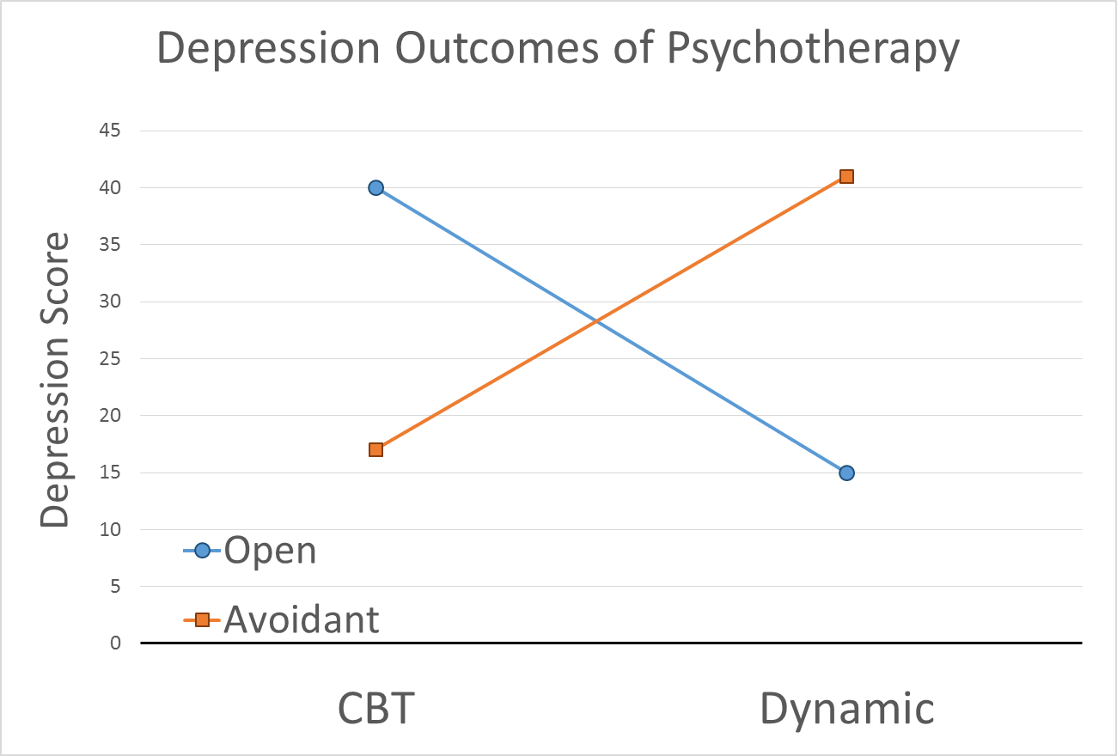

Slide 16
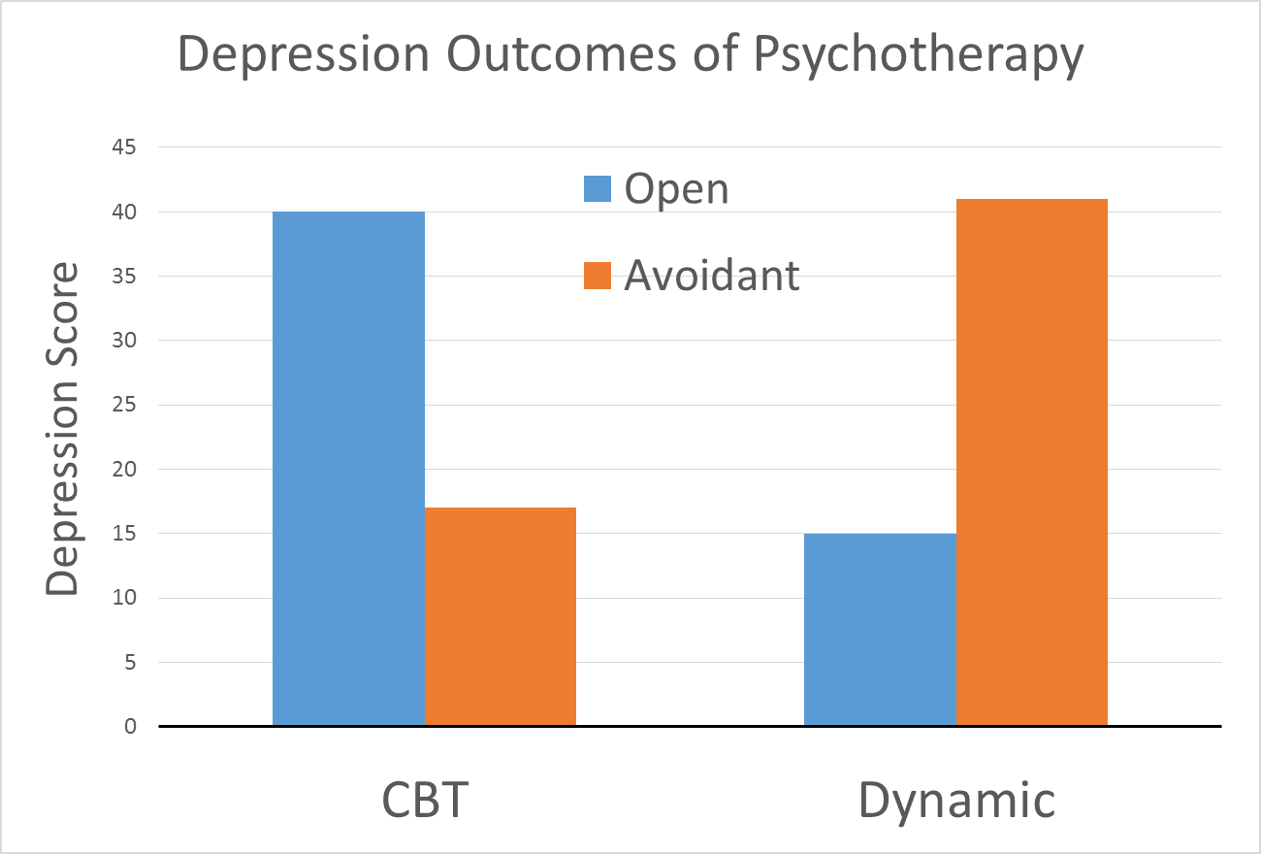

Slide 17
Is CBT or psychodynamic therapy better for depression?
(Assume a 2-pt difference on the BDI is statistically significant)
 |  | Personality Type
 |  | Open-minded | Avoidant
Therapy | CBT | 29 | 34 | 31.5
 | Dynamic | 6 | 43 | 24.5
 |  | 17.5 | 38.5

Slide 18
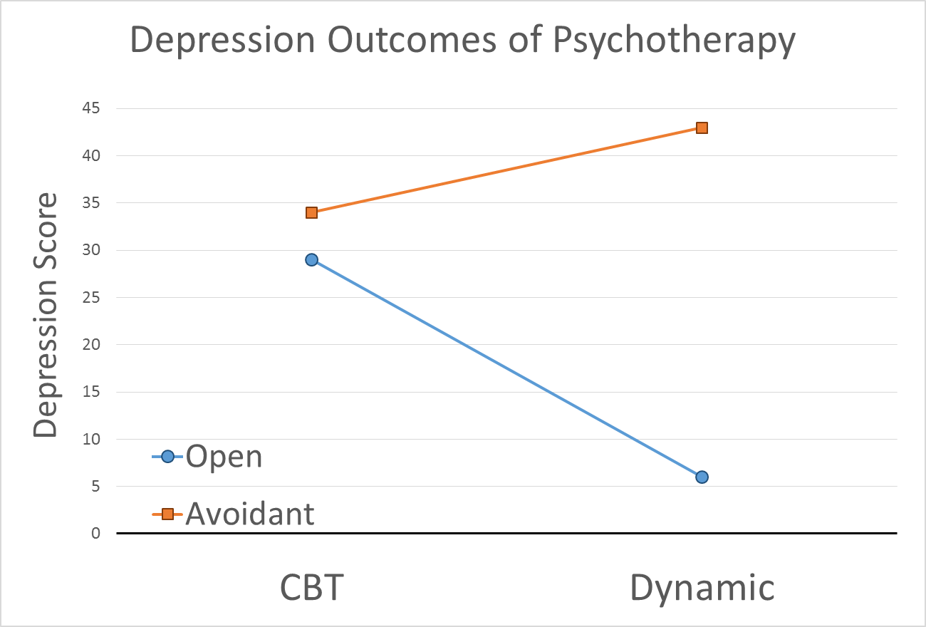

Slide 19
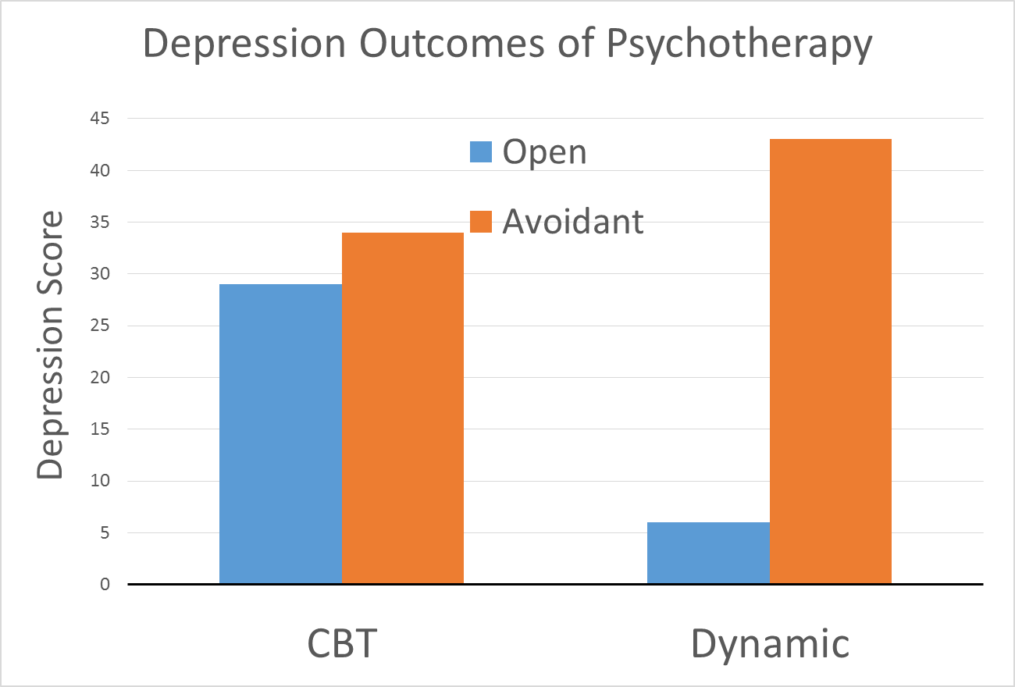

Slide 20
Are loud obnoxious commercials more effective than typical commercials in affecting consumer behavior?

