Slide 1
Correlations: Part II

Slide 2
Overview
Interpreting Correlations: p-values
Challenges in Observational Research
  Correlations reduced by poor psychometrics (reliability and validity)
    Combining measures
  Individual predictors often weak
    Multiple regression
  Correlation ≠ causation
    Directionality and 3rd-variable problems
    Causal inference
    Advanced topics: Standardized betas (β) , mediation, moderation
    Beyond causation: Prediction and description

Slide 3
Interpreting Correlations
Correlation coefficient
  Magnitude
    Clinical significance, real-world significance, public health significance
  p-value
    Probability of observing an association of a particular magnitude when no real-world relationship exists
    More simply: Probability the result is due to sampling error
    Even more simply: Probability the result is due to chance
    p < .05 means statistically significant, trustworthy, reliable, not due to chance

Slide 4
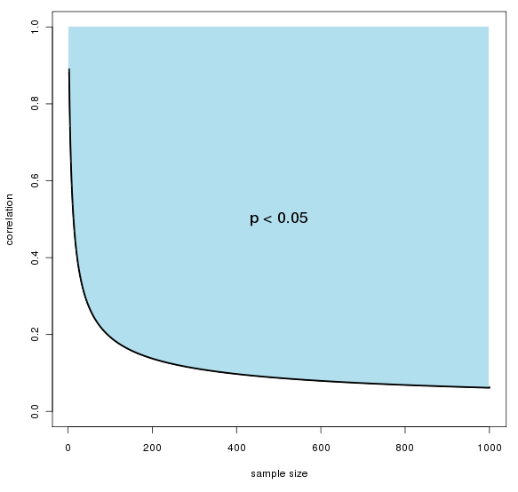
Statistical Significance
Depends on the
observed effect
(magnitude of the
correlation)
Depends on the
sample size

Slide 5
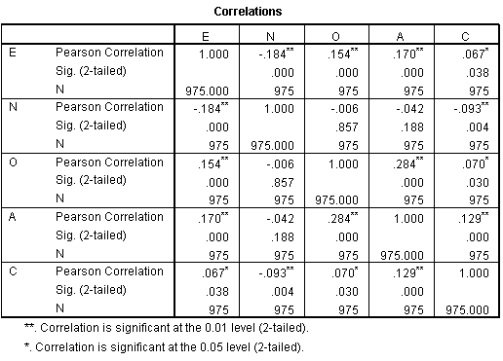

Slide 6
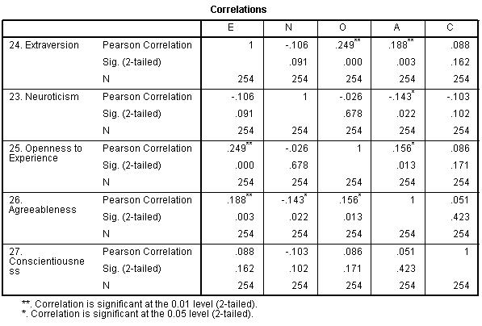

Slide 7
Challenges Encountered in Observational Research
Correlations reduced by poor psychometrics (reliability and validity)
Individual predictors often weak
Correlation ≠ causation

Slide 8
Challenges Encountered in Observational Research
Correlations reduced by poor psychometrics (reliability and validity)
  Use/make better measures (next unit)
  Combine measures
Individual predictors often weak
  Multiple regression
Correlation ≠ causation
  Methods for improving causal inferences
  Prediction is fun too

Slide 9
Combining Measures
Any given item (or measure or indicator) has error
Can reduce overall error by combining items, measures, indicators
Many different ways
  Complex: Many varieties of factor analysis
  Elegant: Summated scale scores (add them)

Slide 10
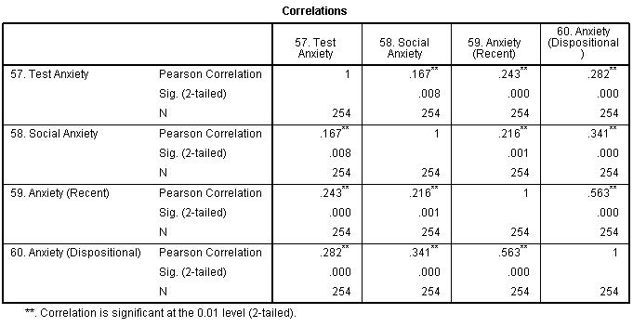

Slide 11
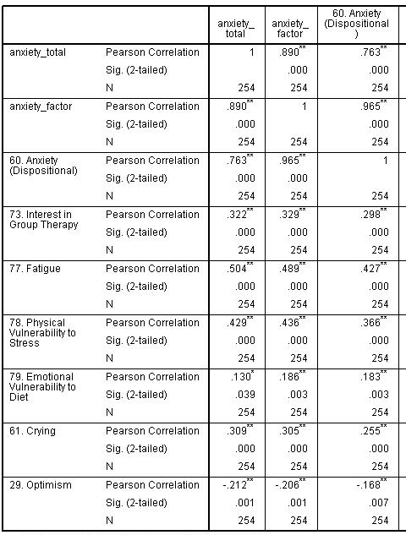

Slide 12
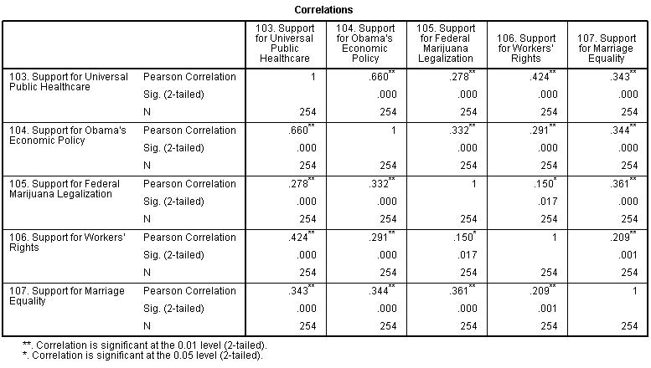

Slide 13
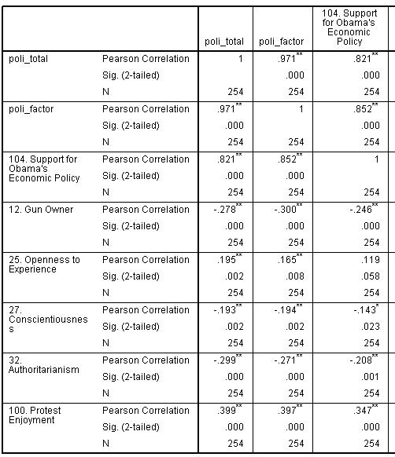

Slide 14
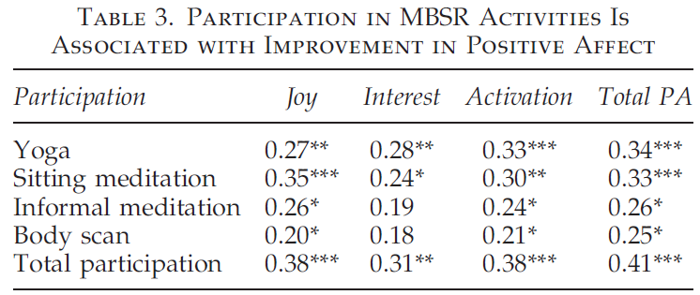

Slide 16

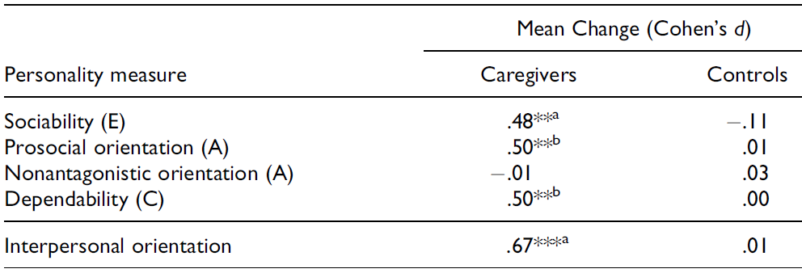
This a different statistic than r,
but the same rules apply

Slide 18

DOESN’T KNOW
FACTOR ANALYSIS
STILL DOES HER JOB
Summated
Scale Scores

Slide 19


Multiple Regression
Single predictors often weak
Human behavior is often multidetermined
Can be used to examine how well several different independent variables combine to predict a single
dependent variable of interest
  When to use this versus
  summated scale scores?
R
r

Slide 20
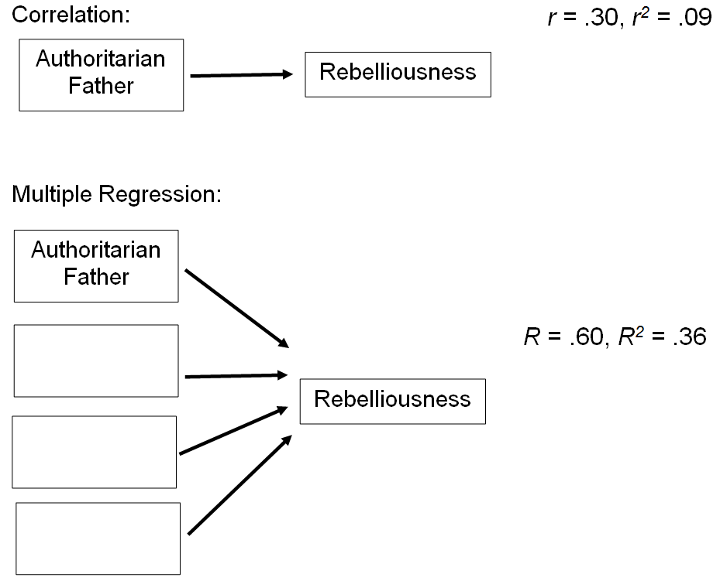

Slide 21
One predictor… not bad

Slide 22
Try finding some more predictors…

Slide 23
Now put them in a multiple regression…

Slide 25
Correlation ≠ Causation
Mantra of Psyc 1000
Directionality problem
3rd-variable problem
  AKA Confounding
Education
Level
r = -.20
Depression
Symptom
Severity

Slide 26
Correlation ≠ Causation
Education
Level
r = -.20
Depression
Symptom
Severity

Slide 27
Correlation ≠ Causation
Education
Level
r = -.20
Depression
Symptom
Severity

Slide 28
Correlation ≠ Causation
Education
Level
r = -.20
Depression
Symptom
Severity

Slide 29
Correlation ≠ Causation
Education
Level
Parental
SES
r = -.20
Depression
Symptom
Severity

Slide 30
Correlation ≠ Causation
Pot
Smoking
r = .20
Ice Cream
Eating

Slide 31
Causal Inference
Ability to infer (assert) causation exists on a continuum
Requirements for Causation
  Internal validity: Rule out 3rd variables (alternative explanations)
  Temporal precedence
Also helpful
  Stronger associations
  Theoretically plausible
  Corroborating experimental evidence

Slide 32
3rd–Variable Problem
Methodologic Control
  If worried about a 3rd variable, control for it in your sample (e.g., if worried about SES, only study doctors)
Measure 3rd Variables
  Measure potential confounders to show they are not correlated with the variables you wish to study
Statistically Control for 3rd Variables
  Easy peasy. Many statistical techniques for doing this (e.g., partial correlations, ANCOVA), but we’ll just use regression
  Only works well if the potential confounder was measured well (breast milk example)

Slide 33
Statistical Control in Regression

Slide 34
Statistical Control in Regression
Imagine that cigarette smoking across the lifespan is correlated with physical health at age 60 (r = -.40)
If you were a cigarette company, what third variables might you blame?
Alcohol use, extraversion, income, education level, poor coping skills
Do a multiple regression and find that smoking is still associated with physical health even after controlling for those variables (β = -.37, p < .001)

Slide 35
Temporal Precedence
Cross-sectional vs. longitudinal study
  Prospective vs. retrospective study
Education
Level
T1
Education
Level
T2
Depression
Symptom
Severity T1
Depression
Symptom
Severity T2

Slide 36
Temporal Precedence
Education
Level
T1
Education
Level
T2
Depression
Symptom
Severity T1
Depression
Symptom
Severity T2

Slide 37
Temporal Precedence
Education level at T1 predicts Depression at T2, while controlling for Depression at T1.
More or less, Education level at T1 predicts changes in depression.
Education
Level
T1
Education
Level
T2
β = .03
β = .21
Depression
Symptom
Severity T1
Depression
Symptom
Severity T2

Slide 38
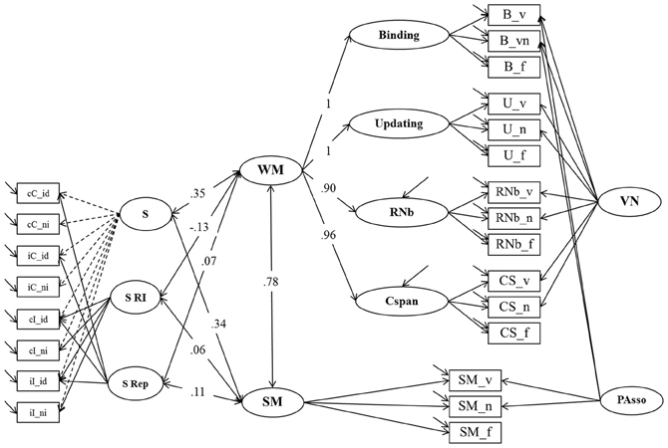

Slide 39


Slide 40
Mediation
Rather than examining how A causes B, focuses on a causal chain: A causing B causing C…
Education
Level
T1
Child Depression
Symptom Severity
T3
Depression
Symptom
Severity T2

Slide 41
Moderation
Different from mediation
Also called “interaction” and “effect modification”
Means that an association varies by group
Relationship between A and B depends on C
Education
Level
T1
Education
Level
T1
β = .21
β = .11
Depression
Symptom
Severity T2
Depression
Symptom
Severity T2
Males Females

Slide 42
Prediction and Description
Observational research (and correlations) are important in their own right, regardless of whether or not associations are causal
Examples
  Decision-making research
  Personalized medicine, MMPI, Pandora, dating
  Others

Slide 44
