Slide 1
Correlations

Slide 2
Overview
Correlations
Scatterplots
Factors influencing observed relationships
Reminders
Make sure to have a simple ($3-5) calculator for the exam (no text entry or graphing, no cell phones)
Get going on Paper 1!

Slide 3
Introduction
Correlations
Correlations are a type of analysis, not a study design
Commonly used in observational (non-intervention) studies
However, observational studies often use a broad range of statistics (r, R, t, F, OR, HR, RR, d, %, p, Z, β, α, χ²)
Experimental studies also commonly report correlations, though usually in non-primary analyses
Commonly used in studies aimed at developing and evaluating psychological measures (scales, tests, surveys)

Slide 4
Correlation Coefficient
Several types, but the Pearson correlation coefficient (r) is the most common
Numeric value indicating the direction and magnitude (strength) of the relationship between two variables, ranges from -1.00 to +1.00
Should involve two continuous variables with relatively normal distributions
Can involve dichotomous variables, but typically weakens results

Slide 5
Direction
Positive = direct relationship
As X increases, Y increases
As X decreases, Y decreases
Depression and anxiety
Extraversion and subjective well-being
Negative = inverse relationship
As X increases, Y decreases
As X decreases, Y increases
Depression and socioeconomic status (SES)
Neuroticism and subjective well-being

Slide 6
Magnitude (Strength, Effect Size)
impossible! | more extreme than +1.00
LARGE (strong) | +.50 to +1.00 | positive (direct)
MEDIUM (modest, moderate) | +.30 to +.49
SMALL (slight) | +.10 to +.29
zero / near-zero | 0 ish
SMALL (slight) | -.10 to -.29 | negative (inverse)
MEDIUM (modest, moderate) | -.30 to -.49
LARGE (strong) | -.50 to -1.00
impossible! | more extreme than -1.00
r
r²
Coefficient of Determination (r²): The proportion of the differences in one variable that can be explained by another

Slide 7
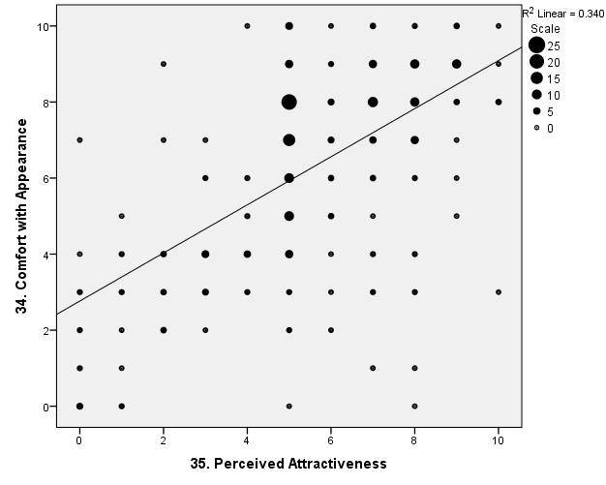
Direct Relationship
Direct Relationship, r = +.58

Slide 8
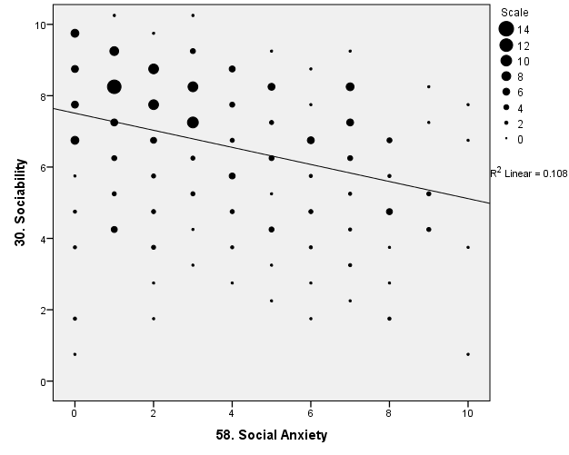
Inverse Relationship
Inverse Relationship, r = -.33

Slide 9
Practice Questions
If the correlation between hours studying and exam grades is r = .50, what is the coefficient of determination, and what does it mean?
Coefficient of determination = r² = .50*.50 = .25
This means that studying explains 25% of the differences in exam grades. Other factors account for the remaining 75% of the variability in exam grades.

Slide 10
Practice Questions
If the correlation between dehumanization and happiness is r = -.25, what is the coefficient of determination, and what does it mean?
Coefficient of determination = r² = -.25*-.25 = .06
This means that dehumanization accounts for 6% of the individual differences in happiness. Other factors account for the remaining 94%.

Slide 11
Practice Questions
Name the direction for each correlation.
Describe the magnitude.
r = .52
r = -.18
r = -.49
r = 1.03
r = -.09

Slide 12
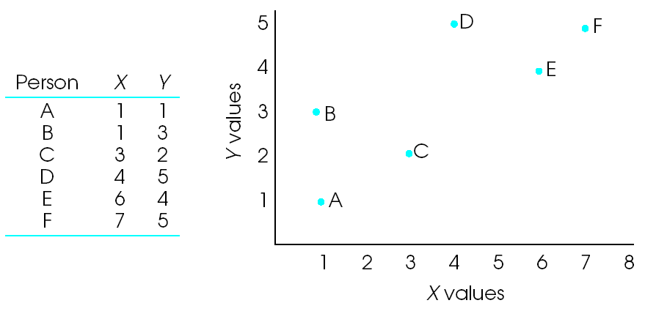
Scatterplots

Slide 13
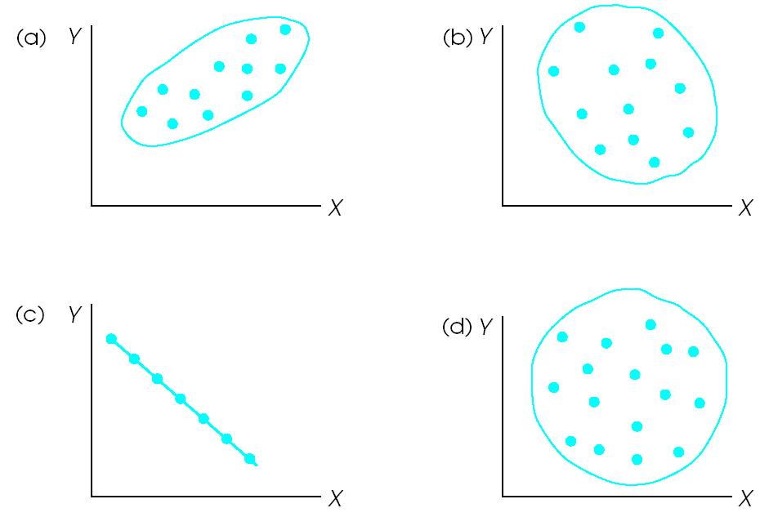
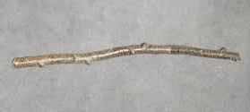
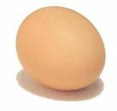
Scatterplots
Find the correlation coefficient for these scatterplots:
Tips: stick = 1.0, hot dog = 0.8, sub sandwich = 0.5, egg = 0.3, circle = 0.0
If you can tell the difference between an egg and a bratwurst, you’re in good shape

Slide 14
Factors Impacting Correlation Coefficients (Observed Relationships)
Magnitude of the real relationship
Reliability and validity of the measures
Outliers
Variation present in each of the variables
Shape of the distribution for each variable
Reminder: Correlations are one statistic used to represent effect size. These issues apply to any observed relationship, regardless of the statistics or design characteristics employed

Slide 15
Reliability and Validity (Psychometrics)
Measurement error (poor reliability and validity) typically deflate observed relationships, often substantially
Major emphasis later in the course
Historically, a major problem (personality, social psychology, medicine)
PCORI priority #5
NIH PROMIS Initiative

Slide 16
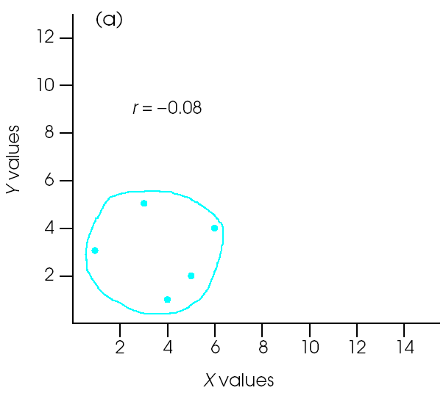
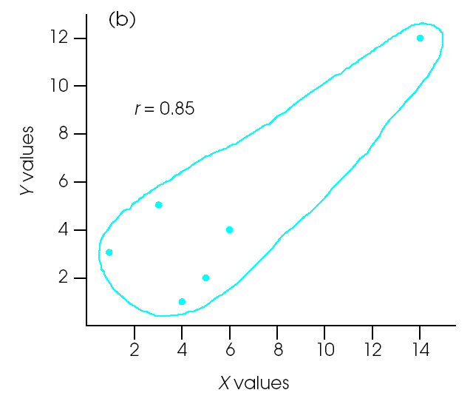
Outliers
Can increase or decrease observed relationships. Should use a priori decision rules
E.g., 1.5(IQR), Z-score more extreme than ±2.5
Usually not a major factor in large studies
Check data file

Slide 17
Variation
Can’t have covariation (correlation, varying together) without variation
More variability (high range, high SD) = bigger correlations
Less variability (range restriction, low SD) = smaller correlations
Different studies and samples may have different levels of variation in each of the variables, so important to consider this when examining conflicting findings

Slide 18
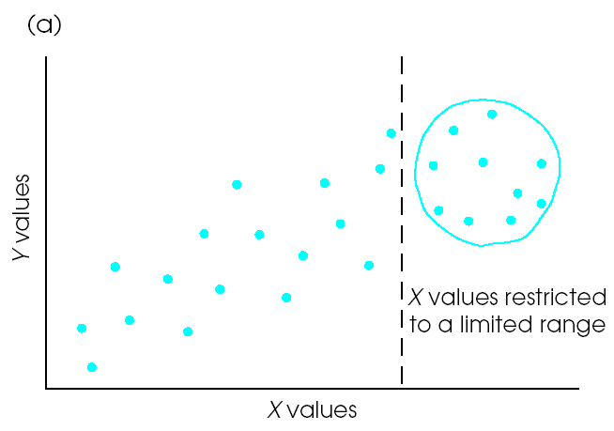
Range Restriction
Relative to a typical community, what would be an example of a sample with restricted range on IQ? Age? Wealth? Any examples of samples with exaggerated variability?

Slide 19
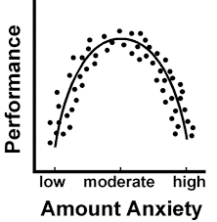
Shape of the Distribution
Correlations are for describing linear relationships between two continuous variables that each have relatively normal distributions
Violations of these assumptions can also impact observed relationships

