Slide 1
Clinical Research:
Part 4

Slide 2
Overview
Take home messages
CBPR
Reminders
  Food day
  Course evaluations

Slide 3
Take Home Messages of the Course
Understand the value of research and experience a greater desire to engage in research in some capacity
Understand p-values (anyone with a college degree should know this)
Understand what an “experiment” is, how it differs from a non-experiment (it’s in the course title)
Gain a greater tolerance for ambiguity
Improve scientific writing and statistical skills
Understand different methodologies as tools that can improve the quality of research
Gain practical skills and accomplishments that can advance your academic and career goals

Slide 4
Community-Based Participatory Research
An approach to research that involves meaningfully partnering with stakeholders throughout the research process
CBPR, like many terms in this course (PCORI, Cohen’s d, translational science, REDCap), should be common knowledge to most researchers but is not
Meaning… If you can give it the old college-try, or at least know what it is, you can do better research and experience better academic/occupational success
This is the future, e.g., every PCORI study requires this

Slide 5
Family Physician
Administrative Assistant
Psychologist
Nurse
“Patient” Stakeholder with History of
Polysubstance Abuse
Family Caregiver of Patient with Liver Disease
Medical
Sociologist
Social Worker Specializing in Substance Treatment
Head of a Local Non-Profit
Brainy Undergrad who just learned about 697 types of reliability and validity, knows the catalogue of 342 social psych biases, can run descriptive statistics in SPSS, has a CV and CITI training, and responds to email twice daily
Biostatistician
Psychologist

Slide 6
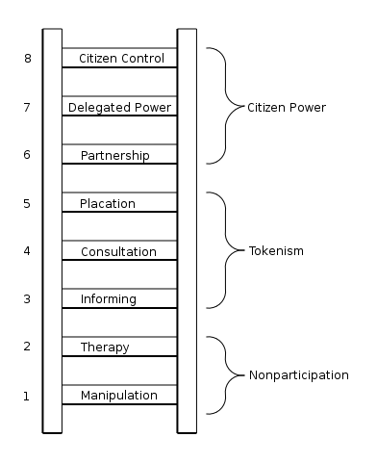
Arnstein’s Ladder of Participation

Slide 7
Dimensional Perspective
Traditional Research
  Researcher driven, problem identified by the researcher, who plans and conducts the research and then analyzes, interprets, and disseminates the results to academic community
Community-Placed Research
  Research happening in the community setting, still researcher driven, stakeholders not involved
Community-Based Research
  Research with the community where stakeholders are participating to some degree in the research process
Community-Based Participatory Research
  Research where stakeholders are equal partners in all aspects of the research process

Slide 8
Why CBPR?
Study questions, measures, and findings will be relevant to people in the real-world (who pay taxes, want the world to be a better place, etc.)
Stakeholders can provide specialized expertise that can complement the expertise of the interdisciplinary scientists on the research team

