Slide 1
Clinical Research:
Part 3

Slide 2
Overview
Randomized Controlled Trials
  Experiments in clinical settings
  Key considerations
  Control groups
Basics are simple, but also an incredibly complex methodology

Slide 3
Randomized Controlled Trial
Simply an experiment designed to influence a clinical outcome
  Experiment = random assignment across two or more conditions
  Clinical outcome = physical or mental health outcome (notably somewhat ambiguous)

Slide 4
Key Considerations
Aims (Goals) of the research
Participants (eligibility, sample size, and accrual)
Intervention(s) and control condition(s)
Randomization procedures
Measures
Timeline

Slide 5
Control Groups
Placebo
  Substance lacking an active treatment ingredient
  Any observed effect (placebo effect) is due to a self-fulfilling prophecy
  Inert vs. active placebo
Waitlist
Treatment as Usual (or Usual Care)
Alternative Intervention
Ethical issues? Scientific issues?

Slide 6
Ethics
Placebo
  Many treatments are harmful if not toxic in the short-run, have unknown long-term side effects, are ineffective, and/or expensive
Waitlist
  Many communities lack resources to avoid waitlists

Slide 7
Scientific Rigor
Designed to increase internal validity (strengthen causal conclusions)
Goal: Make all conditions identical, except for the specific elements thought to cause change → Any observed group differences can be attributed to the active element(s) of the intervention
PCORI’s Methodologic Committee recommends using an Alternative Intervention for comparison, well-defined Usual Care, or “Enhanced” Usual Care
  Comparative Effectiveness Research

Slide 8
Example: SSRIs
Waitlist
Inert Placebo
Active Placebo
SSRI
Regression
Toward
the Mean
Regression
Toward
the Mean
Pill-related
Self-fulfilling
Prophecy
Regression
Toward
the Mean
Pill-related
Self-fulfilling
Prophecy
Side effect-related
Self-fulfilling
Prophecy
Regression
Toward
the Mean
Pill-related
Self-fulfilling
Prophecy
Side effect-related
Self-fulfilling
Prophecy
Serotonergic
Specific
Effects

Slide 9
Example: SSRIs
Made-up Remission Rates
Waitlist
Inert Placebo
Active Placebo
SSRI
Regression
Toward
the Mean
What accounts for the
differences between one
condition and another?
Which comparison is most
scientifically valid?
Which comparison yield
the biggest difference?
10%
Regression
Toward
the Mean
Pill-related
Self-fulfilling
Prophecy
20%
Regression
Toward
the Mean
Pill-related
Self-fulfilling
Prophecy
Side effect-related
Self-fulfilling
Prophecy
30%
Regression
Toward
the Mean
Pill-related
Self-fulfilling
Prophecy
Side effect-related
Self-fulfilling
Prophecy
Serotonergic
Specific
Effects
35%

Slide 10
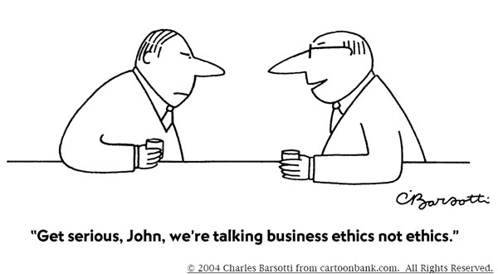

Slide 11
Example: Medicaid PTSD Treatment
Regression
Toward
the Mean
Waitlist
CBT
Group
Therapy
CBT +
Group Therapy
Regression
Toward
the Mean
Warmth, Empathy,
Genuineness,
Problem-Solving
Cognitive/
Behavioral
Methods
Regression
Toward
the Mean
Warmth, Empathy,
Genuineness,
Problem-Solving
Group
Process
Regression
Toward
the Mean
Warmth, Empathy,
Genuineness,
Problem-Solving
Cognitive/
Behavioral
Methods
Group
Process

Slide 12
Example: Medicaid PTSD Treatment
Regression
Toward
the Mean
Waitlist
CBT
Group
Therapy
CBT +
Group Therapy
10%
Regression
Toward
the Mean
Warmth, Empathy,
Genuineness,
Problem-Solving
Cognitive/
Behavioral
Methods
40%
Regression
Toward
the Mean
Warmth, Empathy,
Genuineness,
Problem-Solving
Group
Process
35%
Regression
Toward
the Mean
Warmth, Empathy,
Genuineness,
Problem-Solving
Cognitive/
Behavioral
Methods
Group
Process
60%

Slide 13
Example: Medicaid PTSD Treatment
Regression
Toward
the Mean
Waitlist
CBT
10%
Regression
Toward
the Mean
Warmth, Empathy,
Genuineness,
Problem-Solving
Cognitive/
Behavioral
Methods
40%

Slide 14
Example: Medicaid PTSD Treatment
Waitlist
CBT
Group
Therapy
Regression
Toward
the Mean
Warmth, Empathy,
Genuineness,
Problem-Solving
Cognitive/
Behavioral
Methods
40%
Regression
Toward
the Mean
Warmth, Empathy,
Genuineness,
Problem-Solving
Group
Process
35%

Slide 15
Example: Medicaid PTSD Treatment
Waitlist
CBT
Group
Therapy
CBT +
Group Therapy
Regression
Toward
the Mean
Warmth, Empathy,
Genuineness,
Problem-Solving
Cognitive/
Behavioral
Methods
40%
Regression
Toward
the Mean
Warmth, Empathy,
Genuineness,
Problem-Solving
Cognitive/
Behavioral
Methods
Group
Process
60%

