Slide 1
Clinical Research:
Part 2

Slide 2
Overview
Quasi-Experimental Designs
  Non-equivalent control group design
  Interrupted time series design
  Controlled interrupted time series design

Slide 3
Quasi-Experimental Designs
Experiment
  Random assignment to two or more conditions
Quasi-Experiment
  “Quasi” = almost, so an almost-experiment
  Could use non-random assignment
    Condition could be assigned some contextual factor (e.g., school, class, company)
    Condition could be assigned based on some other participant variable (e.g., diagnostic status)
    Participants could self-select their condition
    Researchers/clinicians could select the condition non-randomly (based on personal preferences)
  Might only involve one group (no control group)

Slide 4
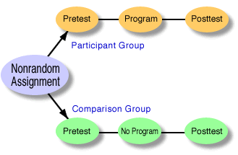
Non-Equivalent Control Group Design

Slide 5
Non-Equivalent Control Group Design
Choose two groups (e.g., two schools) that are similar
Make one group the experimental group and one the comparison group
Examine how scores on a DV change before and after the experimental program is implemented
Because there was no random assignment, the two groups probably differ in a number of ways (e.g. age, gender, ethnicity, personality)
  Confounds reduce internal validity (ability to draw causal conclusions)
Reduce the problem of these confounds by choosing a comparison group that matches the experimental group as closely as possible

Slide 6
Intervention to reduce
no-shows at Clinic A

Slide 7
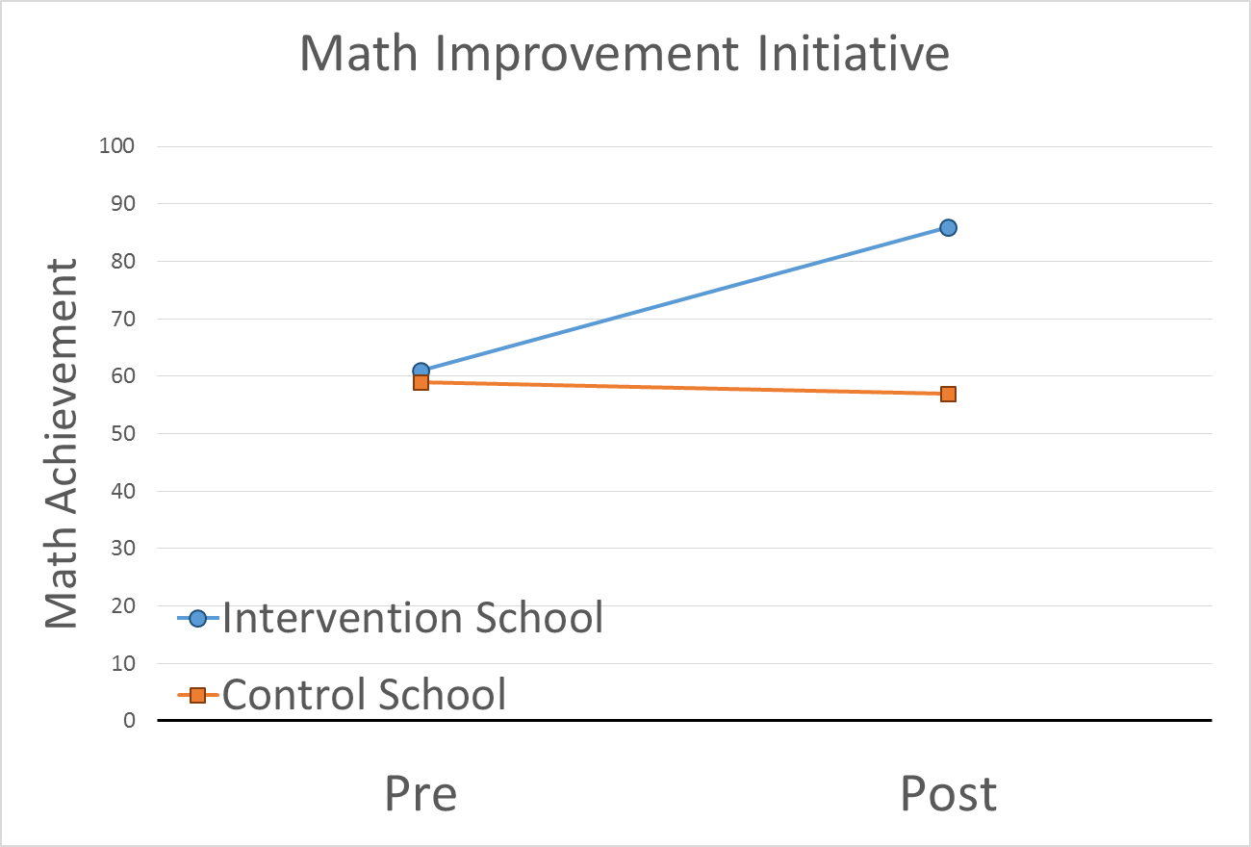

Slide 8
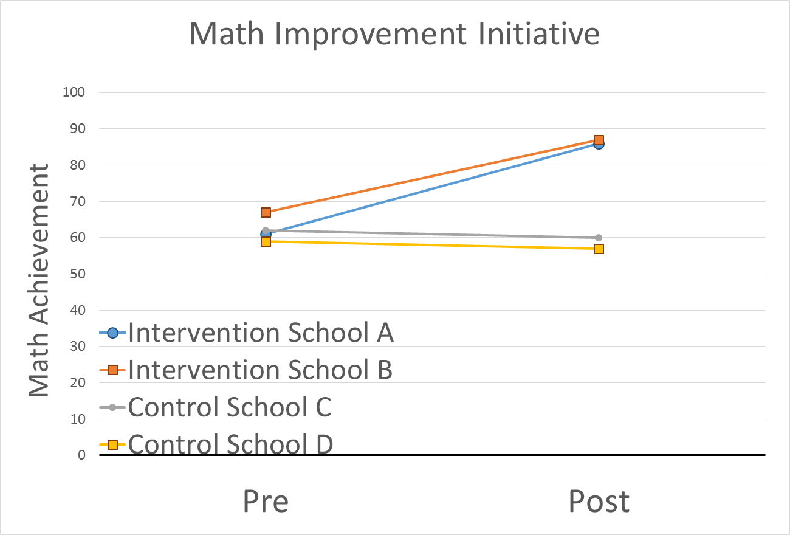

Slide 9
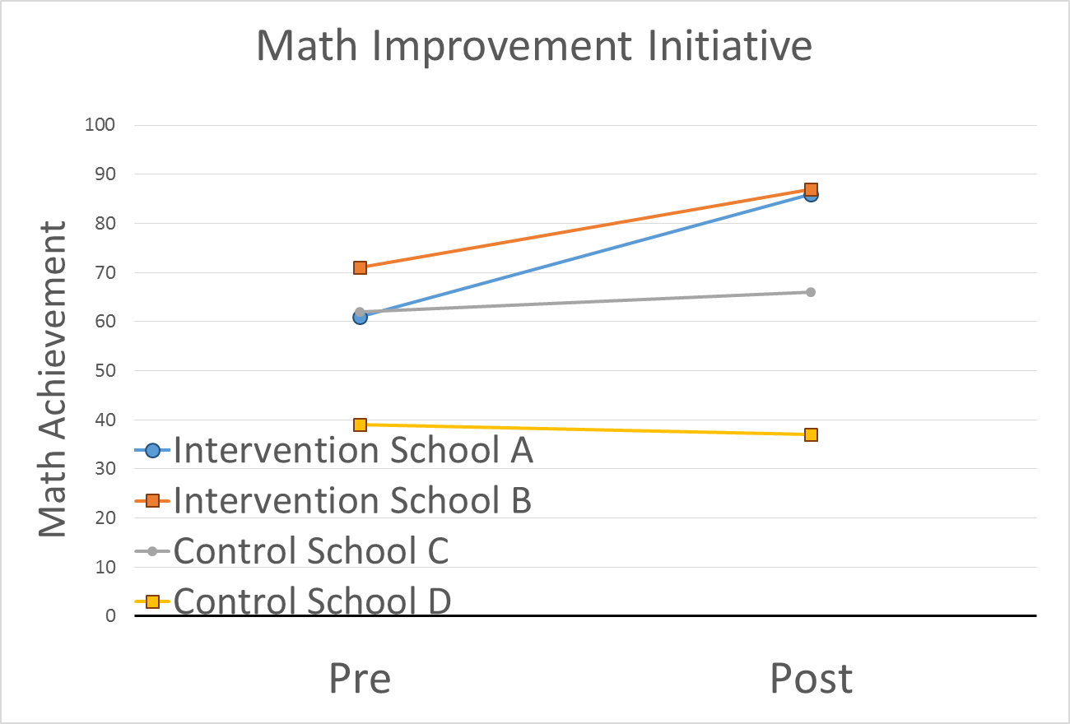

Slide 10
Interrupted Time Series Design
Usually no comparison group
Gather data extensively before and after a program is implemented

Slide 11
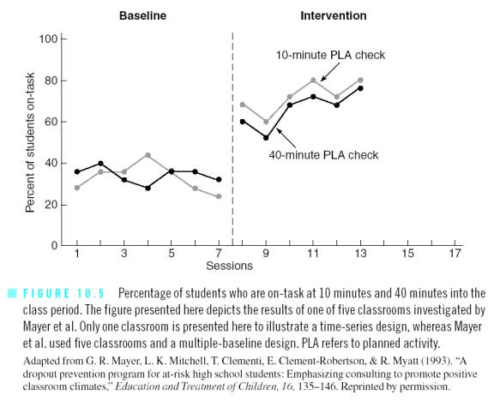

Slide 12
Lopez Bernal et al. (2013)

Slide 13
Wagenaar et al. (2009)

Slide 14
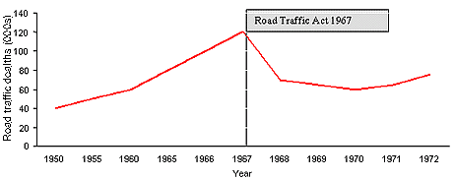
Traffic
Fatalities

Slide 15
Frank’s dog died
Traffic
Fatalities

Slide 16
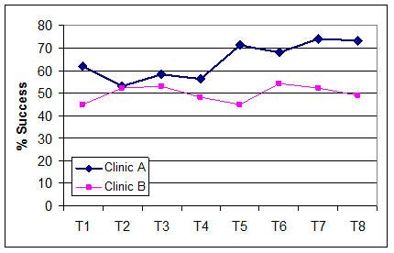
Controlled Interrupted Time
Series Design
Strengths of the non-equivalent control group design (has a comparison group) and interrupted time series design (has longitudinal data)

