Slide 1
Clinical Research:
Part 1

Slide 2
Overview
Clinical research
Small-N Designs
  Case Studies
  Single-subject designs
    A-B, A-B-A, etc.
    Multiple baselines
    Changing Criterion
    Self-experiments

Slide 3
Examples of Clinical Research
Randomized Controlled Trials
Quasi-experimental Designs
Small-N designs
  Involves attempting to help a single or small number of individuals
  Therapy, parenting, animal training, school-based intervention, medicine, sports psychology, self-help

Slide 4
Rationale for Small-N Designs
Critique of large-N designs
  Any difference is statistically significant if big enough N
    Clinical (practical, real-world) significance can be demonstrated with a single individual
  Group-level findings may not apply to a particular individual
    Health service psychology (e.g., clinical, counseling, school psychology) is often focused on intervening with individuals
Periodic fluctuations in historical focus on groups vs. individuals

Slide 5
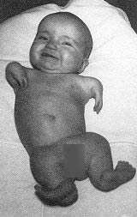
Case Studies
Detailed account of a single case
Examples
  Charcot and Freud, Thalidomide, FAS, SSRI-induced suicidality, Lung cancer
Advantages
  Excellent detail, Useful when a single incident proves a claim, Focuses attention, facilitating more comprehensive research
Disadvantages
  Prone to bias, Can facilitate pseudoscience, Difficult to show internal validity, Poor external validity

Slide 6
Single-Subject Designs
Study an individual or small sample in detail
Like a case study, but much more focus on data and control, involves tracking outcomes closely and implementing interventions systematically
Terminology
  A = baseline
  B = some treatment, manipulation, or intervention
  C, D, E, etc = other treatments
  CD = combination of two treatments
  B₁, B₂, B₃ = variation of same treatment
DV (outcome) measured repeatedly throughout varying phases

Slide 7
Example Designs
Simple examples
  A-B
  A-B-A
  A-B-A-B
Other examples
  A-B₁-B₂-B₃
  A-B-C-BC
  A-B₁-B₂-B₃-C-D-B₂D-A-B₂D

Slide 8
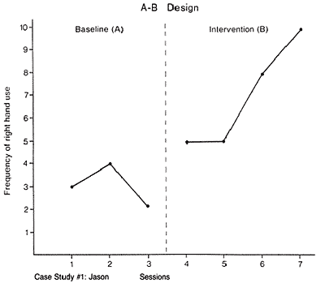
Frequency of Emotion Words

Slide 9
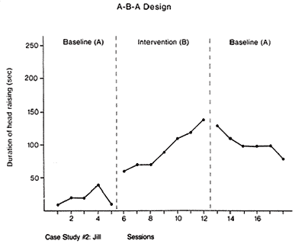
Minutes Spent Reading Each Day

Slide 11
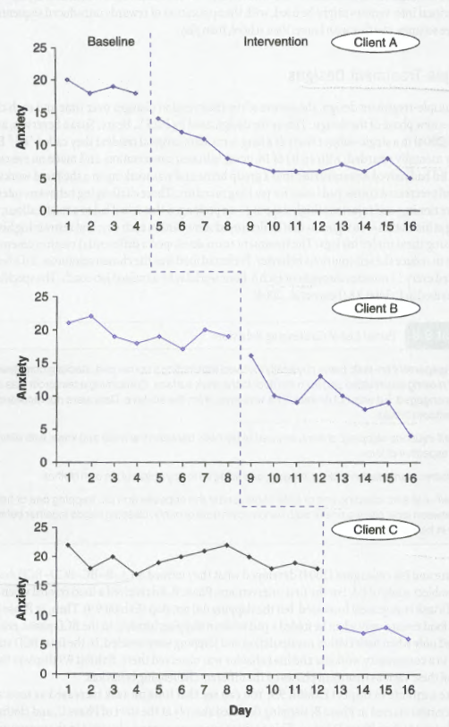
Multiple-Baseline
Designs
Multiple people, settings,
or outcomes - why?
Phase changes typically
staggered - why?

Slide 12
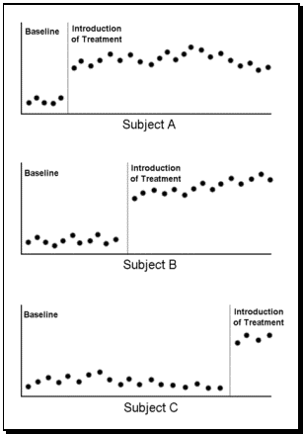

Slide 13
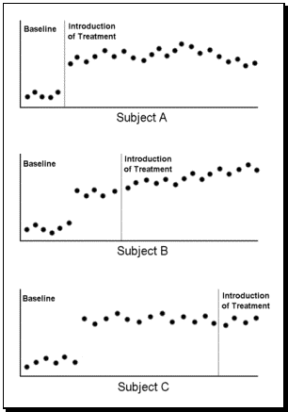

Slide 14
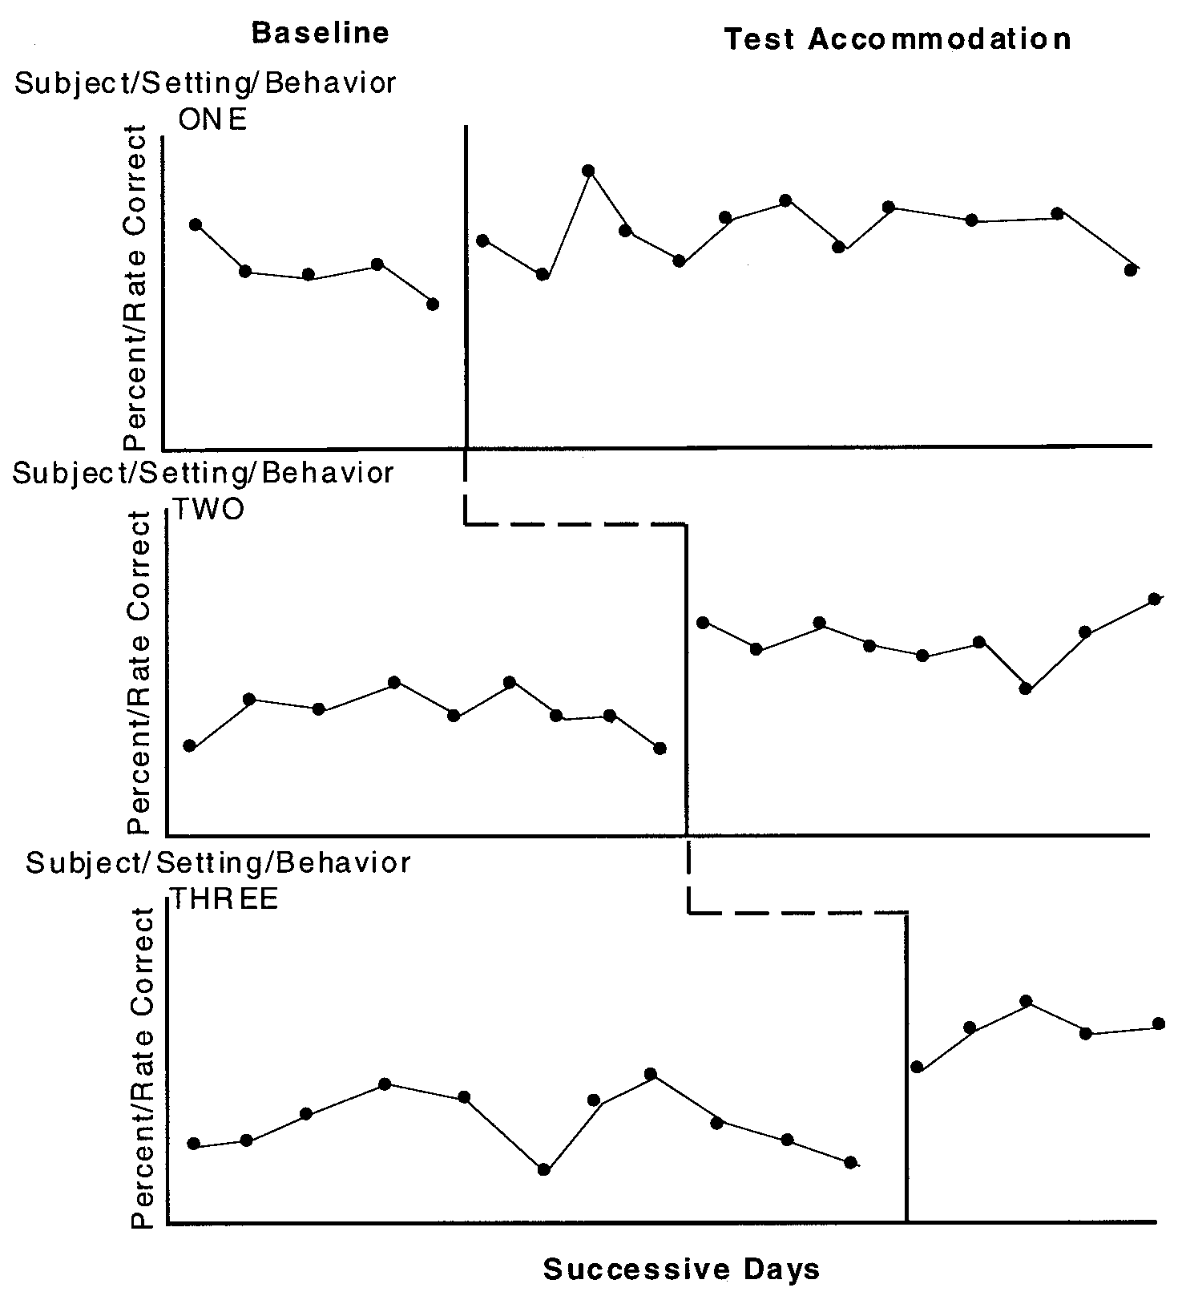

Slide 15
Changing-Criterion Designs (Shaping)
Begin by identifying a goal (outcome, criterion, target behavior) that is too complex to readily achieve
Identify subgoals along the pathway to the goal
Offer a reward when the first subgoal is met
In each subsequent phase, only offer the reward when the next subgoal is met, until finally reaching the goal
Examples: Encouraging reading, training a dog to fetch beer, exercise, behavioral activation, getting a partner/parent/sibling to do something

Slide 16
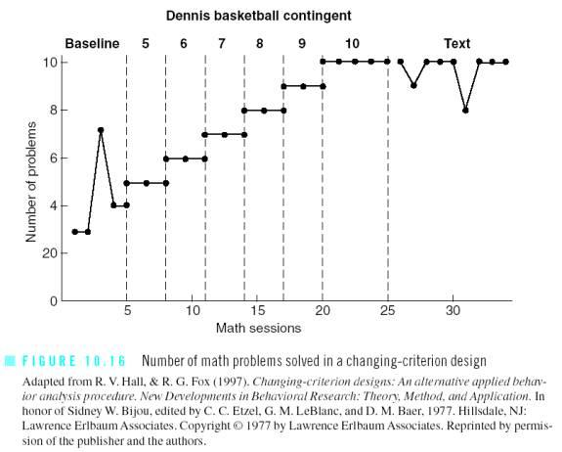

Slide 17
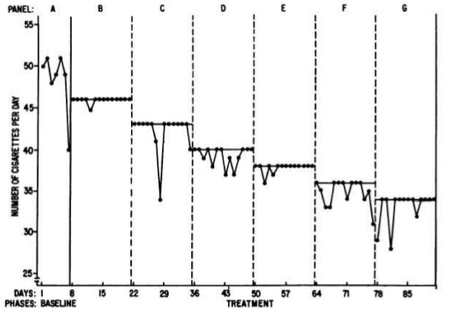

Slide 18
Self-Experiments*
Uses
  Improve a desired outcome in one’s own life
  Conduct research too meticulous or dangerous for other participants
Examples
  Ebbinghaus’ studies of memory
  LSD, soda water, ABO blood typing, local anesthesia, antabuse, snake bite vaccinations
  Mike’s (2012) daily affective forecasting study
  Barry Marshall (2005): Watch + reaction paper = 1 ELC hour
    http://www.nobelprize.org/mediaplayer/index.php?id=614
*Note. True “experiments” require random assignment to two or more conditions

